Slide 1

10 Times When You Really
Need to Speak Up for Yourself!
“Maxine Moments”
in Health Care

Slide 2
Insert Your Photo Here
Welcome!
Thank you for coming!
Your Name, Credentials
Your Title
The Care Partner Project Community Educator
Your Company
Your Website
Your Phone Number
Thank you to our hosts for bringing us together today!
Host Name
Organization
Event Name
Date
Notes:
PRESENTER: INSERT YOUR INFO AS INDICATED IN THE BLUE COLUMN. ADD HOST INFO IN THE RIGHT COLUMN. UPLOAD AND INSERT A GREAT PHOTO OF YOURSELF!

Slide 3

“Maxine Moments” is Brought to You by…
The Care Partner Project (TheCarePartnerProject.org)
Notes:
The Care Partner Project is dedicated to helping you feel informed and confident as Care Partners to your loved ones. Simple downloadable checklists and grass roots community education are all designed to help “everyday” people know what to watch for and what to do to pitch in for their loved ones’ care. The Care Partner Project also has a fund to help provide professional patient advocates for patients who have no one in their lives to help them through a medical crisis and no other resources, such as good insurance or an income. The Fund provides help for a lot of homeless people and those with developmental challenges. I’m very proud to be a Community Educator for the Care Partner Project in our area!

Slide 4

Today’s Plan: Next 30/40 Minutes Together
I’ll share 10 times when you really need to speak up for good care!
We’ll rehearse a few times to help you feel comfortable.
Then, we’ll talk!

Slide 5

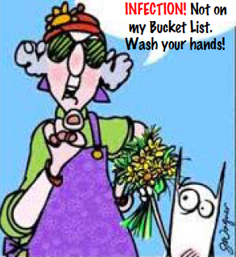
Speak Up to Prevent Infection
Make Sure Everyone Washes Their Hands Before Touching Any Patient
The #1 Way to Prevent Infection is Hand Washing.
Simple!
Notes:
Hand washing is the #1 way to prevent a hospital infection such as MRSA, C diff and common viruses that circulate. Hospitals are public places, germs are everywhere and patients’ immune systems are not 100% -- most are very low. Preventing infection is everyone’s job and simple hand washing with soap and water, or an alcohol based cleanser goes a long way toward protecting every patient in the hospital. When you speak up for yourself, you’re really speaking up for everyone.

Slide 6

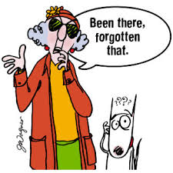
Speak Up To Get the Correct Diagnosis
1 out of 20 Diagnoses are Incorrect
What else could I have, Doc?
Singh H, Meyer AND, Thomas The frequency of diagnostic errors in outpatient care: estimations from three large observational studies involving US adult populations, BMJ Quality & Safety 2014;23:727-731.
Notes:
There are 10,000 diseases and only about 200-300 symptoms. So, If you share your symptoms with 2 different doctors, your diagnoses may be very different, especially if they are specialists. Lower back pain? A “bone doctor” will think about how your spine may be misaligned or that you may have a bulging disk. A nephrologist’s mind will leap to kidney disease and a generalist may chalk up your pain to a strained muscle from exercising without warming up first. So… the lesson is… It’s worth asking your doc to think outside their own box. It matters A LOT because your treatment plan depends on it.

Slide 7

Speak Up for Alternatives to Surgery
It is estimated that up to 40% of Recommended Surgeries are Unnecessary
What are my choices?
Notes:
If you see a surgeon, the surgeon will cut. It’s just that simple. Studies have shown that the more patients know about a recommended surgery, the more likely they are to find another treatment that works for them. Never hesitate to seek 2nd or 3rd opinions and don’t let anyone tell you that any surgery is “routine.” There are often good rewards for having surgery, but there are always risks.
NOTE TO PRESENTER: There is no study with hard incidence data. This number of up to 40% came from a study funded by Welvie, a company that provides patient education. They studied the Medicare population in 2 states and shared the data with Medicare but it was not published.

Slide 8

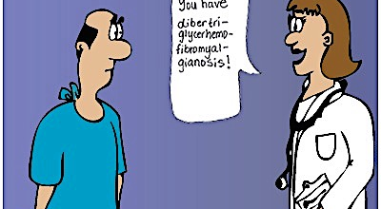
Speak Up for Plain Speak
Tell your Doc You Didn’t Go to Medical School
Notes:
People just tend to nod their heads and listen -- but leave feeling confused and no better informed about their own health and care! What would you say if your doctor seems to be “speaking Greek” to you? (AUDIENCE SUGGESTIONS.)

Slide 9

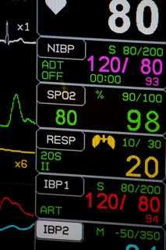
Speak Up for Alarms
Alarm Fatigue is Real -- and Really Dangerous
(What would Maxine say?)
Notes:
Alarm fatigue is a very real problem. It refers to times when we tune out noises in order to focus on a task at hand. On busy hospital units, people on the medical team do this, too. They try not to, but it’s a natural reaction to some when they're trying to focus on care tasks at hand.
Speak up when your alarms go off or when you hear another patients’ alarms ringing or beeping. It takes a village!
Also, if one of your monitors is ringing because it is actually not working correctly – ask for a replacement, a machine that’s in good working order. You deserve peace of mind that your monitor is doing its job for you!
So, what would Maxine say to get help for an alarm that’s going off and no one comes to investigate?

Slide 10

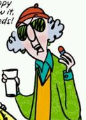
Speak Up About Drug Costs!
This little pill costs how much!?#
Notes:
When you get a new prescription, it’s OK to ask your doctor, nurse, discharge planner or advocate office to find out the cost for you. If it’s more than you can afford, it’s OK to ask about a potential alternative. You may also contact the company that makes the drug to ask about any discounts they can give you or if they have any assistance programs.
In the hospital, your doctor may start a new medication she intends for you to continue after leaving the hospital. This is so that she can see how well it works for you, and if it appears to help you, she’ll feel comfortable prescribing it for you. This practice is called “
True story example: Catherine filled a new prescription for her mother on a medication started during her recent hospitalization. To her horror, each dose would cost $300 out-of-pocket to her mother, for a total cost of $3000 for a 10-day treatment course. Catherine had to leave the pharmacy empty handed.
It really pays to know the costs. Skipping meds is dangerous, but so is going broke because of them.

Slide 11


Speak Up for a Safe Discharge
You don’t have to go home if you’re not ready – or if your home isn’t ready for you!
Worried...
Alone
Confused
Can’t drive
Feel weak
No food in house
No one to help me
I don’t feel safe going home right now.
Notes:
I think this really says it all. Your doctors and nurses want you to go home when you feel it is safe to do so… and to an environment that will support your recovery.
You can raise the red flag and they will help you get the support you need, or make sure you get additional care in the hospital if your symptoms are troubling you.
The code phrase to use is: “This is not a safe discharge.”
Likewise, if you have a friend or loved one in the hospital and you are worried about their physical, mental or emotional safety – which may include any domestic abuse you know is going on in the home -- you can bring your concerns to the hospital staff.
Be sure to use the same words: “This is not a safe discharge for (Patient’s Name).

Slide 12

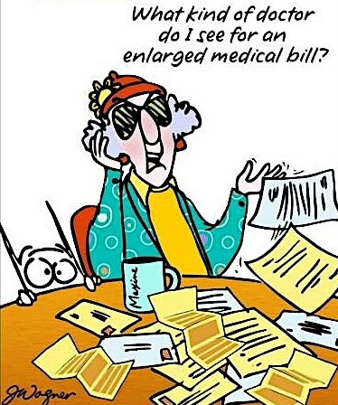
Speak Up About Your Patient Status
Observation? Admitted? Know the Medicare Loophole, also known as the “2-Midnight Rule”
Observation Status
No $$ for Rehab
No $$ for Skilled Nursing
Comes out of your pocket!
Notes:
Just because you’re wearing a hospital gown and a hospital bed (hopefully in a room!) and doctors have been seeing you, it does not mean you are an “Admitted patient”. Why does that make a difference?
Hospital admission status affects Medicare coverage of skilled nursing services that may be needed after discharge from the hospital -- and it can cost patients BIG $$ if Medicare doesn’t cover it.
A good overview is found here: https://www.medicareresources.org/faqs/how-does-medicares-two-midnight-rule-affect-my-hospital-bills/
Why wouldn’t Medicare cover it if your Dr. said you needed the care? Medicare requires a three-day minimum hospital inpatient stay (counted by midnights) before it will cover the cost of rehab care you may need in a skilled nursing care center. However, observation stays, regardless of length, do not count toward Medicare’s requirement.
Even if you’re not sure if you’ll rehab or longer care at a nursing facility, it’s worth fighting for that admission status.
What would Maxine say to get Admitted Patient status on her record?

Slide 13

Speak Up For Safe Surgery!
3 Critical Questions Make a Critical Difference
Does your surgery team use a checklist?
Does your surgery team take a time-out in the operating room before surgery to introduce each other (and go over a checklist together)
Is everyone on your surgery team Board Certified -- including the anesthesiologist?
Don’t chicken out! This is serious.
Haynes AB, Edmondson L, Lipsitz SR, Molina G, Neville BA, Singer SJet al. Mortality trends after a voluntary checklist-based surgical safety collaborative. Ann Surg. 2017;266(6):923–9.
Notes:
Numerous studies show that these 3 things contribute to better surgery results.
On the last point, more and more surgeries are being performed at stand-alone outpatient surgery centers, which have not been as well monitored for safety as hospitals. While this is changing, board accreditation is a particularly critical question when considering outpatient surgery beyond hospital walls.
BACKGROUND NOTES TO PRESENTER: When fully implemented, the most widely used surgical checklist from the World Health Organization, includes introductions among surgery team members, who may be assembling to work together for the first time. Communication during the surgical procedure is greatly enhanced when the team members know each other’s names and roles. Good communication leads to better outcomes. Good article: https://www.healthaffairs.org/doi/full/10.1377/hlthaff.2018.0717.
About same day surgery centers: https://www.medscape.com/viewarticle/920271?src=rss&fbclid=IwAR23y5ucVzUUFXgzzXS78HTAS6TYaosIulDM-lGStR-XNTrEjMPw05GsvtA

Slide 14


Speak Up for Help!
We Get By with a Little Help from Our Friends
www.LotsaHelpingHands.org
Your friends and family
Local social service agencies
Us! Professional Advocates
Hello People! Could use some help here!

Slide 15

Let’s Talk! Questions? Your Ideas?

Slide 16

Thank you!
Presenter: Insert your headshot here.
Your Name Credentials
Company Name
Phone Number
Email
If Maxine and I were helpful to you, kindly spread the word about today’s presentation with your groups in our area.
I speak on other topics, as well. (In person or on ZOOM!) Just call or drop me a note!
Notes:
PRESENTER: INSERT YOUR HEADSHOT AND CONTACT INFO.

