Slide 1


30 Minutes to Better Care
Key tips that can make a big difference.

Slide 2
Insert Your Photo Here
Welcome!
Thank you for coming!
Your Name, Credentials
Your Title
The Care Partner Project Community Educator
Your Company
Your Website
Your Phone Number
Thank you to our hosts for bringing us together today!
Host Name
Organization
Event Name
Date
Notes:
PRESENTER: INSERT YOUR INFO AS INDICATED IN THE BLUE COLUMN. ADD HOST INFO IN THE RIGHT COLUMN. UPLOAD AND INSERT A GREAT PHOTO OF YOURSELF!

Slide 3

Today’s Plan
Achieving the best care is not as simple as having the best facilities and the brightest medical team.
Quick tips
How you can make a big difference to the quality of your care: how to get the best out of our best!
Q&A – Let’s talk!

Slide 4


TOP Tips!
1
Take Someone With You
Having a companion, your “Care Partner” at medical appointments, and during a hospital stay, can provide support and help you take notes, remember important information, and coordinate your care
2
Prepare For Every Doctor's Appointment
It's a meeting where every minute counts. Create your agenda, know your priorities, write your questions, take notes and take someone with you! (Even via phone!)
3
Get a Second Opinion: Every Diagnosis, Treatment
About 15% of diagnoses are incorrect, and up to 30% of recommended surgeries are unnecessary. Don't hesitate to get another professional opinion from an independent doctor, not your doctor's referral.
4
Speak up for Plain Speak
Don't understand anything? Ask questions!

Slide 5

How to Manage Your Care
1
Accept: You are your own quarterback for care (find someone to help you)
With many specialists involved, ensure your care is well-coordinated between all of them. Never assume they talk to each other or even share your records. Good communication prevents mistakes, helps ensure you get the best treatments and more…!
2
Know your costs, discuss costs frankly
Speak up about medication expenses. You can ask for affordable options. For every test, ask: Is this "need to know?" or "nice to know."
– Know your insurance coverages
– If necessary, get help understanding your policy, its benefits, and limitations.
3
Trust, but verify
Do your homework. Vet your doctors and hospitals. Know the integrity and quality you're getting. Use HospitalSafetyGrade.org and HospitalCompare.gov to check out hospital track records.

Slide 6




Be Pro-Active
Speak Up for Help
We get by with a little help from our friends!
Numerous studies show: patients forget up to 80% of what doctors tell them… that's normal! Don't hesitate to ask for assistance when needed. A second pair of eyes and ears is valuable!
Ask Questions Until You Feel Crystal Clear!
If you're worried, confused, or unsure about anything, speak up and ask for clarification. Remember, you can ask your doctors to slow down, speak in "everyday" words. (Doctor doesn’t respect your questions? Get another doc!)
Track Details
Take good notes, list your questions. Stay on top of your patient portal. Correct errors. Be sure your doctors know all your diagnoses & medications
—the "whole you."

Slide 7
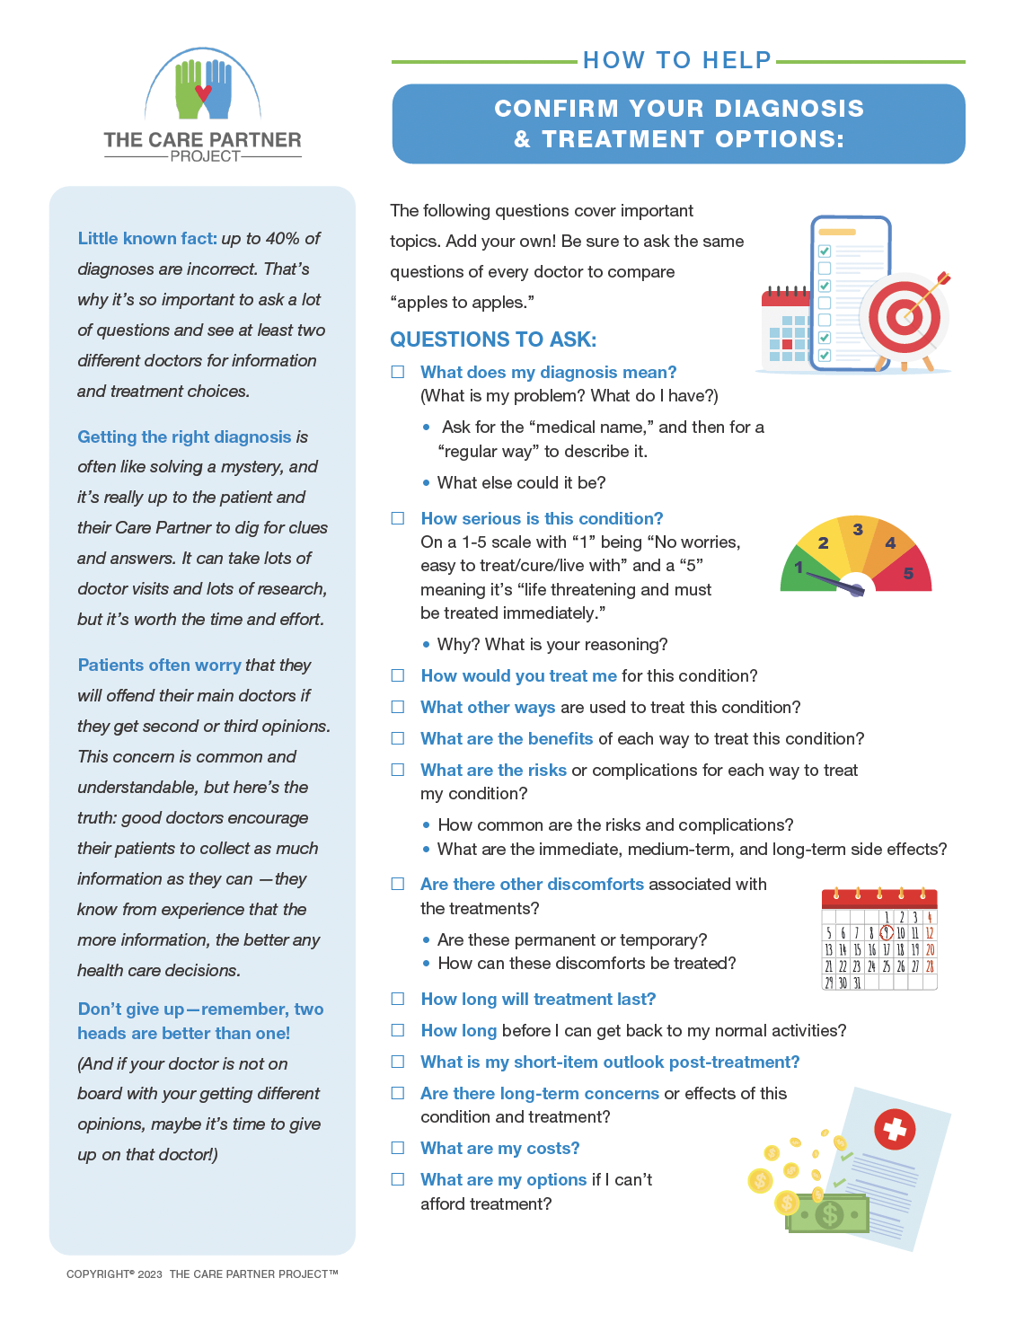
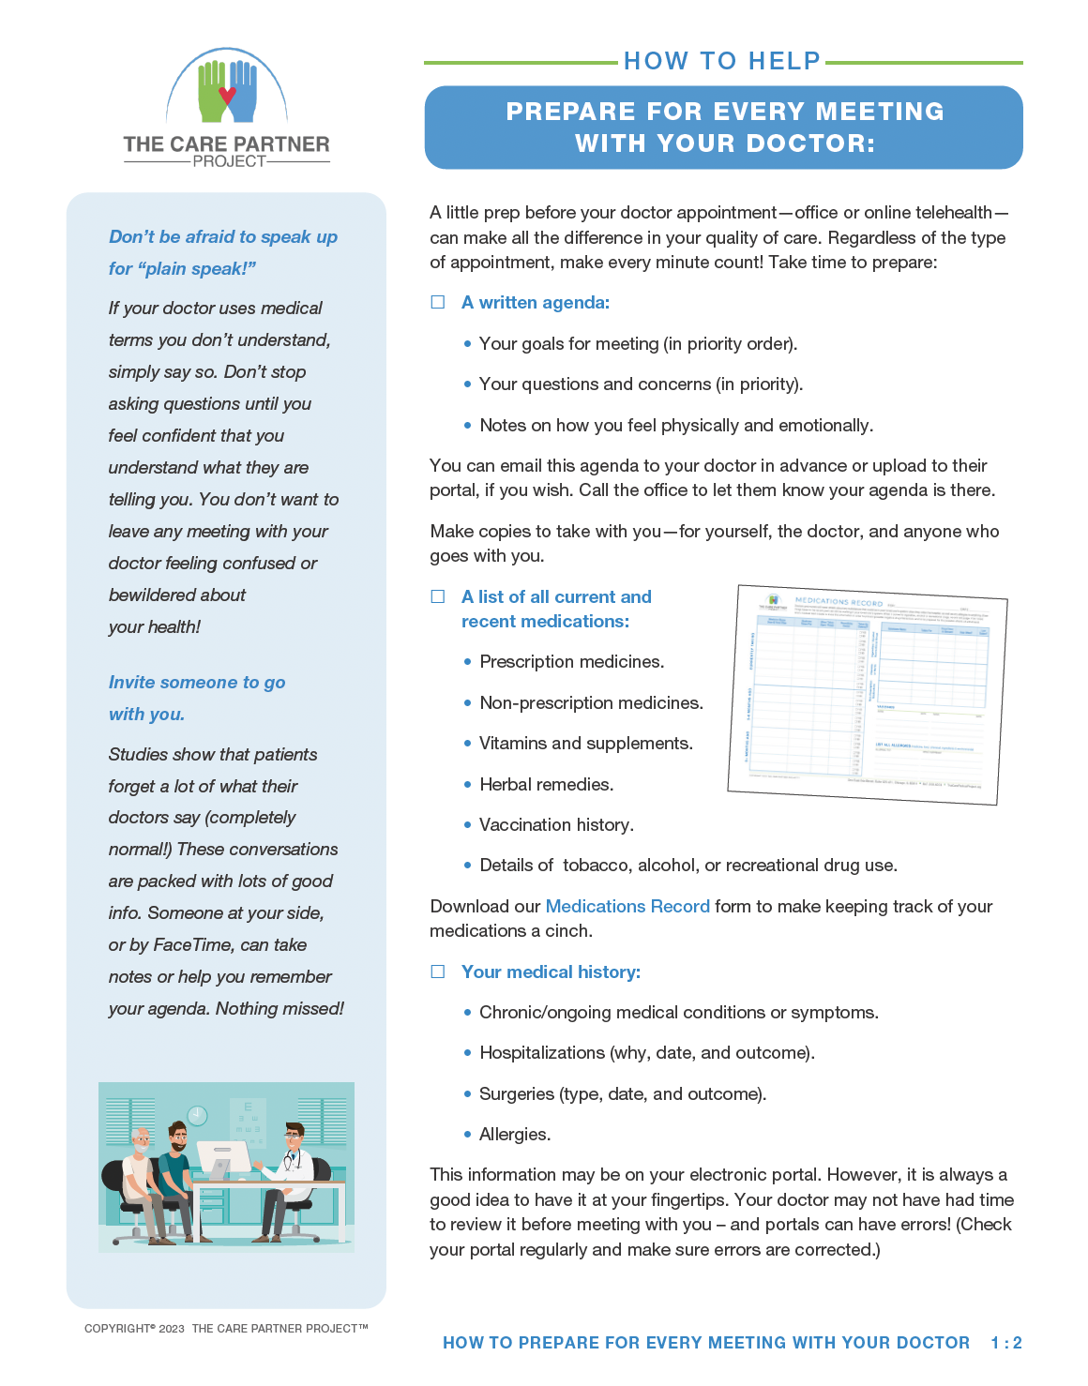
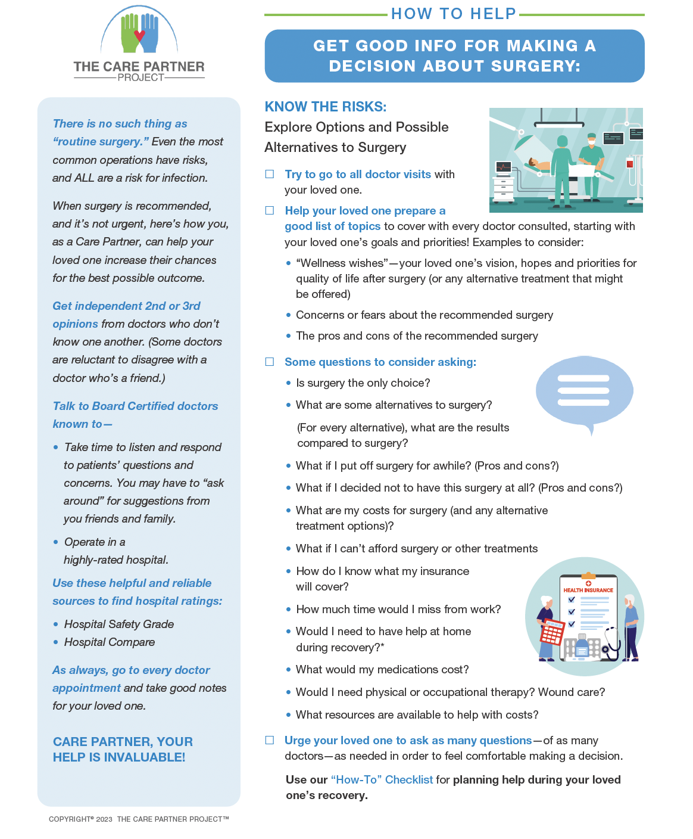
Free Checklists for More Info and to Help You Remember!
www.TheCarePartnerProject.org

Slide 8

Lots More Good Tips! The Care Partner Project www.TheCarePartnerProject.org

Slide 9


Let's Talk!
What’s on Your Mind
Topics today or any other
health care concerns!

Slide 10



Thank You!
INSERT YOUR COMPANY LOGO, YOUR PHOTO, A SCREENSHOT OF YOUR COMPANY HOME PAGE OR ANY OTHER IMAGE THAT REPRESENTS YOU.
More Topics!
Call/Write Me
Spread the Word
In person, or ZOOM. Just call or drop me a note to learn more.
[Your Name] [Credentials]
[Company Name]
[Phone Number]
[Email]
Kindly share this presentation with your friends, family, and groups!

