Slide 1


How Professional Patient Advocates Help Patients Get Better Health Care – And Peace of Mind
Notes:
PRESENTER, MODIFY THIS DECK ANY WAY YOU WISH. A LOT OF INFO IS REPEATED IN DIFFERENT FORMATS. CHOOSE SLIDES YOU LIKE BEST, OR CREATE YOUR OWN.
THE CARLITO FONT WAS USED THROUGOUT. IF YOU DON’T HAVE IT, YOU WILL SEE A NOTE ABOUT THIS. SAVE ANYWAY – YOUR DECK WILL BE FINE.

Slide 2


Presented by:
(Your name and credentials)
Email
Phone Number
Website

Slide 3


Coming up...
What is a Patient Advocate?
Role of a Patient Advocate
Why have an Advocate on Your Care Team?
Qualities of an Effective Patient Advocate
How to Find a Patient Advocate
Patient Advocacy in Action
Typical costs
Quick Sum Up!
©2024 Proprietary and Confidential. All Rights Reserved.

Slide 4





What Does a Patient Advocate Do?
Navigates and demystifies the healthcare system
Speaks up for
patients’ needs
Offers emotional
support and coaching
Helps demystify complex medical information
Patient advocates play a crucial role in empowering patients and ensuring they receive the best possible care throughout their healthcare journey.
Notes:
Navigate the healthcare system: Advocates help patients understand their rights, options, and access the appropriate resources and services.
Help demystify complex medical information: explains medical terminology, treatment options, and potential side effects in a way that is easy for the patient to understand
Speaks up for patients’s needs: Communicates with healthcare providers, insurance companies, and other stakeholders to ensure the patient's best interests are represented
Offers emotional support and coaching: Offers guidance, information, and a listening ear to help patients and their families during challenging healthcare situations.

Slide 5

The Role of a Patient Advocate
Communicate with healthcare providers
Explain medical information
Coordinate care among providers
Advocate for the patient's rights and needs
Advocates put all the pieces of health care together…
to work best for patients.
Notes:
Explain the conflicting “agendas”: payers/insurance companies, health care systems, provider incentives, pharma influence.

Slide 6



Why have a Patient Advocate On Your Care Team?
To improve communication and coordinate your care among all doctors: doctor appointments, hospital stays, treatment centers, assisted living, more, anywhere care is discussed, delivered.
To better understand your medical information, diagnosis, treatment options, find best doctors for you, ensure medications are right for you, track test results, insurance, costs and bills, more
©2024 Proprietary and Confidential. All Rights Reserved.
Notes:
Communication: A patient advocate can help you effectively communicate your concerns, questions, and preferences to your healthcare team, ensuring your voice is heard.
Better understand diagnosis, medical condition treatment options, costs (insurance and billing, too.): Patient advocates can help you understand complex medical terminology, test results, and treatment options, so you to make fully informed decisions about your care
Reduce stess, anxiety, on patients, and often, their families, too: Having a patient advocate by your side can alleviate the stress and anxiety that often come with managing the healthcare system on your own, allowing you to focus on your self-care

Slide 7

For peace of mind.

Slide 8

Qualities of an Effective
Patient Advocate
A thorough understanding of the healthcare system
Excellent communication skills
Empathy and compassion
The ability to problem-solve and think critically
Committed to sharing their knowledge and skills
©2024 Proprietary and Confidential. All Rights Reserved.

Slide 9




EXAMPLE: Patient Advocacy in Action
Everyone is different and has different needs.
This is a common scenario.
Patient has complex diagnosis or medical needs, and/or complex insurance or medical billing issues
Advocate Coordinates and Communicates with Healthcare Team
Advocate Helps Patient Understand
Advocate Navigates Healthcare System
The patient is managing a medical condition that requires specialized care and understanding, or is managing one or more health care conditions, and feels overwhelmed and frustrated by the health care system.
The patient advocate helps ensure the patient is fully informed about their diagnosis, medical condition, and treatment options so they can make fully informed decisions about their care.
The patient advocate helps ensure the patient's needs are met, advocating on the patient's behalf and facilitating effective communication between the patient and all the medical professionals caring for the patient
The patient advocate provides guidance on accessing necessary resources, such as specialists, support services, and financial assistance, to ensure the patient receives the best possible care.
©2024 Proprietary and Confidential. All Rights Reserved.

Slide 10
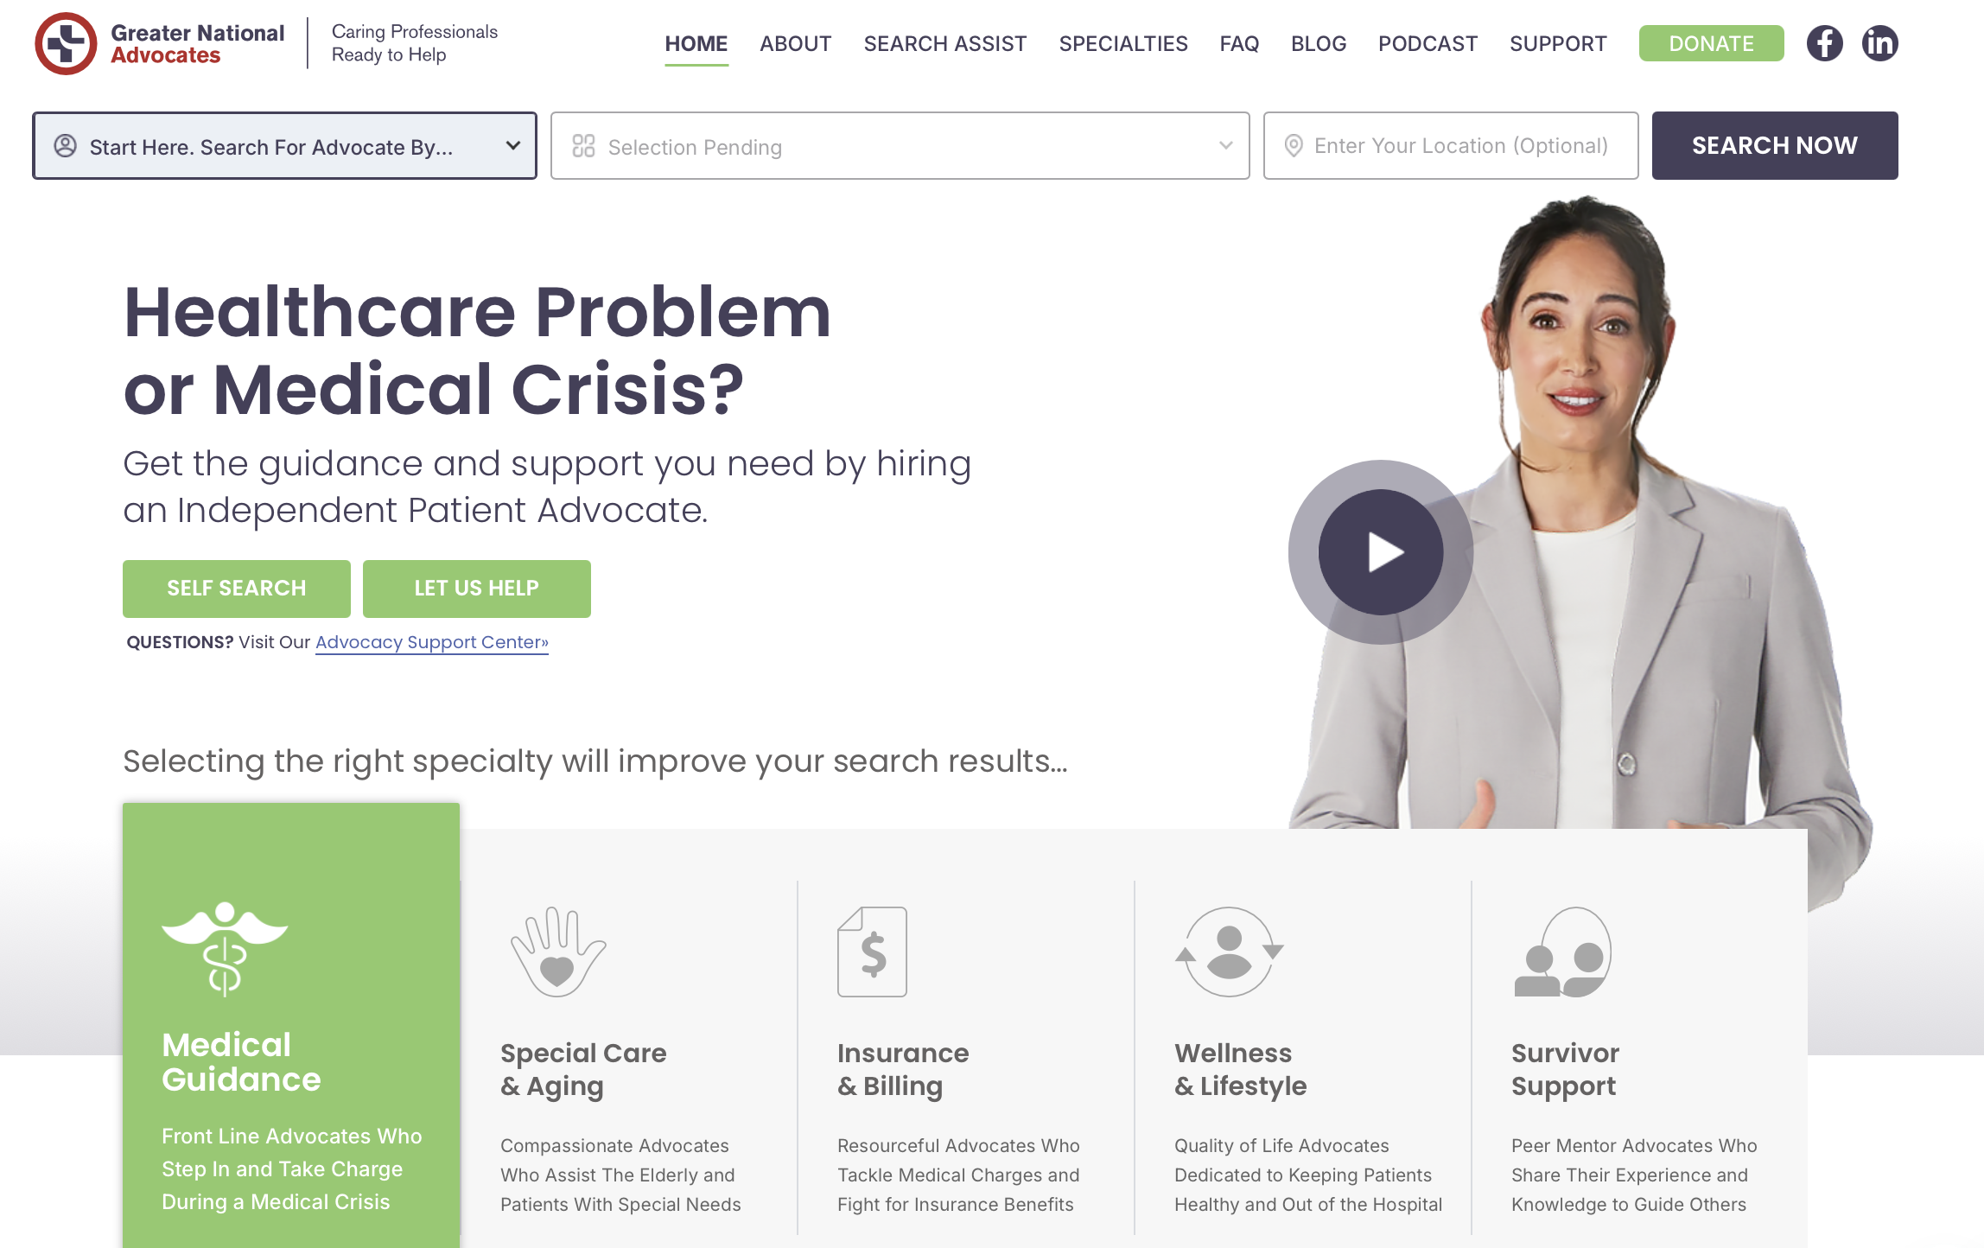
Where to find a Patient Advocate? GNAnow.org

Slide 11



The Cost of Patient Advocacy
Costs vary by location, level of experience, and specialities.
Some advocates offer a free 15 – 30-minute initial consultation.
Some advocates offer service packages plans and rates.
Most offer tele-health support and coaching.
Service
Cost
Initial Consultation
$100 - $300
Hourly Rate
$50 - $300 per hour
©2024 Proprietary and Confidential. All Rights Reserved.

Slide 12
Patient advocates help clients get the best possible care for the best possible results.
©2024 Proprietary and Confidential. All Rights Reserved.

Slide 13

Questions?
Let’s talk!

Slide 14
Thank you for joining me today!
INSERT HERE:
YOUR PHOTO
YOUR NAME, CREDENTIALS
YOUR COMPANY NAME/LOGO
Website
Phone Number
Email
Linked In
Facebook
Please contact me if you have any questions or may need an advocate by your side.
We appreciate referrals.
Notes:
INSERT YOUR OWN PHOTO, COMPANY LOGO OR ANY OTHER IMAGE IN THE WHITE BLOCK.

