Slide 1
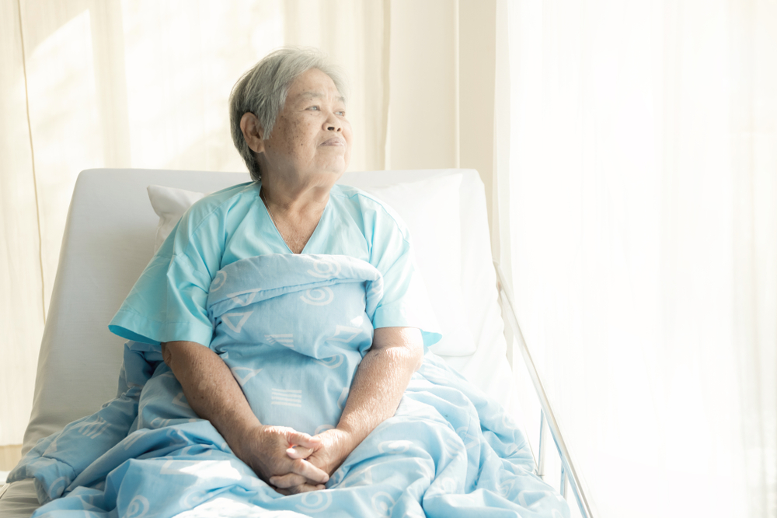
How to Support Your Loved Ones’ Care from Afar

Slide 2
Insert Your Photo Here
Welcome!
Thank you for coming
Your Name, Credentials
Your Title
Your Company
Your Website
Your Phone Number
Thank you to our hosts:
Host Name
Organization
Event Name
Date
Notes:
PRESENTER: INSERT YOUR INFO AS INDICATED IN THE BLUE COLUMN. ADD HOST INFO IN THE RIGHT COLUMN. UPLOAD AND INSERT A GREAT PHOTO OF YOURSELF!

Slide 3
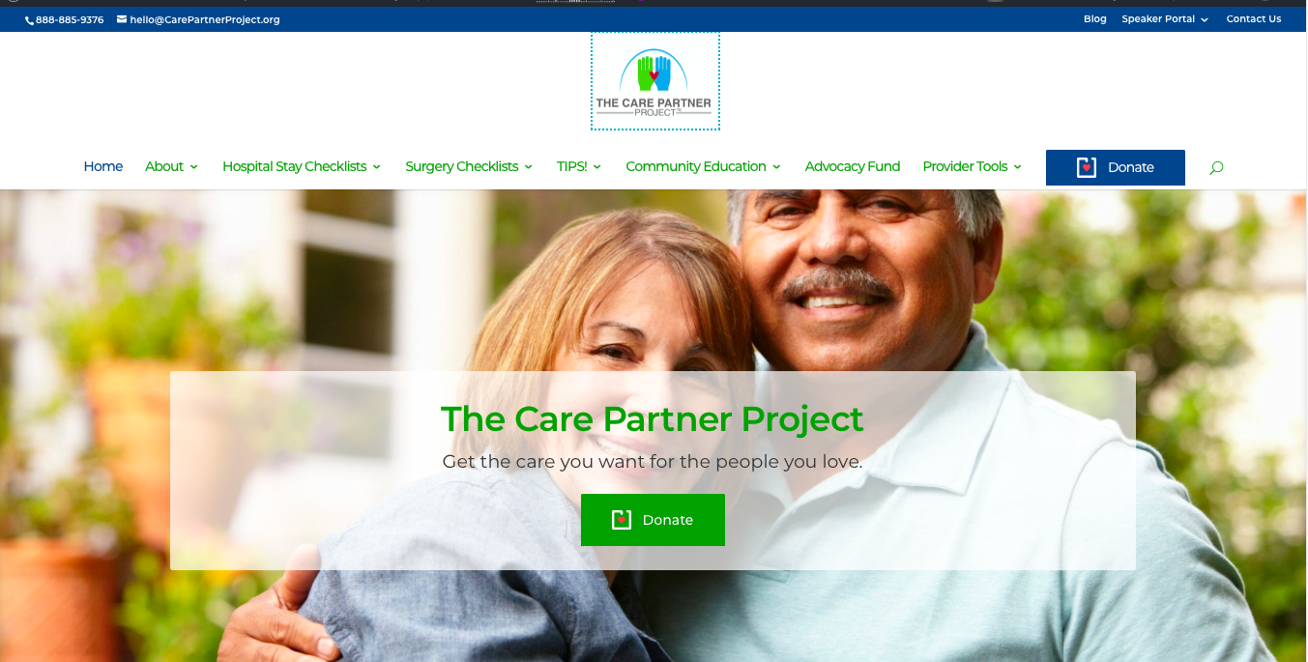
This Presentation was Brought to You By…
The Care Partner Project (TheCarePartnerProject.org)
Notes:
The Care Partner Project is dedicated to helping you feel informed and confident as Care Partners to your loved ones. Simple downloadable checklists and grass roots community education are all designed to help “everyday” people know what to watch for and what to do to pitch in for their loved ones’ care. The Care Partner Project also has a fund to help provide professional patient advocates for patients who have no one in their lives to help them through a medical crisis and no other resources, such as good insurance or an income. The Fund provides help for a lot of homeless people and those with developmental challenges. I’m very proud to be a Community Educator for the Care Partner Project in our area!

Slide 4

Today’s Plan: Next 30 Minutes Together
Solo Patients: How to support your loved ones’ medical care when they have to go it alone..
Tips and strategies
    for Dr. Appointments
    Hospital Stays
Q&A – Let’s talk!

Slide 5
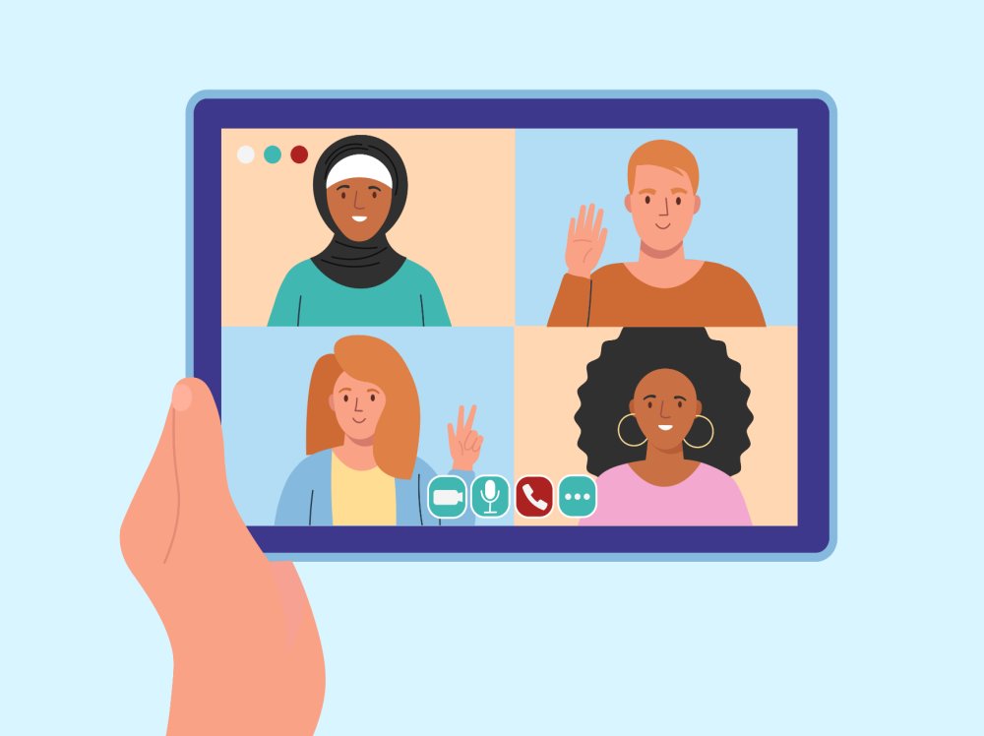

Speak Up for Alarms
Alarm Fatigue is Real -- and Really Dangerous
Goals for Medical Care:
When alone, not lonely
When alone, fully supported
The Care Partner Project, ©2021
Notes:
PRESENTER: THIS SLIDE IS INTENDED TO SET THE TONE AS A QUICK INTRO
No doubt we share these goals for our loved ones' care. How to accomplish will be what we cover today. Even when Covid goes away, there will be lots of patients on their own. This has always been the case. Covid put a spotlight on the problem.
.

Slide 6

Critical Info and Documents to Have On Hand
Prepare now for peace of mind later
Notes:
Next we’ll talk about the basic items all of us must have in order to get through the health care system. Not having them in place and at your fingertips could cause complications in getting care and roadblocks to good communication with health care providers.

Slide 7
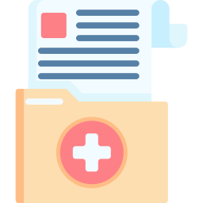
Correct Medical Records Are a Must!
Gather all: review, correct, keep up.
Have them at your fingertips
Create a Medical Binder
Know username and passwords for all patient portals:
Check for errors (common)
Especially the medications
Get all errors corrected!
Make sure that all doctors are using correct records
Notes:
A plain old 3-ring binder or file folder works, or there are apps on smart phones. (e.g., Apple phones come with health care file.) For Login info: create a system for staying current/how are changes communicated or documented? People change their logins from time to time: how will families stay current https://www.mylinks.com can aggregate all records in one place, in real time. Records still need to be checked, however.

Slide 8
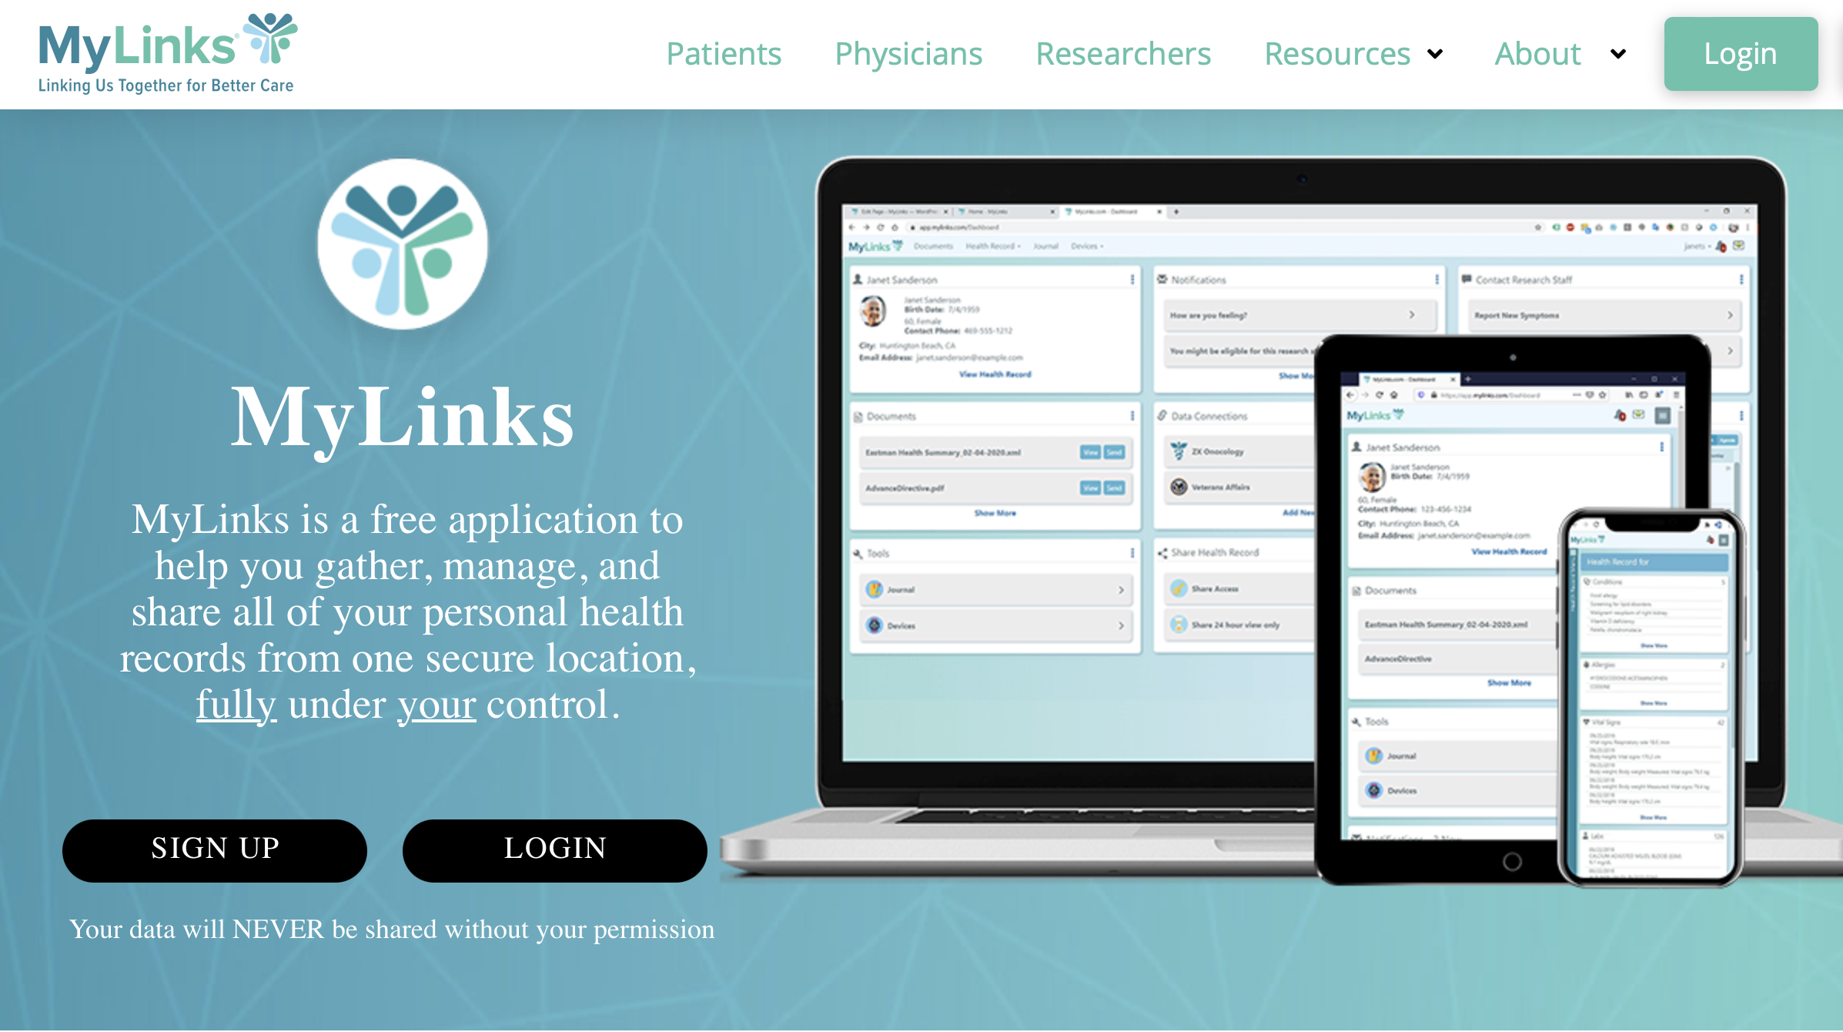
MyLinks.com - All Records in One Place!
Free, easy to use, fast, updated in real time.

Slide 9

Put Privacy/HIPAA Legal Permission in Place
Medical providers cannot share info with you about your loved one you without their legal written permission
Download forms from the state where your loved one lives (know the legal address for “snowbirds”)
Make paper copies to share with doctors or nurses
Store on your own phone, your loved one’s phone
Send electronic versions to your loved one’s doctors (Follow up to confirm they are added their records.)
Notes:
Verbal OK from your loved one should suffice but some offices are sticklers for documentation. May even ask your loved one to fill out their own form granting you permission to participate in an office visit. Don’t fret or argue… it’s just the ”way it is.!” While tackling the privacy form given out at all doctors’ offices (HIPAA), would be a good idea to complete Advanced Directives and POA. Can do it yourself, but it can be daunting. An advocate can help.

Slide 10
Necessary Documents
POLST/MOLST
Physician/Medical Orders for Life-Sustaining Treatment
Completed at end of life, based on your Advanced Directives with person who has medical Power of Attorney (POA)
Medical Power of Attorney (aka POA)
Who will speak for me on medical decisions when I can’t?
Advanced Directives
When I can’t speak for myself, what care do I want? What I don’t want!
“Fill in the blank” versions are available for download on .gov sites in your loved one’s state.
Have good conversations because…
Forms can be customized
Tough issues are raised
Patient’s personal values and choices must guide
Notes:
Many families call on professional advocates to moderate conversations around choices and decisions reflected in these documents. There are times, too, when patients feel private about their health care decisions and don’t want family involved, but they need someone to explain the options presented in these forms.

Slide 11
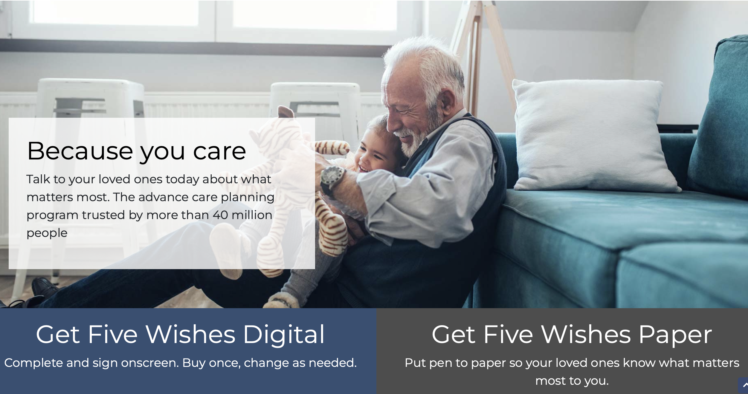
A Great Resource: FiveWishes.com
Gentle guidance for hard conversations

Slide 12

How to Support Loved Ones for Dr. Appointments
When you can’t go, you can still be there
Notes:
Patients always need a 2nd pair of eyes, ears and hands. Doctors can only schedule relatively short visits (plan for 15 minutes). Lots of info must be exchanged so it’s Important to be prepped with questions, absorb all info doctor conveys and think on feet for questions. Two heads are better than one.

Slide 13

For Every Appointment, Your Help is Valuable
Two heads are better than one
Go to your loved one’s dr. appointment by phone/iPad.
Call office staff in advance to let them know.
Expect possible reservations or push-back.
Make your case: you are a help to them!
“I can make this appointment go quickly/efficiently for the doctor: I am prepared with questions that my loved one is concerned about.”
“I will take notes so we won’t have to call your office to bother you.”
“I can help make sure my loved one understands and adheres to the doctor’s instructions.”
Your help makes a difference in care – important to patients and doctors.
Notes:
Describe how your help makes life better for the doctor. One key word to use is "compliant". It's code for understanding that the patient will adhere to doctor's advice -- which is largely dependent on the patient actually understanding the doctor's advice or having the physical, social and financial support to follow through. Patients' Care Partners (Advocates) can make the difference. It's very hard for patients to navigate on their own and frankly, patients tend to forget most of what doctors say during Dr. appts. This is completely normal, mainly because the visits can be rushed and patients are under stress. Further, Doctors speak a foreign "medical" language and many patients feel intimidated. Care Partner can speak up and ask for "plain and simple" explanations when patients may not feel comfortable doing that themselves.

Slide 14

NOTES NOTES NOTES NOTES NOTES
With your loved one, create a list of questions and topics to cover before any Dr. appointments.
  List In order of priority
Take notes on doctor’s answers.
Ask to record on your phone so you and your loved can listen and take notes later.
”Rinse and repeat” for every contact with doctors, nurses or other care providers.
Notes:
We all need a memory aid! Some doctors are prickly about being recorded but when you explain that you want to be a good listener and take notes later for your loved one ... for compliance ... the doctor is more likely to appreciate that you appreciate all care details and the wisdom shared by the doctor.

Slide 15
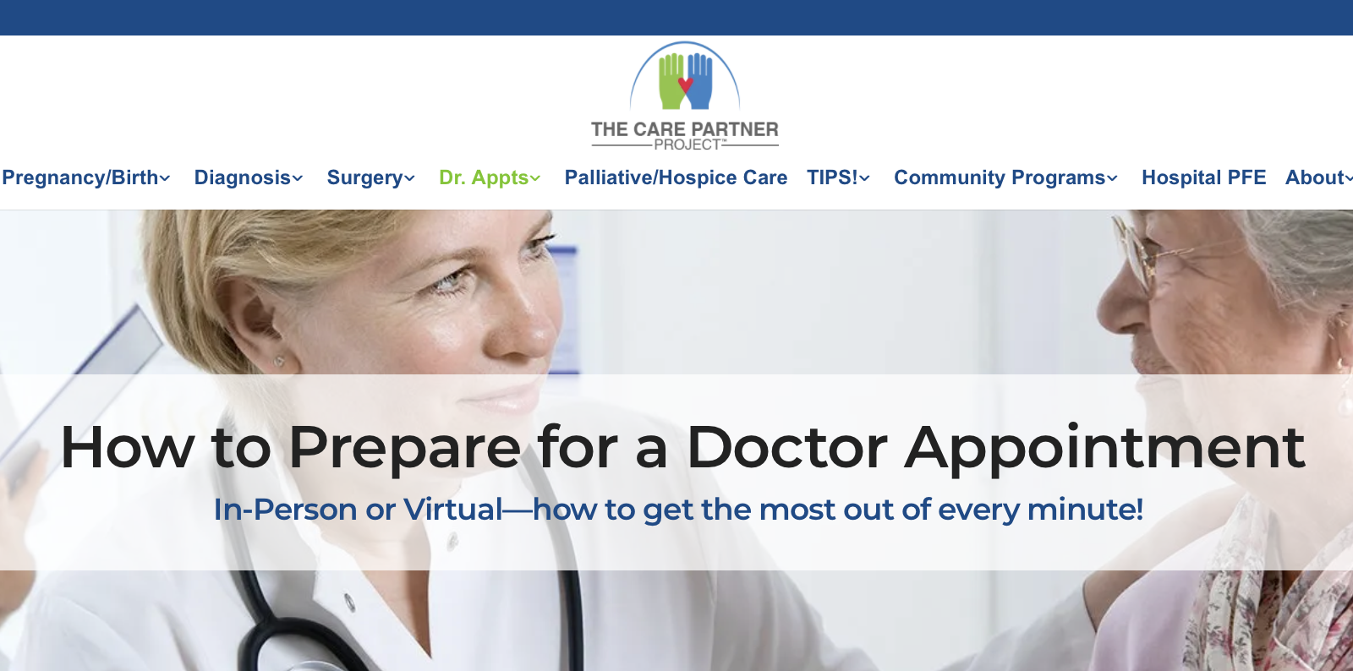
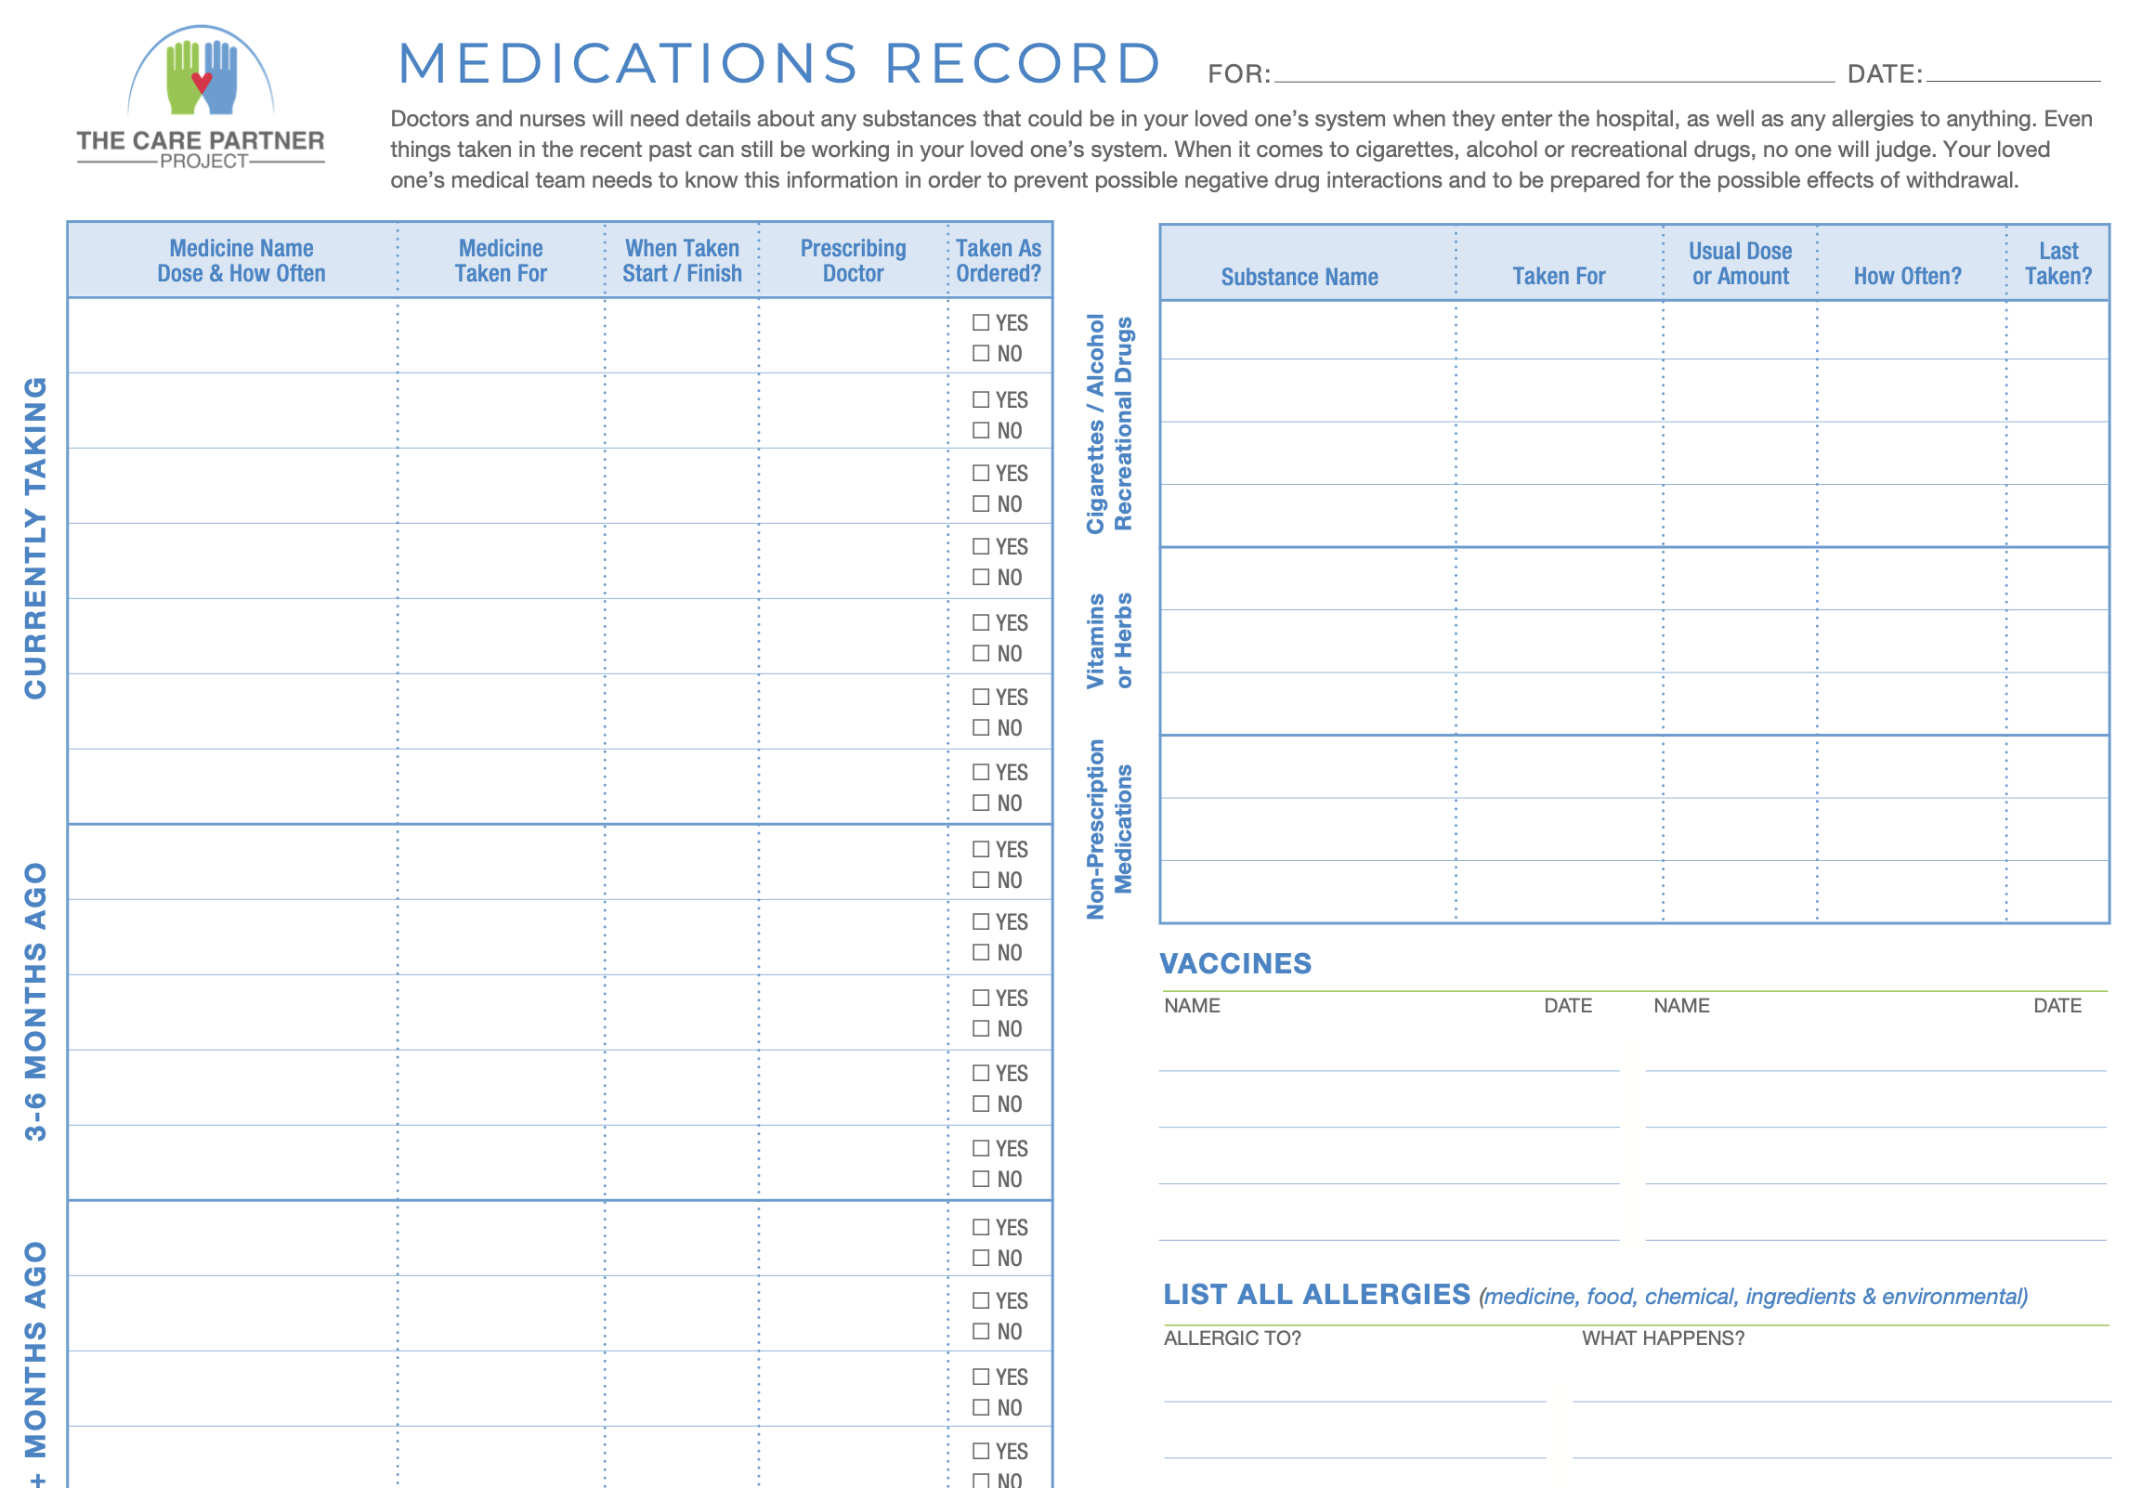
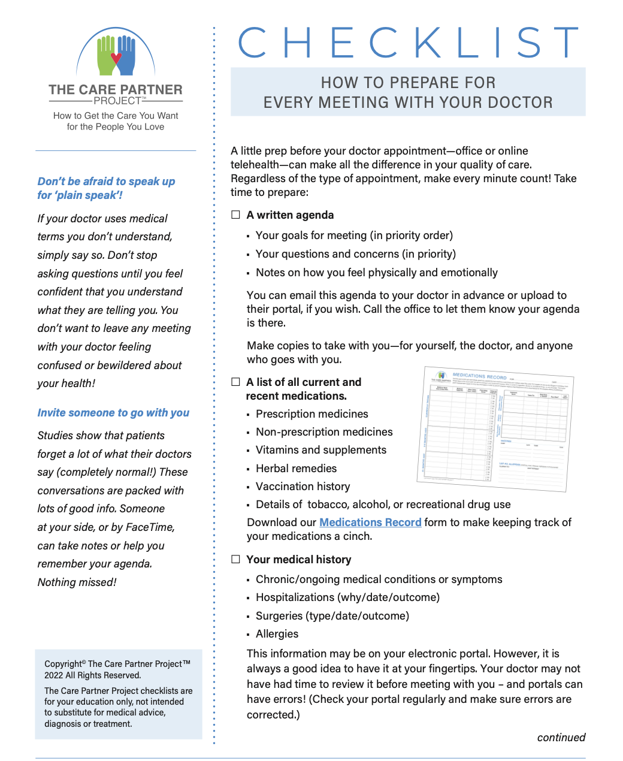
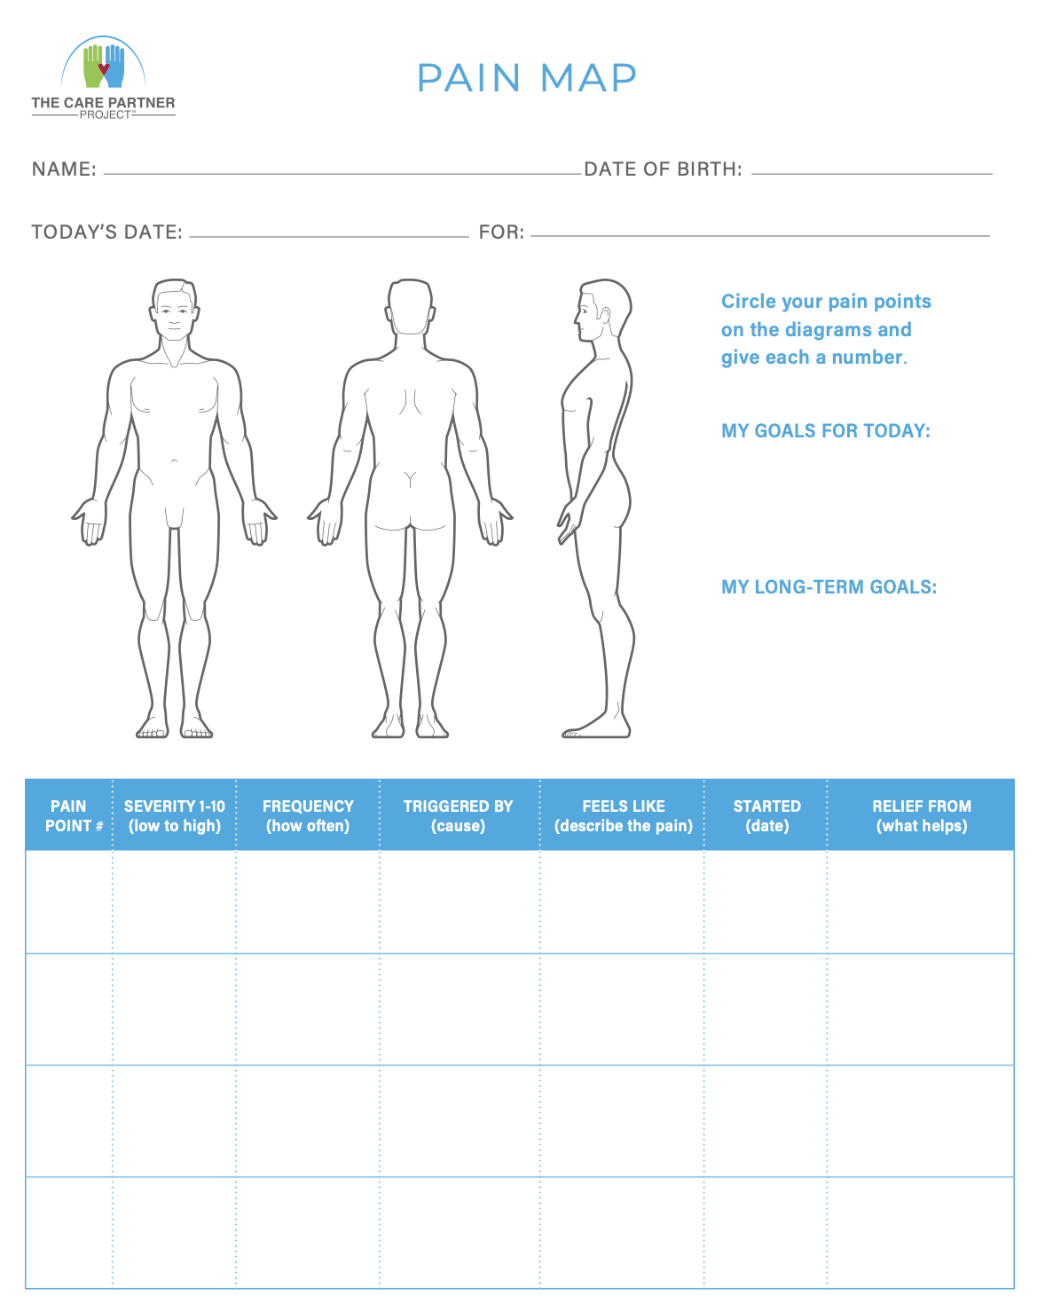
Notes:
The Care Partner Project offers several handy tips and forms to help you prepare to meet your doctor so you won’t forget anything and help ensure that your questions and concerns are covered.

Slide 16
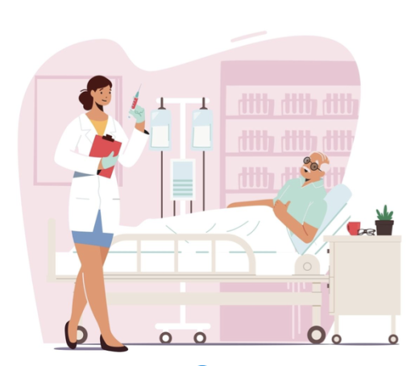
How to Support Your Loved One’s Hospital Stay
When you you can’t be there, you can still stay on top of details that make a difference in quality of care
Notes:
Moving on to hospital visits, which have been very distressing this year. Stories of solo patients have been heartbreaking. Raises awareness of all the patients past and future who cope alone without family and friends to help them. Fortunately, we have new tools that help!

Slide 17
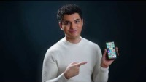
Essential for Your Loved One’s Hospital Stay
How to stay connected at all times! (And why you should.)
https://www.youtube.com/watch?v=hFJE6NymC08
Notes:
PRESENTER: PLAY VIDEO. IN PREPPING FOR THIS PRESENTATION, ARRIVE EARLY SO YOU CAN TEST THIS LINK ON YOUR HOST'S INTERNET CONNECTION.

Slide 18
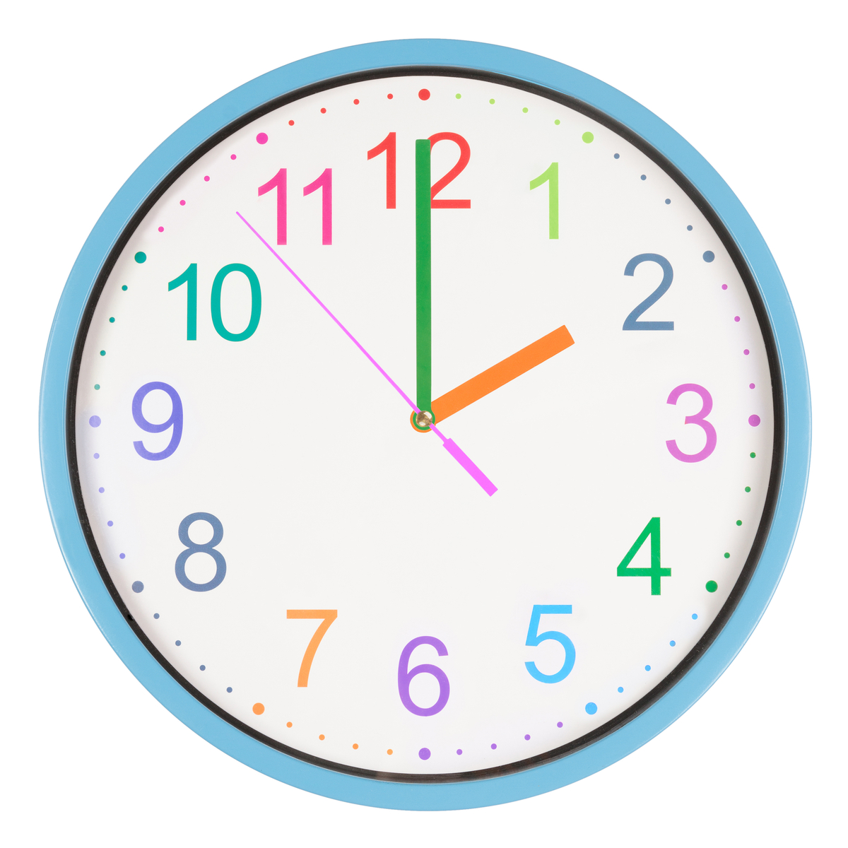
Buddy Up with a Nurse for Updates & Info
Call the nurse’s station every day at the same time
  The best time is 2 – 5pm.
  Try to talk to the same nurse each time
  If your loved one is in Intensive Care (ICU), call a second time, about 10 – 11pm
Wrap up each call with:
“I’ll call again tomorrow at the same time.”
And… “Thank you!”
Notes:
Ask for the nurse who is taking care of your loved one.
However, in ICU’s (Intensive Care), nurse may be too busy so ask for the Charge Nurse.
Can’t connect with nursing staff? Reach out to others for daily updates, such as the shift supervisor, hospitalist.

Slide 19

Topics to Cover About Your Loved One’s Care
And take notes, of course!
Tests ordered and results (Why ordered? Looking for?)
Medications started or stopped? Why?
Vital signs: Improving? Same? Worrisome?
Daily case conference: what was said?
Daily rounds with doctors: can you join via phone or tablet?
Loved one’s spirits
Notes:
Try to ask the same questions in the same order every day so you develop an efficient routine, much appreciated by nursing staff. On Census: Ask nurse if s/he feels it’s a safe load or not? If climbing or at an unsafe level, you may want to contact your loved one’s primary care doctor about possible transfer to another hospital or some other solution.

Slide 20

It’s OK to Ask for Help!
Arrange for Good Communication
Ask the nurses to let you know times for morning rounds and bedside shift changes.
Ask if you can participate via phone or ipad.
Visit with your loved one via Zoom, Google Chats, Facetime.
Nurses, aids, social workers, case managers are often willing to help set up.
Notes:
Make sure your loved one has a phone, iPad and chargers. Seeing your loved one will also help you monitor physical and mental well being. Because you know your loved one best, you may notice signs for concern that the nurses and doctors do not.

Slide 21

Be Mindful of How Busy Nurses Are
Express your respect and empathy for all their daily challenges.
“I know how busy you are. I really appreciate your time to share details about how (loved one) is doing.”

Slide 22

Have an Attitude of Gratitude
Health care can be stressful for everyone!
After your loved one is discharged, follow up with thank you notes to those who helped you.
Consider writing to the hospital’s Medical Director and CEO to compliment any staff members who’ve been particularly wonderful to your loved one or you.
Notes:
Attitude of Gratitude! Easy to remember and practice.

Slide 23

Let’s Talk
Questions? Ideas? All welcome!

Slide 24

Thank you!
Presenter: Insert your headshot here.
If this presentation was helpful to you, kindly spread the word about today’s presentation with your groups in our area.
I speak on other topics, as well. (In person or on ZOOM!) Just call or drop me a note!
Your Name Credentials
Company Name
Phone Number
Email
Notes:
PRESENTER: INSERT YOUR HEADSHOT AND CONTACT INFO.

