Slide 1

How to choose a
senior community that
meets your needs—
today and tomorrow.
Notes:
This presentation reflects our point of view that any consideration of your senior community options should go beyond how the community looks, or even how it feels to you when you visit. It’s a big decision and one that may actually impact so many quality of life and quality of health care you need or receive. We cover a lot of topics that help you consider aspects of quality and safety you may not know about just by “shopping around” or talking to your friends and relatives. As people age, health care and safety are necessary facts of life; as advocates, it’s our job to help get to the nitty-gritty of how to make decisions that optimize your chances for safe, quality care and support.

Slide 2



Welcome!
Thank you for
joining me today!
And thank you
to our hosts today:
[ host name ]
Presenter Name
Company Name
Notes:
PRESENTER: CUSTOMIZE THIS PAGE AS SHOWN

Slide 3


Brought to You by…
www.TheCarePartnerProject.org
Notes:
The Care Partner Project is dedicated to helping you feel informed and confident as Care Partners to your loved ones. Simple downloadable checklists and grass roots community education are all designed to help “everyday” people know what to watch for and what to do to pitch in for their loved ones’ care. The Care Partner Project also has a fund to help provide professional patient advocates for patients who have no one in their lives to help them through a medical crisis and no other resources, such as good insurance or an income. The Fund provides help for a lot of homeless people and those with developmental challenges. I’m very proud to be a Community Educator for the Care Partner Project in our area!

Slide 4

Today’s Plan:
How to put your needs and priorities front and center!
How to get past the sales pitch to the “nitty gritty”
What to watch for when you tour: quality, safety and a match to your needs and priorities (or not!)
The Care Partner Project ©2023

Slide 5




It’s a big decision. A good process helps!
1. Take Stock
2. Decide on Type of Community
3. Phone Screen Top Prospects
4. Tour Top Prospects
All are alternatives to aging in place.

Slide 6
Step 1
Take stock. What’s important to you?
What’s not?
6

Slide 7

It’s OK to have a big wish list!
What are your needs, wants and priorities?
Notes:
Step 1, take inventory!

Slide 8

Start with Good Conversations
MAKE YOUR LISTS!

Slide 9
There’s a lot to life: cover it all!
What’s important to you? List it!
Personal Preferences
Everyday Routine Support
Medical Support
Meal & Food Preferences
Social Interactions
Hobbies & Activities
Travel & Outings
Visiting Arrangements
Location Preferences
Pets
Finances & Contracts
Notes:
This list can be overwhelming! The Care Partner Project offers you free checklists to download so you don’t have to take notes now, but more importantly, you can have all of these topics on this page and in this presentation right at your fingertips.
For a small donation, The Care Partner Project also offers a handy spreadsheet to help you organize your notes for each of these topics for every community you contact.
It’s a lot of info and a lot of digging but it’s a big decision, and for most of us, a big investment, as well.

Slide 10
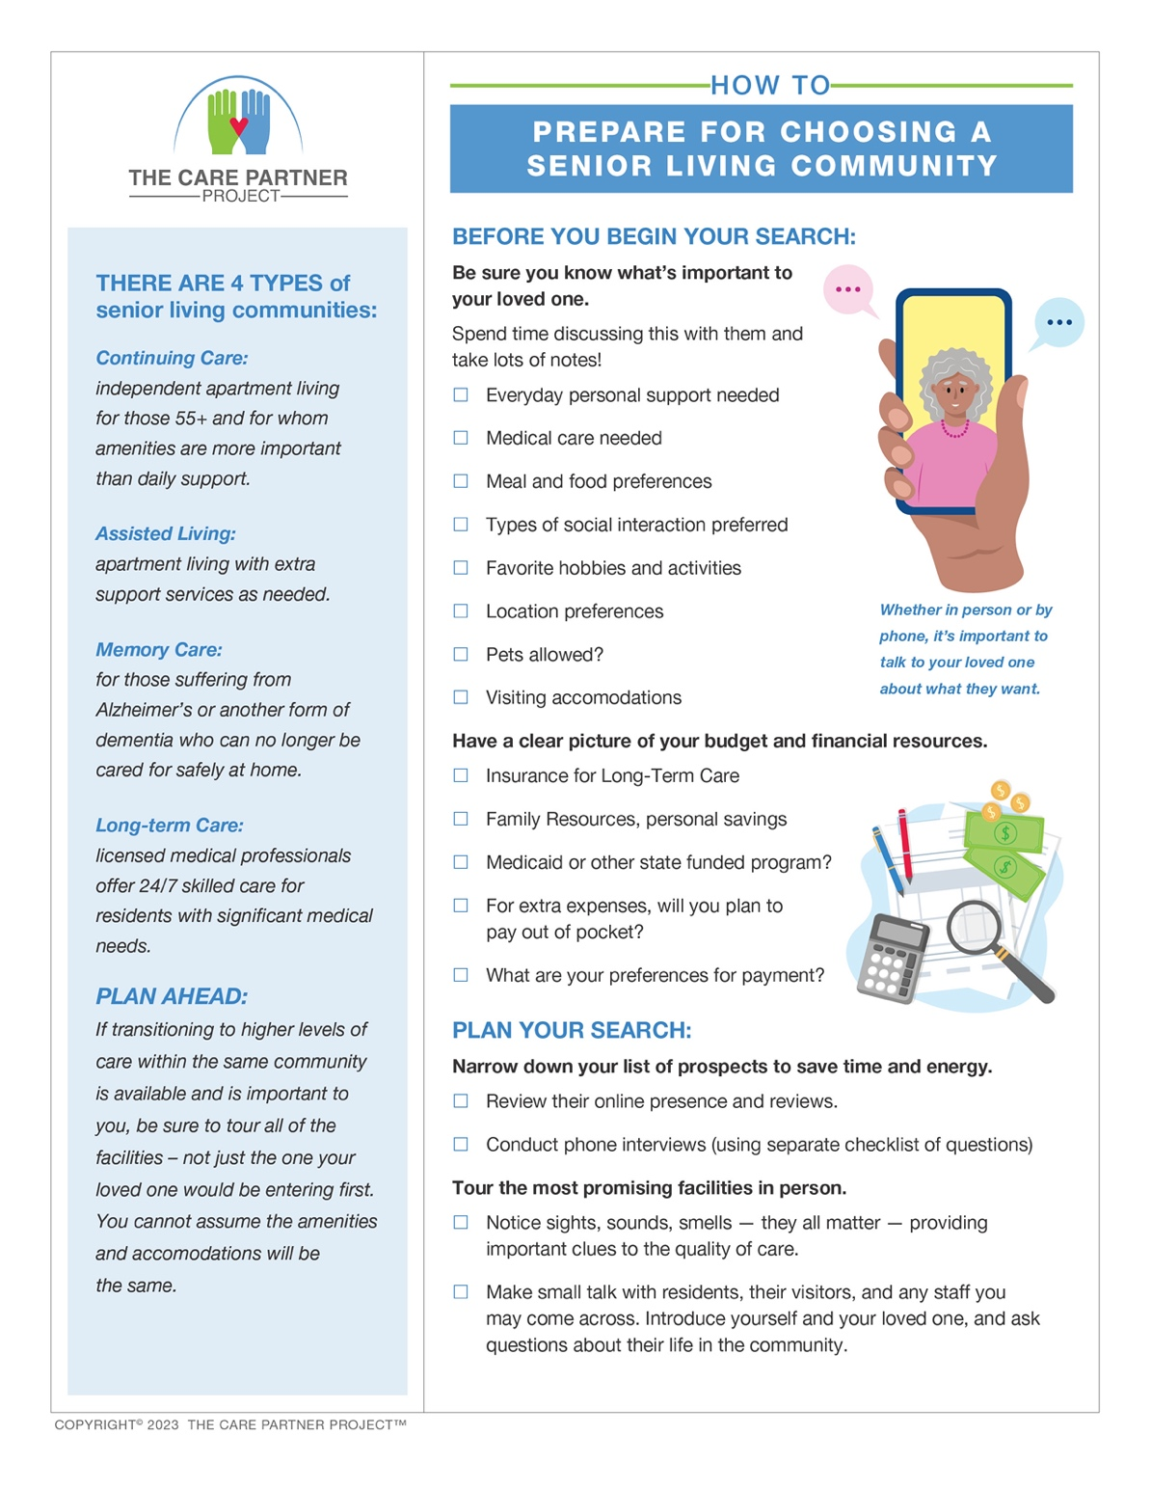
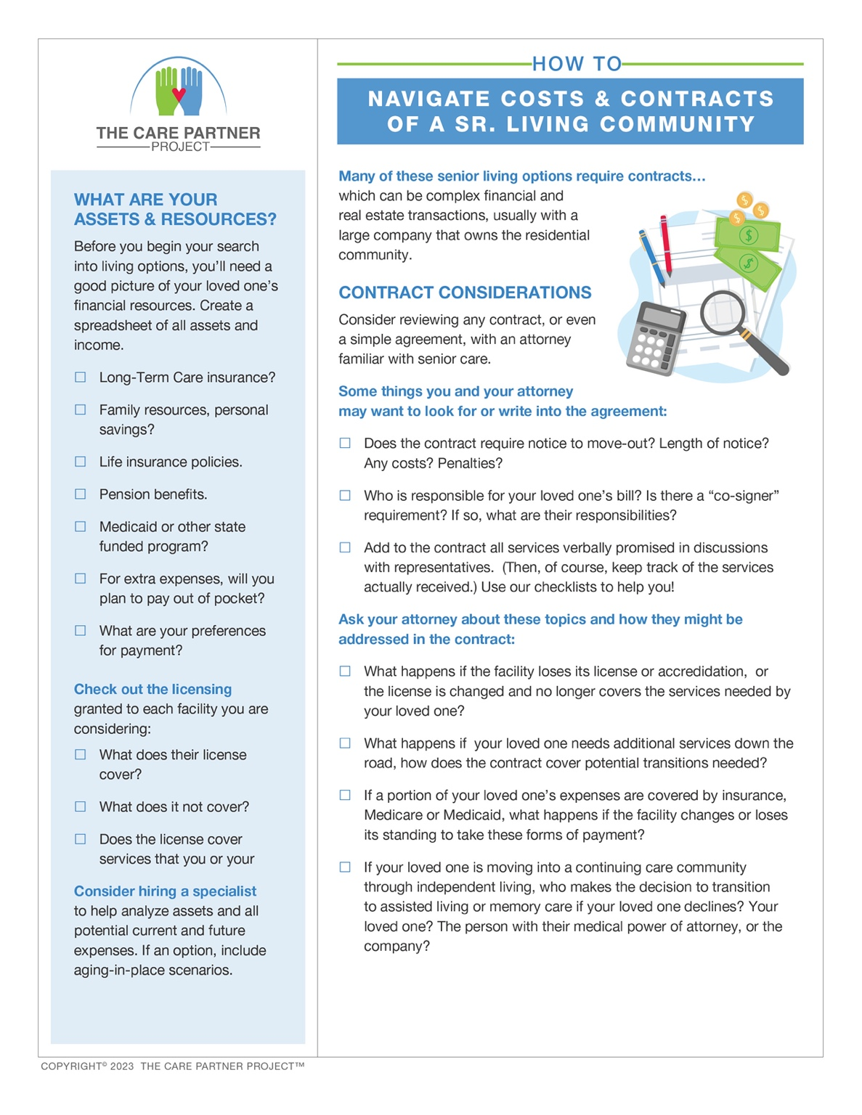
To help you, download free checklists
from The Care Partner Project
Use to simplify and
organize your search!

Slide 11

Talk, listen, open hearts and minds - take notes!
Notes:
The process of discussing living options is rarely completed in one sitting.

Slide 12
Step 2
What Type of Community Offers the Best Fit for Needs, Wants & Priorities?
Quality, Safety, Fit for Evolving Needs
12
Notes:
We are just trying to inject some of the needs, wants and priorities to include here – quality of care and support, safety and fit for evolving needs. Too often, these are just naturally assumed. We assume that any business that specializes in senior communities would include quality, safety and support for evolving needs as their residents age in place. This would be an erroneous assumption.

Slide 13




Continuing Care Communities (CCRC)
Offer 3 or 4 levels of care to support changing needs.
Independent
Memory Care
Assisted Living
Long-Term Care
Possible substantial upfront investment, plus ongoing monthly fees.
A long-term contract may be required.
Notes:
Possible substantial upfront investment, plus ongoing monthly fees.
A long-term contract may be required.

Slide 14


Independent Living (IL)
Apartments or small townhouse homes plus a range of activities and amenities:
sports facilities
meals
housecleaning
transportation for shopping, doctor appointments, etc.
community and off-campus social activities

Slide 15

Potential unwelcome surprises and problems!
In Continuing Care communities, Independent Living may be significantly more attractive, “buttoned up” and amenity-rich than their Assisted, Memory, Long-term care facilities. Check out all of them before you commit!
For Assisted Living and Memory Care, lock in specifics in writing about all services included in monthly fees plus any extra costs for additional assistance beyond medication management.
Any planned construction or renovations? Either in the community or area around it.
Notes:
Underestimating costs for making a move. Budget for labor for packing, unpacking, supplies, final utility bills, any new utility and internet, hook-ups, furniture arranging, furniture disposal (downsizing!), any deposits.
In continuing care communities (CCRCs), Independent Living may be significantly more attractive and “buttoned up” than Assisted, Memory and Long-term care. Check out all of them before you lock in!
Assisted living support with no support other than medication management, or support offered on an “ala carte” basis for additional fees. Lock in specifics in writing about all services included in monthly fees plus costs for assistance.

Slide 16

MARGARET’S STORY
The ”Ritz” of Independent Living
is the frumpy Motel
of Assisted Living
Notes:
PRESENTER READ Margaret’s story (in your Speaker Toolkit)

Slide 17



Assisted Living (AL)
Help with daily living
Compact apartments with small kitchens and small appliances (no ovens or dishwashers)
Meals served in dining rooms
Notes:
Kitchen appliances are limited for safety reasons. Residents are encouraged to eat communally, but meals may also be delivered to residents’ rooms. Be sure to check out if this is an extra charge, or included in the monthly fee.
Also, if a resident needs assistance walking back/forth to the dining room, escorts can usually be provided – no on wants to take a fall! However, this service may be an extra charge, too.

Slide 18

Assisted Living Community: What to Expect
Help with daily living
Dining room meals with menu options
Housekeeping and laundry services
Medications administration (always by staff)
Showering, dressing and other support services for daily needs
COSTS VARY WIDELY
Not covered by Medicare or Medicaid

Slide 19


Memory Care Communities (MCC)
Help for body and mind
Geared to those diagnosed with dementia, small studio-type apartments are set up to offer a simple and (ideally) safe environment for those with impaired daily living skills.

Slide 20

Memory Care
Exterior doors are locked for
residents’ safety
Communal meals only
Medication is always administered
by staff
Staff will help as needed with
showering, dressing, eating,
and toileting
Expect costs to be higher
Not covered by Medicare or Medicaid

Slide 21

CAROL’S STORY
Carol, who longed to see her mother, repeatedly fell while trying to reach the door.
Notes:
PRESENTER READ Carol’s Story located in your Speaker Toolkit

Slide 22


Long-Term Care (LTC)
Rehab after surgery or
care during serious, long illness
Medication therapy
Physical therapy
Feeding tube
Urinary catheter care
Will offer or help arrange for also offer palliative or hospice care if needed
May be covered by Medicare
or Medicaid
May/may not be covered by
Medicare Advantage – CHECK!
Notes:
Once called a nursing home; now also called a Skilled Nursing Facility (SNF, pronounced SNIFF). May want to note that this is the only type of senior residential care that’s covered by insurance. Warning for Medicare Advantage policies: check coverages carefully. Also, be sure any SNF being considered actually takes the Advantage Plan. Another warning: SNF’s can drop Medicare Advantage plan, and there is a certain amount of turnover every year because these plans don’t pay as well as Medicare. Patients can get caught having to go private pay, or else move to another SNF.

Slide 23
Call Top Prospects and
Quiz Them!
Step 3
23

Slide 24

Check online reviews. “Ask around.” Ask a nurse!
It’s hard to hide
a bad reputation these days!
Notes:
You can pick up a lot of good info in public reviews, especially on Yelp. Indeed is a good resource for learning how employees view their workplace, however, Indeed requires that you create an account – which is free. While it’s good to keep in mind that people have more of a tendency to complain than to compliment, if you see a pattern of negative reviews – especially about qualities you’re looking for in a senior community - why not put them on the back burner. You may want to revisit, but starting with those with good reviews will help your process move along. And while you’re at it, you may want to ask nurses you know in your community, or network to find any nurses you can talk to. They see everything. Hospital nurses, nurses in the ER, nurses in doctors’ officers – they see how patients come in, reasons for needing care, how they are being nourished and much more.

Slide 25

Let your fingers do the walking – phone first!
Follow your checklist
Remember, they are selling! Keep pressing for answers
Take notes!
Notes:
Keep in mind that you’ll be talking to SALES people. They may not have answers to all the questions you have. It’s OK to ask to talk to someone else who would have the answers. It’s OK to be firm. Their job is to get you in the door to tour, and depending on how much time you have, you may want to be gather as much information as you can so you won’t waste time touring places that won’t meet your needs.
Talk to others who work there, too.

Slide 26

Your phone interview: key questions to ask
1. Levels of Care
2. Licensing
3. Staffing and credentials
  RNs, clinical staff
  Medical/doctors
  Geriatricians
  Staff-to-resident ratio
  Frequency of rounds
Ongoing, professional
staff training (ask for
details, e.g., Teepa Snow training)
This is your first pass to weed out those that don’t match your needs and preferences.
Notes:
These are just the highlights. Pick up so much more at The Care Partner Project where you can download our free checklists.

Slide 27
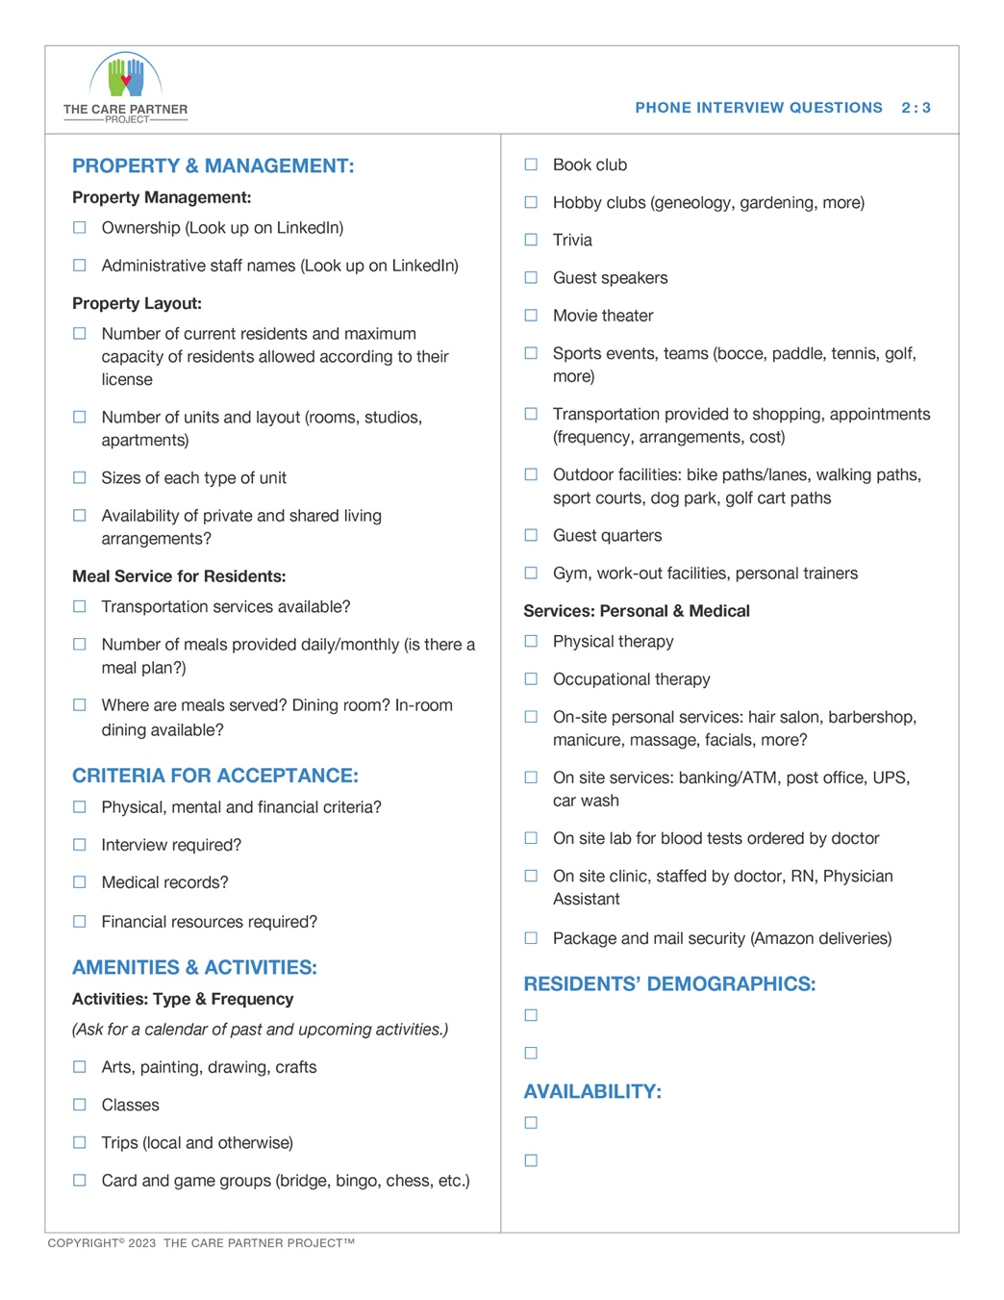
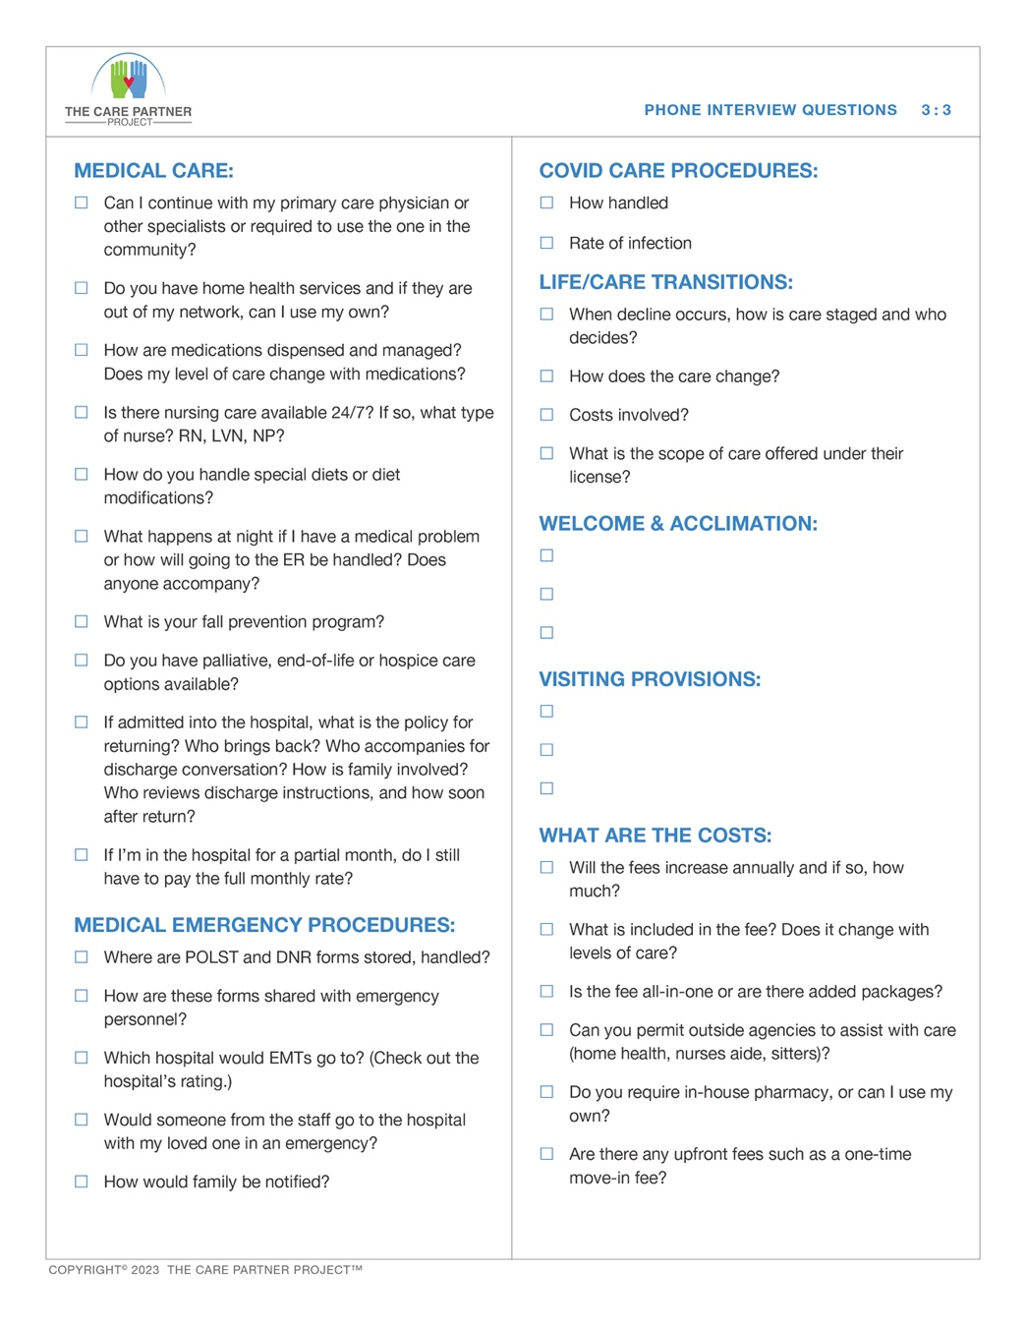
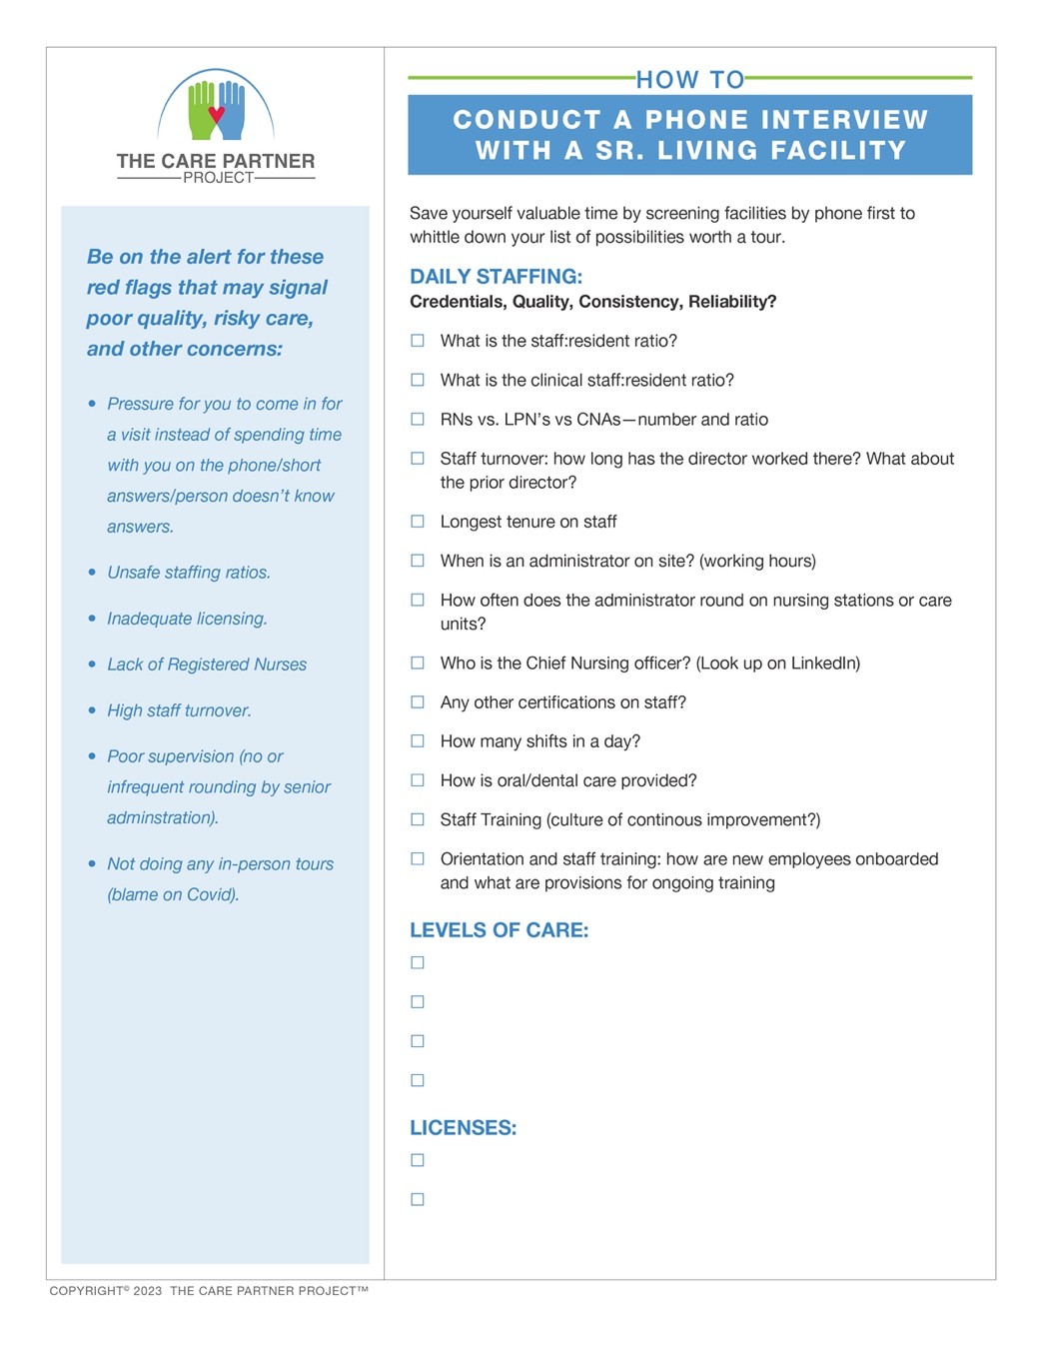
Your phone interview: key questions to ask
5. Services
  Medical, dental, and physical therapy
  On-site medical clinic?
  Meals, menus
6. Units, Sizes, Amenities
  Personal (hair salon, gym)
  Activities (type, frequency)
  Transportation for shopping, appointments
Costs and Contracts
Availability, waiting lists?
Download our FREE phone interview checklist!

Slide 28

RED FLAGS
Not necessarily “deal breakers,”
but good details to sweat
Possible signs of poor quality, risky care, & other concerns…
Pressure for you to come in for a visit instead of spending time with you on the phone/short answers/person doesn’t know answers/won’t refer you to others
Unsafe staffing ratios (no hard/fast ratio: compare answers across all options Inadequate licensing, no commitment to ongoing training for staff
Lack of Registered Nurses, doctors, geriatricians, regular staff training
High staff turnover (“ask around” among friends, neighbors, others)
Poor supervision (no/infrequent rounding by senior administration) Ask around!
Poor reputation, “horror stories” when you ask around
Notes:
This is all relative and you will only know what’s “good” versus ”not so good” by calling several communities. For example, on staffing ratios: something like 15 residents for every staff member may sound reasonable until you learn that other communities may staff at 8:1 or 10:1. Since senior communities are unregulated, it’s up to you, the “shopper” to come up with your own sense of quality and value for your money. It’s a big expense and big decision, but most importantly, the quality of care and support you’ll receive is at stake. Careful research will likely help you make a decision that’s right for you for the long term.
You may not get answers to some of these questions when you call (like staff turnover) but it’s on the list as a reminder of something to dig into, such as clues in Yelp reviews or in conversations with others you may ask for references on senior communities you’re considering.

Slide 29

Step 4
Time to Tour!

Slide 30




Tour with your senses
for quality and safety clues!
LOOK for…
clean surroundings
contented people
SNIFF for…
yucky odors
freshness
LISTEN for…
kind voices
calm vs chaos
TASTE…
the food
Notes:
These are just the highlights. Pick up so much more at The Care Partner Project where you can download our free checklists.

Slide 31
RED FLAGS
Not necessarily “deal breakers,”
but good details to sweat
What you see doesn’t line up with what you were told when you called
Residents appear unkempt
You don’t hear any happy voices! Staff is grumpy, sour, unfriendly and residents appear bored, sad or listless
You see staff on personal phones! You see staff sitting around, doing nothing
Odd smells, bad smells come from residents, their rooms or public areas
Unclean public bathrooms
Unclean residents’ bathrooms
Interactions with residents
Poor quality of food, nutritional content

Slide 32

Special considerations for couples
Interview will be necessary
Medical records are reviewed
A nurse and doctor must certify that one
person in the couple can safely live
on their own without additional assistance
“Hybrid apartments” may be available: one person in the couple may receive medication management support, help with dressing, bathing or other assistance that is needed for wellness and safety

Slide 33

Financial criteria for acceptance
Be prepared to share your entire
financial picture
Ask what resources are needed
to qualify
Look for details: annual increases,
extra possible fees like transportation,
haircut services, food delivery to unit,
assistance while walking. Many more!
Faith-based community?
Ask about financial assistance
Review details with a lawyer, accountant, financial planner, possibly another family member or trusted friend.

Slide 34

Navigate Costs and Contracts
Deposit needed to hold, additional10% required to do medical screening/application
When get money back in the event of death or decision to leave (have to wait for two years or until the apartment is sold)
If you “give it a try,” what are the $$$ implications?
Review details with a lawyer, accountant, financial planner, possibly another family member, or trusted friend.
The Care Partner Project ©2023
34
Notes:
As you can see, we’ve repeated the sidebar about consulting with professionals before you make a commitment.

Slide 35
You’ve made a decision. Now what?

Slide 36

Start with your move-in date…
Lots of logistics — make your plan, make your lists!
Will your new unit need renovations? Or is it
move-in ready?
Cost of renovations?
Have a house to sell?

Slide 37

What is your moving plan?
Downsizing?
(Time is of the essence!)
Have family or friends to help with the move?
Need a mover?
Will your new community help with any of these details?
(If so, Included in your fees, or not?)

Slide 38

You’ve moved in!
Get involved! This is your last quality and safety check.
If anything does not match up to what you were promised, act quickly.
Ask for a meeting. Include your trusted family, friends, any advisors who helped you with the search and your contract.
Use your Care Partner Project checklists and notes you kept during your search. Use these notes to explain or back up any concerns you have.
Expect accountability:
              Ask for “fixes!” Details, and timing (When?)
              Get promises in writing!

Slide 39




Feeling overwhelmed?
There’s help!
Reliable, independent* professionals
Certified Senior Advisors
Patient Advocates
Independent means not paid by any senior community, not paid a referral or “finder’s” fee. Senior Care Authority and Care Patrol are examples, not endorsements. Search in your area for these and similar consultants.
Notes:
Kitchen appliances are limited for safety reasons. Residents are encouraged to eat communally, but meals may also be delivered to residents’ rooms. Be sure to check out if this is an extra charge, or included in the monthly fee.
Also, if a resident needs assistance walking back/forth to the dining room, escorts can usually be provided – no on wants to take a fall! However, this service may be an extra charge, too.

Slide 40



LET’S TALK!
QUESTIONS? IDEAS?

Slide 41

Thank you!
Presenter: Insert your headshot here.
If this presentation was helpful to you, kindly spread the word about it with your groups in our area.
I speak on other topics, as well. (In person or on ZOOM.)
Just call or drop me a note!
Your Name Credentials
Company Name
Phone Number
Email
Notes:
PRESENTER: INSERT YOUR HEADSHOT AND CONTACT INFO.

