Slide 1

Mystified by Your Medicare Options?
You’re not alone!
2026 facts & figures in plain terms to help you make decisions that are right for you.

Slide 2
Welcome!
Thank you for
joining me
today!
INSERT YOUR HEADSHOT, NAME, TITLE CREDENTIALS, COMPANY INFO, CONTACT INFO IN THIS SPACE
Many thanks to our hosts!
Notes:
PRESENTER: FOR ADDIITONAL INFORMATION TO HELP YOU PREPARE, THIS IS AN EXCELLENT RESOURCE. https://www.kff.org/medicare/issue-brief/what-to-know-about-the-medicare-open-enrollment-period-and-medicare-coverage-options/
THIS PRESENTATION DOES NOT COVER EVERY FINE POINT AS THERE ARE MULTIPLE PERSONAL SITUATIONS THAT MAY AFFECT DECISIONS. THERE ARE ALSO MULTIPLE “NOOKS AND CRANNIES” IN ALL POLICIES THAT WE CAN’T COVER IN A FAIRLY BRIEF PRESENTATION. THIS COVERS THE MAJORITY OF SITUATIONS, BUT NOT ALL. DOING HOMEWORK IS KEY. AS AN ADVOCATE, YOU MAY WANT TO PROVIDE YOUR SERVICES TO HELP CLIENTS SIFT THROUGH THEIR OPTIONS AND MATCH THEM TO THEIR MEDICAL NEEDS AND BUDGETS.

Slide 3

We coordinate care and communication among doctors
Accompany to doctor appointments
Research doctors, treatments, 2nd opinions
Get answers about about insurance benefits, denials, appeals and bills
Coordinate and guide end-of-life planning, document preparation
Notes:
PRESENTER: THIS IS YOUR SLIDE TO CUSTOMIZE AS YOU WISH. THIS IS FOR EXAMPLE PURPOSES.

Slide 4

Today’s Plan:
Our Next Hour Together
Key issues and details to consider in your open enrollment choices
Changes to plans for 2026
Key questions to ask of your insurance broker, or to research yourself
Tips and information on little known features in Traditional Medicare and Medicare Advantage
Then, Q&A – Let’s talk!
Note: We do not sell insurance nor have any affiliation with the insurance industry.
Notes:
PRESENTER: WE RECOMMEND THAT YOU READ THE NOTE. IN OUR EXPERIENCE, SOME AUDIENCE MEMBERS FORGET THIS IMPORTANT DISCLAIMER AS WE GET FURTHER INTO THE DECK.

Slide 5

Notes:
There are many types of enrollment periods. Right now, we are in the enrollment period when most people are given the opportunity to evaluate their choices, which we will cover in detail today.
PRESENTER: WILL YOU FOLLOW UP WITH YOUR AUDIENCE WITH SOME SORT OF HANDOUT? IF SO, THIS WOULD BE A GOOD TIME TO LET THEM KNOW. OR, DO YOU WANT TO ENCOURAGE THEM TO TAKE NOTES?

Slide 6
A Few Background Details
First steps for straightening out the maze

Slide 7

Fall Open Enrollment
October 15th - December 7th
  You may switch between Original Medicare and Medicare Advantage – or vice versa
  You may switch to a different Medicare Advantage Plan
  You may switch to a different Part D plan
  Coverage starts January 1
Notes:
Special Enrollment Period (SEP) is allowed under certain circumstances, for example, if you move, or if you have a Medicare Advantage Plan and the company discontinues it.
Or:
If you didn’t enroll in Part B during your Initial Enrollment Period (IEP) when you turned 65 because you had employer-based insurance
For 8 months after losing job-based insurance
COBRA and retiree insurance do not count.
There are other special types of enrollment periods, such as if you move, or if you have a Medicare Advantage Plan and the company discontinues it.

Slide 8

Fall Open Enrollment is a time to consider…
Is your current plan meeting your health and budget needs?
Time to look at any cost and benefits changes for 2026!
  Medicare & You Handbook. Watch your mail, published by the government
  Medicare Advantage/Part D:
    Annual Notice of Change (ANOC) and/or
    Evidence of Coverage (EOC)
Notes:
You will see plenty of TV ads, too! All from private insurance companies about Medicare Advantage Plans. The government is not allowed to advertise so you won’t see anything in the media about traditional Medicare.

Slide 9
First, Know the The Medicare “Parts”
Original Medicare
From the Government
Medicare Advantage
by Insurance Companies
Part A
Hospital Insurance
Part C
which includes:
Hospital Insurance
Medical Insurance
Prescription Drug Plan
(in most plans, but not all)
Part B
Medical Insurance
+
Part D
Prescription Drug Plan
(buy from an insurance company)
Supplement Plan
(buy from an insurance company
to cover what Medicare doesn’t )
Notes:
Supplement is also called “Medi-Gap” sometimes: it fills the gaps in costs that Medicare does not cover. You will need to choose one option: Original Medicare OR Medicare Advantage. There is no mix and matching, but there are plenty of choices within each option.
Part A - hospital inpatient, Skilled Nursing Facility, home health care, hospice
Part B - outpatientt services, doctor services, preventive care, home health care, durable medical equipment/DME (i.e. walkers, wheelchairs), and some ambulance service

Slide 10
All About Medicare
Benefits and Costs

Slide 11

Original Medicare From the Government
Recall the deductions in your paycheck?
Part A and Part B, usually deducted from your Social Security checks
You may go to any doctor in US who accepts Medicare (over 90% do)
No referral is needed to see specialists: it’s your choice
Need to purchase a prescription plan separately, offered by insurance companies (Part D)
Highly recommended: purchase a supplemental policy from an insurance company (known as “Medigap”)
Notes:
Hopefully, this looks familiar to you. This handbook should have arrived in your US postal mail early October. It’s a trove of good information. The website is user-friendly, too.

Slide 12

What’s Covered: Medicare Part A
Hospital inpatient
Skilled nursing facility
Home health
Hospice
Not all home health is covered. Limits on type and duration (number of days). Check policy!
Your benefit period is not a calendar year (Jan – December): it starts with date of hospital admission.
Notes:
A benefit period begins the day you are admitted to a hospital as an inpatient, or to a Skilled Nursing Facility, and ends the day you have been out of the hospital or Skilled Nursing Facility for 60 days in a row.
For medically necessary care: hospitals have up to 90 days/benefit period, plus 60 lifetime reserve days. If a patient needs more than 60 days of care, however, and has certain supplemental policies, the supplemental insurance will kick in and cover more days, maybe even weeks (depends on the plan.)
Skilled Nursing Facility - 100 days/benefit period IF: in hospital for 3 consecutive days in the 30 days before admission and need skilled nursing 7 days/week or PT/OT/Speech 5 days/week. Supplemental policies will, again, pick up coverage when benefit periods run out.
Home health up to 100 days. Homebound; was in hospital for at least 3 days in the prior 14 days. Without hospital stay - Part B.
If, and only if, beneficiary/policy holder needs skilled nursing care, can get home health aide.
Hospice care is covered as long as doctor certifies need: terminally ill with life expectancy of <6 months. Palliative care is covered, but with a higher co-pay. It is worthwhile to check exactly what various supplemental policies will cover, too.

Slide 13
  What isn’t covered by Medicare?
Long-term care (nursing home, assisted living or memory care)
Most dental care
Routine vision
Cosmetic procedures
Dentures
Hearing aids/exams
Routine foot care
Acupuncture
Notes:
PRESENTER: YOU MAY WANT TO EMPHASIZE THIS FIRST POINT (ASSISTED, ETC.) BECAUSE THERE IS SO MUCH CONFUSION/MISINFORMATION/MISUNDERSTANDINGS ABOUT THIS. YOU MAY HAVE STORIES TO SHARE, AND SOLUTIONS FROM YOUR OWN EXPERIENCE.
IF TIME PERMITS, YOU MAY WANT TO SHARE THAT MEDICAID WILL COVER NURSING HOME CARE (WHICH MAY INCLUDE MEMORY CARE UNITS) IN QUALIFIED MEDICAID FACILITIES. THE PERSON MUST HAVE VERY FEW ASSETS AND THERE IS A 5-YEAR LOOKBACK PERIOD TO PREVENT PEOPLE FROM TRANSFERRING ASSETS TO A TRUST, HEIRS, OR OTHERS. THE AMOUNT OF MONEY ANYONE CAN HAVE TO QUALIFY FOR MEDICAID COVERAGE VARIES BY STATE. ASSETS INCLUDE CASH AND THE VALUE OF ANY OWNED PROPERTY, SUCH AS A CAR. YOU MAY WANT TO LOOK THIS UP FOR YOUR STATE.

Slide 14





A “Wrinkle”…
Know Your Status During Hospital Care
Inpatient status? OR Observation status?
(Note: You can make a formal appeal if observation status denied.)
Why important?
Affects coverage for post-hospital rehab, skilled nursing care and home health
3-midnight rule: must be an inpatient for 3+ midnights for rehab, skilled nursing care or home health needed after discharge to be covered by insurance
What should you do?
Ask for inpatient status. Keep asking if necessary!
Notes:
Just because you stay overnight in a hospital does not mean you are considered an inpatient. You may be under “observation status.” If you have not been “admitted”, and you are discharged to a rehab facility, or long-term skilled nursing care, those costs may not be covered. It pays to question your status, speak up and ask for inpatient status if you’re on observation, and take the issue up the chain of command: go to the Chief Medical Officer, Risk Management, Patient Advocate office. If you are the patient, this can be incredibly hard: you’re not feeling well and the task of taking on the challenge of advocating for this change is likely daunting. This is when it is very helpful to enlist a family member or friend to help you, or to contact a professional patient advocate. This is what I do.
A fine point to know: If you are inpatient, then Part A pays. If you are observation, then you are considered an outpatient and Part B pays. Usually you pay more if you are an outpatient.
Status can change during a stay so be sure to ask every day!

Slide 15

What’s Covered:
Medicare Part B
Doctors’ services
Some preventive care
Outpatient PT/OT/speech
Durable medical equipment
Hospital outpatient services
Lab tests
X-rays
Mental health care
Some home health, ambulance services, and prescription drugs
Notes:
Most medically necessary services.

Slide 16

Premiums and Costs in 2026
 | Original Medicare | Medicare Advantage
Premium | Part B monthly base $185 | Part B + possible plan premium
Deductible | Part A ($1676) and Part B ($257) deductibles | Varies by plan
Copayments/Coinsurances | 20% coinsurance for Part B-covered services, e.g. Daily hospital and Skilled Nursing Facility coinsurance | Varies by plan
Maximum Out-of-Pocket (MOOP) | None/No MOOP** **Supplemental plan kicks in to cover | MOOP $9350 in-network $14,000 for out-of-network
Want more details?
Medicare.gov/basics/costs/medicare-costs
Notes:
One important thing to note is how important it is to buy a Supplemental/Medi-Gap plan for Original Medicare, to limit your risk of high out-of-pocket expenses, especially for hospital costs and treatments. We will get into details about these plans in a few minutes.
The cute lady is on the Medicare webpage where you might want to dive into more details - you’ll know you’re in the right place when you see her!)

Slide 17
Medicare Costs for
People with Higher Incomes
Income-Related Monthly Adjustment Amount (IRMAA)
Determined from tax return two years prior based on MAGI
(your Modified Adjusted Gross Income)
“IRMAA”
May Request a New Initial Determination (for life changing event, altered financial condition, outdated information)
Notes:
Income Related Monthly Adjustment Amount (IRMAA) applies If you are a person who has higher annual earnings. IRMAA is an additional amount that you pay for your monthly Medicare Part B and Medicare Part D premiums (deducted from your Social Security check).
It is re-calculated every year using tax returns from 2 years earlier, based on your Modified Adjusted Gross Income (MAGI), which your CPA/financial advisor can help you determine if you can’t do it on your own.
Generally, MAGI is the total of your household’s adjusted gross income (AGI) plus any tax-exempt interest income you may have.

Slide 18
Income Related Monthly Adjustments
Yearly Income | in 2024 | What you pay | in 2025
Individual | Joint | Part B | Part D
$106,000 or less | $212,000 or less | $0 +$185 | Plan Premium
>$106,000 - <=$133,000 | >$212,000 - <=$266,000 | $74 +$185 | $13.70 + Plan Premium
>$133,000 - <=$167,000 | >$266,000 - <= $334,000 | $185 +$185 | $35.30 + Plan Premium
>$167,000 - <=$200,000 | >$334,000 - <=$400,000 | $259 +$185 | $57 + Plan Premium
>$200,000 - <$500,000 | >$400,000 - <= $750,000 | $406.90 +$185 | $78.60 + Plan Premium
>$500,000 and above | >$750,000 and above | $443.90 +$185 | $85.80 + Plan Premium
Notes:
Medicare bases its costs for your medical care coverage on income 2 years prior. So, to calculate the amount that would be taken out of your Social Security check to cover your medical expenses, let’s use the example of an annual income of $115,000 from 2023. Add $74 + $185 + $13.70. This totals $272.70, which would be deducted from your Social Security payment.

Slide 19
All About Supplemental Plans
that go with Medicare
Benefits and Costs

Slide 20
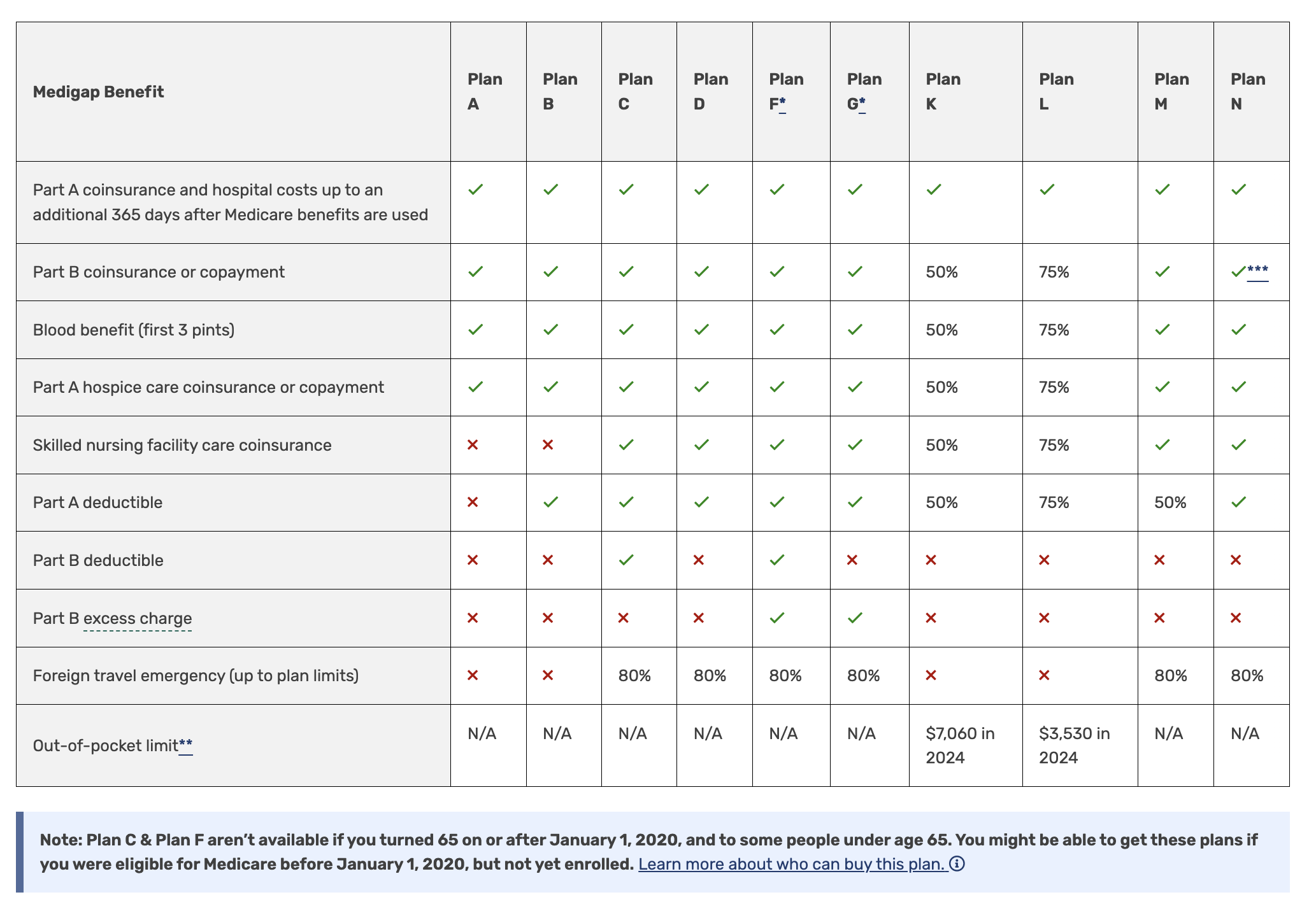
Supplement Plans (”Medigap”)
Notes:
These plans work with Original Medicare to cover out of pocket costs. They are accepted by any doctor or hospital that accepts Medicare. Supplemental policies. But note, they do NOT cover any of the services that Medicare does not cover, for example, dental, vision, and hearing.
The plans are standardized by law, meaning that each plan (known by its letter) must cover the same benefits no matter which insurance company sells them.
Bu t companies can charge different prices. So, it pays to shop around!
Also, There are rules about when you can enroll (guaranteed issue rights). It’s best to enroll within 6 months of signing up for Part B, or within 63 days of using or ending certain kinds of health coverage. If you enroll during these time frames, then any pre-existing conditions you have are covered and insurance companies must sell you a policy at their best available rate, regardless of your health status.

Slide 21
All About Drug Plans
that go with Medicare

Slide 22

Prescription Drug Plans (Part D)
Notes:
Yes, it’s complicated, but the good news is that changes in 2025 make it a lot simpler! Still have to do your homework but drug costs have come down and there’s more to be happy about!

Slide 23

Part D
Prescription Drug Plans
May buy through private insurance companies (wise to shop around)
May buy a stand-alone drug plan to go with your Medicare policy
Expect preferred, in-network pharmacies
Expect the covered drugs and rates to change each year… shop around, match your meds to each plan!
Notes:
Let’s dive into the basics.

Slide 24

How Your Drug Costs Will Be Covered
MOOP amount (Maximum Out-of-Pocket)
you will pay for covered drugs: $2100 in 2026.
Your Deductible
The maximum deductible: $615, up from $590 in 2025.
Note: Must pay deductible before plan starts to share costs.
How it works
You pay for your prescriptions, and your costs are tallied towards the $2,100 cap.
Once you hit $2100, you won't pay for any more covered drugs for 2026.
What doesn't count?
Your monthly Part D premiums don’t count toward the out-of-pocket maximum.
Notes:
This chart shows how the formula works so you pay no more than $2000 per year in total for your prescriptions. Your deductible will be applied in January to prescriptions you have filled that month. Then your cost will be spread out over the remaining 11 months.

Slide 25

The Medicare Prescription Payment Plan (MPPP)
Important details!
Have high drug costs at the start of the year ? (due to your deductible)
You may be able spread those payments out over the year.
Contact the drug insurance company to apply – call, or enroll on its website.
Notes:
If your cost in January, meeting your deductible, is unaffordable, you now have the option to spread that over 12 months, too. Contact your drug plan to enroll in this option.
PRESENTER NOTE: THIS IS A COMPLICATED PLAN. THE PAYMENTS ARE NOT IN EQUAL INSTALLMENTS. CALCULATIONS BASED ON COSTS AND PERSON’S INCOME.

Slide 26


Inflation Reduction Act
In 2025, 20 more drugs added with lower prices due to price negotiations since 2020
Eliquis, for preventing strokes and blood clots
Jardiance, for diabetes and heart failure
Xarelto, for preventing strokes and blood clots
Januvia, for diabetes
Farxiga, for chronic kidney disease
Entresto, for heart failure
Enbrel, for arthritis/other autoimmune conditions
Imbruvica, for blood cancers
Stelara, for Crohn’s disease
Fiasp and NovoLog insulin products
*Insulin remains capped at $35/mo. and Shingrex , and other vaccines remain free. (Started in 2023)
Notes:
PRESENTER: THERE HAS BEEN INCORRECT REPORTING THAT THE CURRENT ADMINISTRATION ROLLED BACK THE NEW PRICING IMPLEMENTED UNDER THE BIDEN INFLACTION REDUCTION ACT, WHICH IS PROTECTED BY STATUTE. THE NEW PRICES ARE AVAILABLE ONLINE IF YOU HAVE TIME/WOULD LIKE TO SHARE A FEW EXAMPLES.

Slide 27
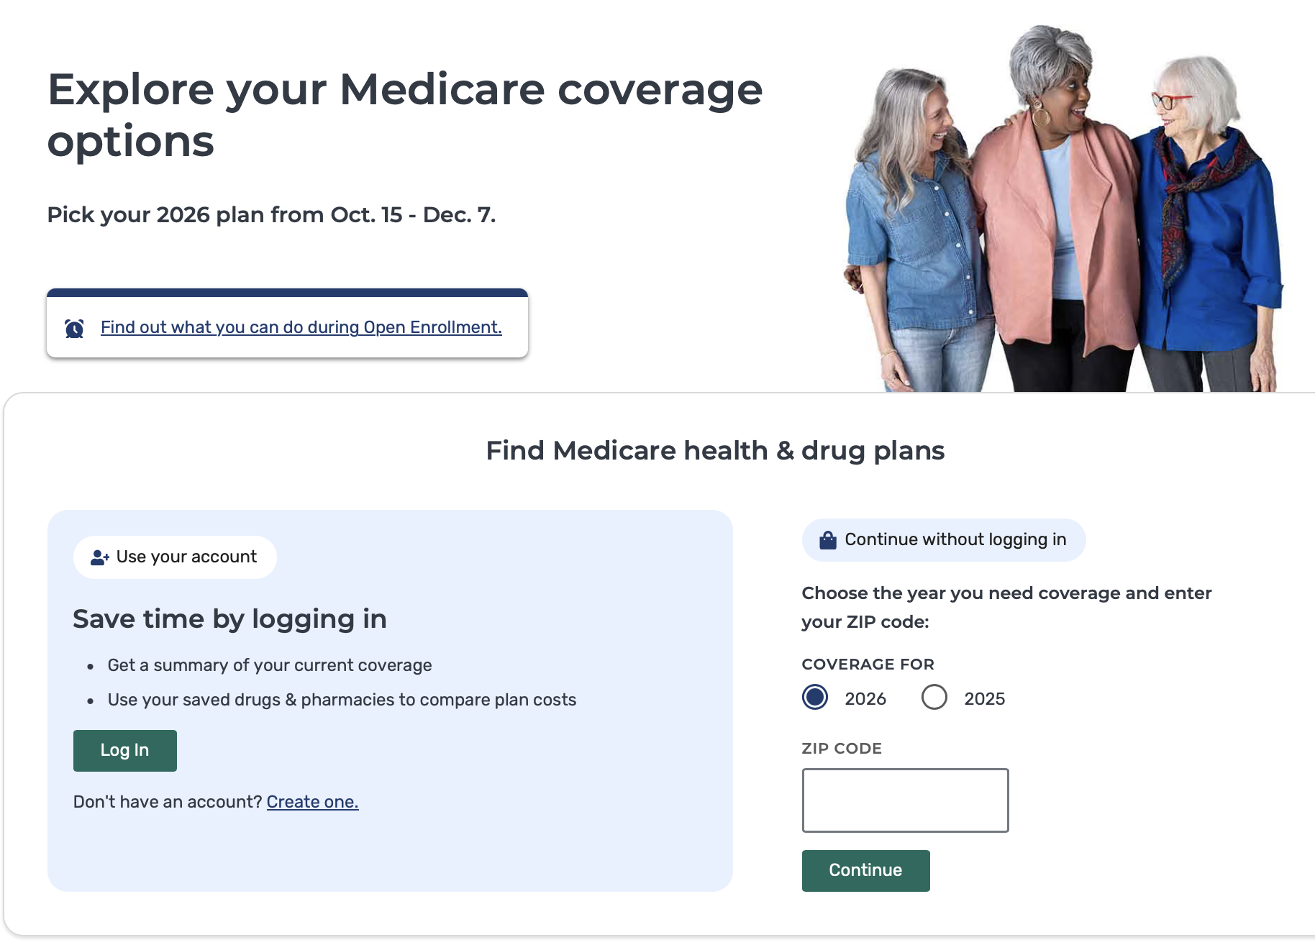
Part D Medicare
Plan Finder
Have a list of your medications on hand to enter (name, dose)
Know the pharmacies where you would like to get your prescriptions filled.
Search for plans using your zip code.
Notes:
Look at all of your costs. The monthly premium, annual deductible, drug cost and the total out-of-pocket cost to you every year. Search a few reputable sites and, possibly, consult an agent. They are paid by commission but may represent plans you don’t see online. There is no obligation to buy if you get a quote.

Slide 28

Final Fine Points Prescription Plans
Based on where you live
If you move to another area, you must call your plan to see if you can keep it or if you must change it
Notes:
In other words, just because you get your prescriptions filled at Walgreens now, and there is a handy Walgreens in your new area, don’t assume your drug plan applies.
You don’t want any surprises when you pick up your first prescription in your new home!

Slide 29
All About Medicare Advantage Plans
(the alternative to Medicare)
Benefits and Costs

Slide 30
Medicare Advantage
Plans
Private health insurance plans
Include Part A, Part B, and usually Part D
No need for MediGap/Supplemental
May have to use in-network providers
May need a referral to see a specialist
Denial rates are high compared to original Medicare and Supplemental ”Medi-Gap” Plans.
Many hospitals and health care systems are dropping Advantage plans or are considering.
Source: Journal American Medical Assn.
https://jamanetwork.com/journals/jama-health-forum/fullarticle/2815743
May need prior authorization
Cover same benefits as Original Medicare but different cost-sharing and rules
May cover additional services
IF THERE IS A HOSPITAL YOU PREFER, DOUBLE CHECK WITH THEM ABOUT THEIR POSITION ON THE ADVANTAGE PLAN/S YOU MAY BE CONSIDERING.
Notes:
Contact the plan directly with questions. All plans are different – unlike the Supplemental/Medigap policies which must be the same across all insurance carrier brands.
If you are part of a couple and one of you has employer coverage, here’s a tip: don’t join a Medicare Advantage plan without checking with their employer insurance first. You want to make sure they are compatible. There are no issues or conflicts to with traditional Medicare, however.

Slide 31
Assess your Needs
Know your Rights and Protections

Slide 32

Questions to Ask Yourself
What type of insurance do my doctors accept? In-network? Accepting new patients?
How often do I see my PCP and specialists?
Do I travel often? Snowbirds?
How well does this plan cover my prescription drug costs?
What health care services do I use/need?
What would my costs be with each type of plan?
Notes:
I am sharing these questions because they may not be top of mind with you, but the answers you get as you collect information about various plans, could affect your costs, the kind of health care you will have access to, and your decision about the best plan for your needs
Travel considerations apply to Medicare Advantage. If you are insured in Florida, for example, your coverage may not extend to California or anywhere else you may visit, including Europe. This is not the case for Original Medicare, which is covered everywhere.
If your primary care provider or specialist doctors you see are affiliated with a hospital system, you may want to double-check that this system takes Medicare Advantage and the limits. Ditto for any other medical facilities you like or trust. Medicare is accepted everywhere, so no need to do this due diligence if you choose Medicare Original.

Slide 33

When you meet with insurance agents…
Read
Read what you sign
Don’t sign
Don’t sign blank applications
Bring
Bring someone with you
Ask
Ask questions and take notes
Get
Get a second visit/conversation
Don’t pay
Don’t pay cash or write a check made out to agent
Verify
Verify licensed agent
Pause
Read your policy. You have 30 days to change your mind.
Notes:
Contact the plan directly with questions. All Medicare Advantage plans are different.
Must cover same benefits as Original Medicare but can have different costs and rules.
Be mindful that agents are on commission.

Slide 34

The Rules to Protect You for Medicare Advantage and Part D plans.
  No uninvited calls, emails, or visits
  Can’t ask for your personal information
  No gifts or prizes > $15
  No comparisons by name
  No “Medicare Endorsed”
Notes:
You will see TONS of ads on TV. In my experience, some have raised my eyebrow… they seem a bit misleading to me.
So, do your homework!
I can help you sort through all of your options and costs if you feel overwhelmed or just want a second pair of eyes on your situation.

Slide 35

Changed Your Mind?
Medicare Advantage Open Enrollment Period: Can change between January 1 – March 31
If already enrolled in a Medicare Advantage plan, you may switch to another Medicare Advantage plan or to Original Medicare, October 15 – December 7
May add or drop Part D, prescription plan
Check into your MediGap protections/policies. Contact a SHIP* counselor! Or a reputable independent agent.
* SHIP, Senior Health Insurance Program, non-profit, free unbiased Medicare plan counseling.
Notes:
If you sign up for Medicare Advantage at age 65, and then decide you don’t like the plan, and want to go Traditional Medicare, be prepared for a possible wrinkle in your plans.

Slide 36

A Potential Wrinkle
Want to switch from Medicare Advantage to Original Medicare?
May not qualify for a Supplemental (Medi-Gap) plan if you have a a pre-existing condition.
and
Notes:
You may leave a Medicare Advantage plan and go to Original Medicare, between January 1 and February 14. This is called the MADP or Medicare Advantage Disenrollment Period. If you make this decision, and notify your Medicare Advantage plan, your new Medicare and the drug plan you choose will become effective on the first day of the month following your request to drop Advantage. . For example, if you request disenrollment in February, it will take effect on March 1.
You may encounter a wrinkle, however, when you contact Insurance companies about getting a Supplemental/Medi-Gap plan to go with your Medicare and drug policies. You may not qualify if you have a pre-existing condition because they are not bound by the regulations that apply under “Obama Care”/Affordable Care Act: they can exclude or deny coverage for pre-existing conditions.
You can get around this by choosing traditional Medicare when you turn 65. If you switch to a Medicare Advantage Plan later, and then you switch back AGAIN to Medicare Original, the supplemental/Med-gap plans will be cover for pre-existing conditions.

Slide 37

Finally… Fine Points to Know
If you don’t get Part B coverage, age 65…
Either through Medicare or an Advantage Plan, and
You don’t have any other insurance for this coverage (i.e., an employer plan)
You will incur a lifetime late enrollment penalty of 10% per year.

Slide 38
Another Fine Point to Know!
In most states, if you don’t get a Supplemental/"Medigap" plan when you first enroll in Medicare at age 65…
              May not be able to get one later
              May get one, but charged more
              May be denied coverage for
              pre-existing conditions
Notes:
PRESENTER: CHECK YOUR STATE LAWS ON THIS.

Slide 39
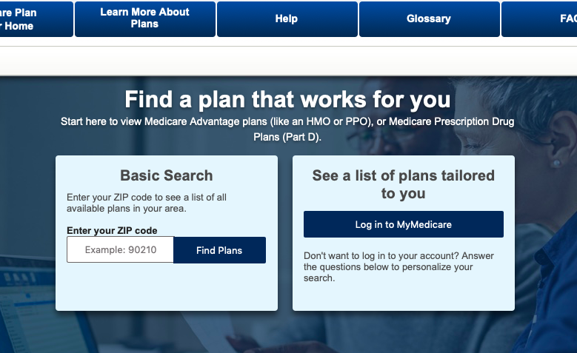

Where to Find Good Information
Medicare Plan Finder
www.medicare.gov
Senior Health Insurance Program/”SHIP”
www.illinois.gov/aging/ship
800-252-8966
Notes:
PRESENTER: INSERT A LINK FOR YOUR LOCAL SHIP WEBSITE (OR OTHER SIMILAR RESOURCES IN YOUR AREA) WITH CONTACT INFO. YOU MAY WANT TO WARN THAT, THOUGH THE SERVICES ARE FREE, APPOINTMENT SPOTS TEND TO FILL UP QUICKLY. IF YOU FEEL QUALIIIED TO HELP WITH RE-ENROLLMENT DECISIONS, YOU MAY WANT TO MENTION HERE THAT THIS IS A SERVICE THAT YOU/ YOUR BUSINESS OFFERS.
CHECK OUT BOOMER BENEFITS, AN EXAMPLE OF AN ONLINE BROKER. (https://boomerbenefits.com).
SHARE IF YOU FEEL COMFORTABLE DOING SO BUT YOU MAY WANT TO MENTION THAT YOU DON’T ENDORSE.

Slide 40

Let’s Talk! Questions? Ideas?

Slide 41

Thank you!
INSERT YOUR HEADSHOT, NAME, TITLE CREDENTIALS, COMPANY INFO, CONTACT INFO IN THIS SPACE
If this information was helpful to you, kindly spread the word about today’s presentation with your friends.
I speak on many other health care topics, too!
(In person or ZOOM!)
Just call or drop a note!

