Slide 1





Name of Group/Organization
Date
Your Name
Company
A Safe & Sound Hospital Stay: How to Get the Care You Want for the People You Love
Welcome!
Notes:
FILL IN GREEN and PURPLE BOXES.

Slide 2
Insert Your Photo Here
Welcome!
Thank you for coming!
Your Name, Credentials
Your Title
The Care Partner Project Community Educator
Your Company
Your Website
Your Phone Number
Thank you to our hosts for bringing us together today!
Host Name
Organization
Event Name
Date
Notes:
PRESENTER: INSERT YOUR INFO AS INDICATED IN THE BLUE COLUMN. ADD HOST INFO IN THE RIGHT COLUMN. UPLOAD AND INSERT A GREAT PHOTO OF YOURSELF!

Slide 3

This Presentation was Brought to You by
The Care Partner Project (TheCarePartnerProject.org)
Notes:
The Care Partner Project is dedicated to helping you feel informed and confident as Care Partners to your loved ones. Simple downloadable checklists and grass roots community education are all designed to help “everyday” people know what to watch for and what to do to pitch in for their loved ones’ care. The Care Partner Project also has a fund to help provide professional patient advocates for patients who have no one in their lives to help them through a medical crisis and no other resources, such as good insurance or an income. The Fund provides help for a lot of homeless people and those with developmental challenges. I’m very proud to be a Community Educator for the Care Partner Project in our area!

Slide 4

Today’s Plan
How to get the care you want for the people you love, including yourself!
Overview of medical care
Why achieving the best care is not as simple as having the best facilities and brightest personnel
Quick tips and great resources
How you can make a big difference to the quality of care
Q&A – Let’s talk!

Slide 5
“Bring someone with you.”
Notes:
How many of you subscribe to conventional wisdom that patients should always bring someone with them to the hospital? How many of you believe in this or try to follow this rule of thumb?
Let’s think about this for a moment: How are any of us really prepared for this important role. To be that someone for those you love when they need you most? Nothing in life prepares us for this: no Brownie Badges or health classes in school, no college courses, no community education at all. We all have to figure it out as we go along, and sometimes, the people who are counting on us pay the price for the fact that we are expected to navigate in a foreign world where the experts we count on speak a foreign language. We’re here today to change that for you. When you leave, you will have the tools, questions to ask and insight and information to feel empowered and confident. Promise!

Slide 6

To all the world, you are
just one person.
But to one person,
you could
mean
the world.
Notes:
READ SLIDE. That “someone” who goes to the hospital with their loved ones truly does mean the world during a health care crisis. Whether it’s a friend, family member or professional advocate, we call these people Care Partners.
This sentiment is what guides our work. Every patient needs an informed and confident Care Partner to help them through a health care crisis.

Slide 7
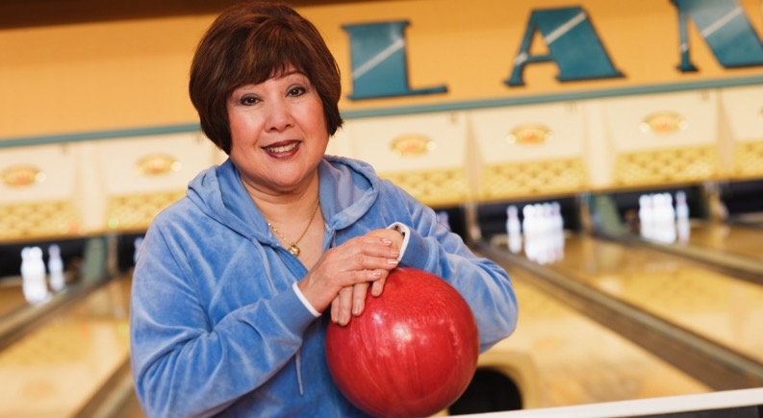
Sarah’s Story
Notes:
(OPTIONAL AS TIME PERMITS.) READ SARAH’S STORY.

Slide 8

1 in 4 Patients Needlessly Suffer from Preventable Medical Complications, often called “Never Events”
Notes:
Did you know that every year, there are about 36 million people who have a hospital stay. The average time they spend there is 3-1/2 days. During that time, patients are vulnerable to common cracks in hospital care known as Adverse Events, many of which are called “Never Events” because they are entirely preventable and should never happen to a patient.
(This 25% statistic comes from a Medicare study published early 2023, which analyzed hospital care experiences and outcomes during 2018 among those aged 65+. Though the data looks at the older population, similar studies haven’t been done among younger patient populations, however, we can assume that younger are also affected: care is not delivered differently by age group! https://oig.hhs.gov/oei/reports/OEI-06-18-00400.asp)
Everyone seems to have a “hospital story” and many chalk it up to bad luck, however, as the numbers show, despite everyone’s best intentions, about 9 million people are harmed by accident during hospital stays every year. Most of these are from hospital- acquired conditions called….(next slide)

Slide 9

MRSA, C diff (staph) Falls
Blood Clots Sepsis/Blood infection
Medication Mix-ups Bed Sores
Urinary Tract Infection Pneumonia
Notes:
Never Events, because they should NEVER happen to you or someone you love. READ LIST: These are the most common and preventable hospital hazards for patients.
The Care Partner Project offers checklists you can download free of charge for all of these Never Events. They list what to watch for, what to do, what to say, and when to get a nurse to help prevent all of these complications, which can be deadly.

Slide 10

Why?

Slide 11
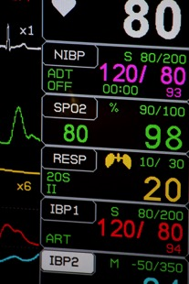


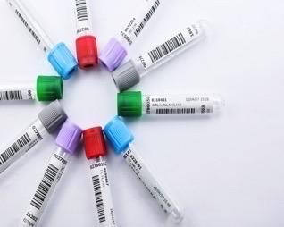


Health Care is Complicated
Notes:
Many factors. But today we are going to focus on preventing the preventable – those Never Events that don’t require a medical degree to prevent. Just a little info, motivation and simple To-Do’s.
Health care is complicated. Overwhelming. Scary.
What are you feeling right now? I promise, you’ll feel a lot more confident when you leave here today!

Slide 12

Stressed. Strained.
Frazzled.
Sleep deprived.
Notes:
This goes for nurses, too. The entire system was taxed before Covid, and you’ve heard all the stories since. It should come as no surprise that nurses are leaving the profession in droves. but you will be happy to know that applications to nursing and medical schools are way up. Currently, we are in a pinch point though, it will take years for those applicants to achieve full medical proficiency

Slide 13
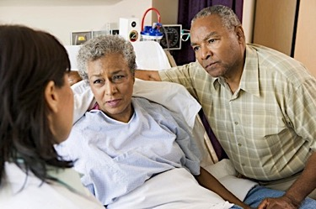
Patients Forget 40 - 80% of What They Hear
(which is completely normal)
Notes:
Medical care can be stressful. In hospitals, patients receive medications, are out of their normal routine, in unfamiliar surroundings, dealing with serious illness and a multitude of care providers. No wonder patients forget 40-80% of what they hear - https://www.ncbi.nlm.nih.gov/pmc/articles/PMC539473/ Patients' memory for medical information , Roy Kessels, PhD, J R Soc Med. 2003 May; 96(5): 219–222.
There is no better reason to have a Care Partner by your side for every hospital stay. There is no better reason to be a Care Partner to someone you love who’s in the hospital.
Such lapses in memory are perfectly normal. Stress, unfamiliar surroundings, and the effects of illness and medications take a toll on learning and memory. It’s just human nature.
Family members and friends who sit bedside, can be an extra pair of eyes, ears and hands to listen and take notes for their loved ones.
It helps to feel feel useful. Patients have peace of mind knowing that someone is capturing important details for them.

Slide 14

3-out-of-4 patients, age 65+, leave the hospital with an incorrect prescription or no understanding of their medication schedule to follow at home.
Notes:
A few years ago, a study at Yale confirmed that medication management at home is a mess! And especially so in the older population, which tends to have more meds to manage with little-to-no help.
The Care Partner Project offers a free checklist to help you know how to prevent medication mix-ups, which are so very dangerous.
PRESENTER: Background Info about the Yale study
Informed and involved family-member Care Partners can help loved ones take their medications safely.
Yale New Haven study by Dr. Leora Horwitz of patients aged 64+ with heart failure, acute coronary syndrome or pneumonia, December 2012.
http://www.nhregister.com/news/article/Yale-study-Medication-errors-confusion-common-11539028.php
Yale Study - As a researcher, Horwitz can now quantify those lapses. A recent study she led looked at 377 patients at Yale-New Haven Hospital, ages 64 and older, who had been admitted with heart failure, acute coronary syndrome or pneumonia, then discharged to home. Of that group, 307 patients - 81 percent -- either experienced a provider error in their discharge medications or had no understanding of at least one intended medication change.
The findings that three out of four patients are going home with the wrong prescriptions or a lack of knowledge about their medications come as hospitals grapple with high readmission rates, and as adverse drug reactions post-discharge are exceedingly common.

Slide 15


Too Many Round Trips!
Notes:
About 1-in-5 patients, on average, is back in the hospital within 30 days.
Why? Many common reasons include…
Can’t get to follow-up doctor appointments
Can’t get prescriptions filled
Take medications incorrectly
Leave the hospital with an infection brewing and don’t know the early warning signs or common symptoms, so don’t get treatment early
Don’t know, or ignore/minimize, early warning signs of other common post-stay complications (i.e. blood clots)
Don’t know, or ignore/minimize, early warning signs for complications related to their condition, especially those for congestive heart failure.
About 19% of hospital patients are back again within 30 days, about a third of those due to medication issues. Patients need Care Partners to stay on the job after going home because no one is 100% when discharged. Getting help managing meds, getting to follow-up dr. appointments, arranging any rehab and getting to it are still usually needed and is extremely hard to manage solo.
PRESENTER NOTE: Hospital readmissions appear to have gone down since 2012 when Medicare initiated value-base reimbursements and started collecting more detailed readmission data. At that time, the readmission range was about 20-30%, and now, it is approx. 14-19% and readmission data varies by age, ethnicity, health care issue and quality of hospital. https://www.cms.gov/files/document/impact-readmissions-reduction-initiatives-report.pdf

Slide 16

Solutions and Tips

Slide 17

We cannot solve our problems with the same thinking we used when we created them.
- Albert Einstein
Notes:
The idea of preparing for medical care is pretty foreign, but lack of preparation is why we may feel so helpless, out of place and intimidated by the health care system when we show up for our loved one’s in the hospital. Knowing that we can be the extra pair of eyes, ears and hands to support their care in a meaningful way is a game-changer and one that’s overdue. Its good for patients and their providers when ”all hands are on deck” for patients who can focus their energies on recovery. As you will learn today, we don’t have to be an Einstein to safeguard our loved ones’ care. We just need to pay attention to a lot of little details that can add up to best-case care.

Slide 18
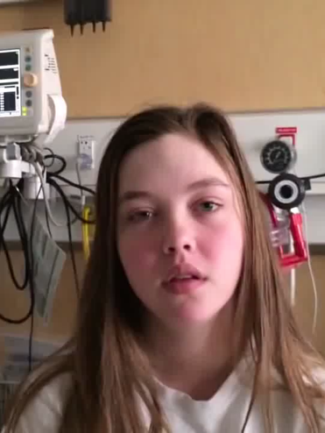
“I am the patient and I need to be heard!”
Morgan Gleeson
Age 15
www.youtube.com/watch?v=iVt3eHAsdK4
Notes:
Morgan represents the new thinking in health care: it’s my body, my care, I deserve to be informed. I deserve to be heard. I am a partner in my own care.
Many care providers are on board and collaborate with their patients and their Care Partners, but not all. It helps to have a more collaborative tone than Morgan! (But clearly, she is frustrated and that’s natural given all she’s been through.)
It’s OK to assume your rights to be heard, to have your wishes understood, to have full information in plain language, to know your care options.

Slide 19
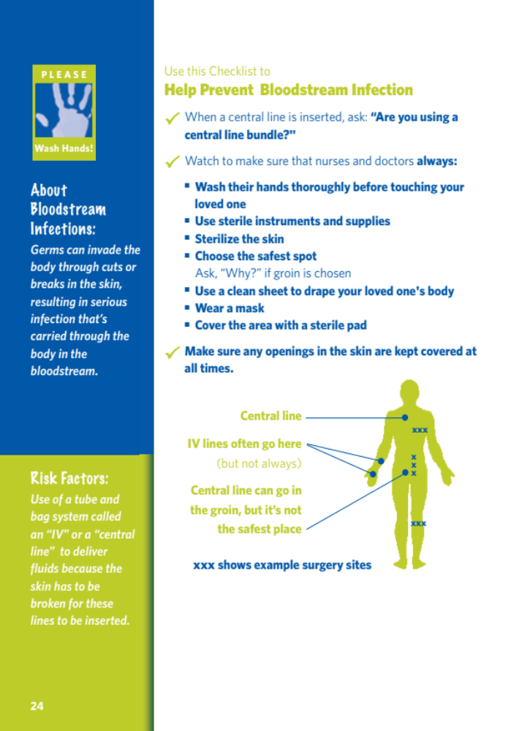

For any hospital or surgery care, bring your Care Partner checklists!
What to Look For
What to Say
What to Do
When to get a nurse
Peace of Mind!
www.TheCarePartnerProject.org
Notes:
This is an example of a Care Partner Project checklist.
Nothing in life really prepares us to manage or navigate health care. For quick “on-the-job” training, the Care Partner Project offers lots of free checklists to inform you of the key info you need to feel confident and comfortable in your role as your loved ones’ advocates – their Care Partners.

Slide 20

Find the Best
Hospital and Doctor
Check out their ratings!
HospitalSafetyGrade.org
HospitalCompare.gov
Notes:
We recommend looking at both sites as they have different kinds of ratings. You will need to sort through both of them and draw your own conclusions.
Word-of-mouth from friends, neighbors, etc. count, too. If you know nurses in your community, ask them – they have a wealth of knowledge and insight.

Slide 21

For Every Diagnosis or Surgery Recommendation
Get an Independent 2nd Opinion
Learn questions to ask at
TheCarePartnerProject.org
Notes:
When surveyed, 99% of doctors say they don’t feel comfortable second guessing a colleagues' opinion. That’s why it is SO important to seek out a doctor from another practice, and ideally, one in a different area. Every doctor develops a reputation and nurses, especially, know those reputations. Bedside manner may not be as important as the surgeon’s success rate, but ideally, you will get both! In all cases, consider only board certified doctors and try to investigate their history of malpractice claims against them. These records are hard to find as state laws vary.
INSERT ANY TIPS YOU HAVE ABOUT VETTING DOCTORS HERE, FOR EXAMPLE, HOW YOU APPROACH IT AS A PROFESSIONAL PATIENT ADVOCATE.

Slide 22






When interviewing surgeons, ask…
Use a Checklist?
Introduce yourselves?
Doing another surgery in the hospital same time?
Going on vacation?
Will you perform, or with others?
How many of these have you done?
See more: TheCarePartnerProject.org
Notes:
Why these questions when interviewing a surgeon?
Surgeons who use checklists have better outcomes ((http://www.healthcarebusinesstech.com/checklists-surgery/ )
Surgeons who take a time-out to make sure everyone involved in the surgery knows each other by name and what they do also have better outcomes (https://www.beckershospitalreview.com/quality/5-takeaways-for-surgical-time-out-success.html)
In teaching hospitals especially, the surgeon may turn over the surgery to a student, resident or intern. You deserve to know who’s performing the surgery and if you are uncomfortable for any reason with the answer you receive, you have the right to be part of the final decision about who’s doing your surgery.
Some doctors are now scheduling multiple surgeries at the same time, going back and forth between two patients. There are mixed reviews of this, but at the very least, the patient is entitled to know.
It’s good to know if the doctor is planning to take a vacation just after your surgery in case of an emergency or any other concerns about follow-up. May have the option to reschedule for a time when the doctor will be available post-surgery.

Slide 23


Take Good Notes!
Notes:
A significant challenge in working with doctors and managing a hospital stay is ensuring and tracking complete, accurate information. Another challenge is making sure that everyone is literally on the same page with the same information -- all caregivers, the patient and family. You’d be surprised by how incomplete and inaccurate medical records can be.! One practical, simple solution is to bring a good old fashioned notebook and a supply of pens.
Take notes…
Jot questions to remember to ask (and the answers you get)
List loved ones’ goals, concerns and questions to share with doctors and nurses
Keep a record of all medications prescribed, given and stopped
Note tests and why they’re needed, what’s learned from each, and next steps
Make lists and notes of supplies needed at home post-discharge
Organize helpers for home care after discharge. Make notes.. Who is going to do what?

Slide 24

Ask:
“What is the
Plan of Care Today?”
Goals?
Meds to Start? Stop?
Test Results?
Tests Scheduled?
Share:
Patient’s Goals
Patient’s Questions
Patient’s Concerns
Notes:
These are the critical questions to ask every day and the answers you get will come in handy during follow-up doctor appointments. Hospital records can take up to 30 days to get to patient’s doctors, yet patients are urged to have follow-up doctor appointments within about 10 days of discharge.

Slide 25

Keep Track of
“Who’s Who” and
What They Do
Notes:
Patients see so many docs and other kinds of caregivers (i.e. physical therapy). Try to get a business card from each. Use your notebook to keep track of everyone and what their area of care is (i.e.. pulmonologist/lung doctor).

Slide 26
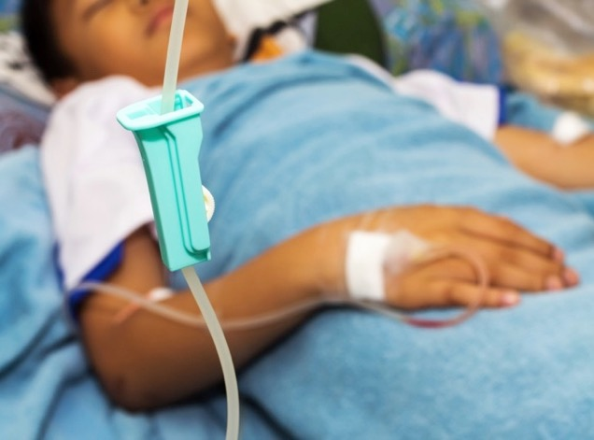

Sweat Every Detail of Every Medicine
MedlinePlus.gov
The Beers List (for seniors)
The KIDs List
Notes:
Again, take notes. Look up every medication given to your loved one in online drug directories – Drugs.com, for example. Know side effects and interactions to watch for. If your loved one is over the age of 65, make sure you have a copy of the Beers list of medications, which is available online. We metabolize medication differently as we age, and since our health care system is not flush with gerontologists, some doctors may not be aware of the medications on the Beers list that are “red flagged” for older adults. It’s good to read about this list before you ever need it – just Google The Beers List, or go to ISMP.org (Institute for Safe Medicine Practices) for more info and the complete list.
Be aware, too, that “meds” come in many forms – liquid, through a tube, pill, patch, creams.
It’s critical to know if your loved one is allergic to any meds, as well as those they take on a regular basis, including any drugstore meds they get without a prescription, any herbs or vitamins, and any recreational drugs (no one will judge) taken recently.
If your loved one is a recovering alcoholic, it’s important to share that info, too.

Slide 27

Keep Track of “Meds”
The 5 “Rights” to Prevent Med Mix-ups
Right Patient?
Right Drug?
Right Dose?
Right Time?
Right Route?
Learn more: TheCarePartnerProject.org
©The Care Partner Project 2023
Notes:
These are the details to track every time a medication is given. Make sure that the nurse checks your loved one’s wristband and verifies his/her name out loud to confirm “right patient.” By the way, sometimes patients become really annoyed when nurses check their name bands and ask the patient to say their name multiple times per day. They are not forgetful or uncaring – just the opposite. This is a patient safety measure drilled into the hospital routine.
Never interrupt a nurse giving a medication unless you sense a mistake is being made.
The Care Partner Project has a great checklist to help you prevent medication mix-ups.

Slide 28
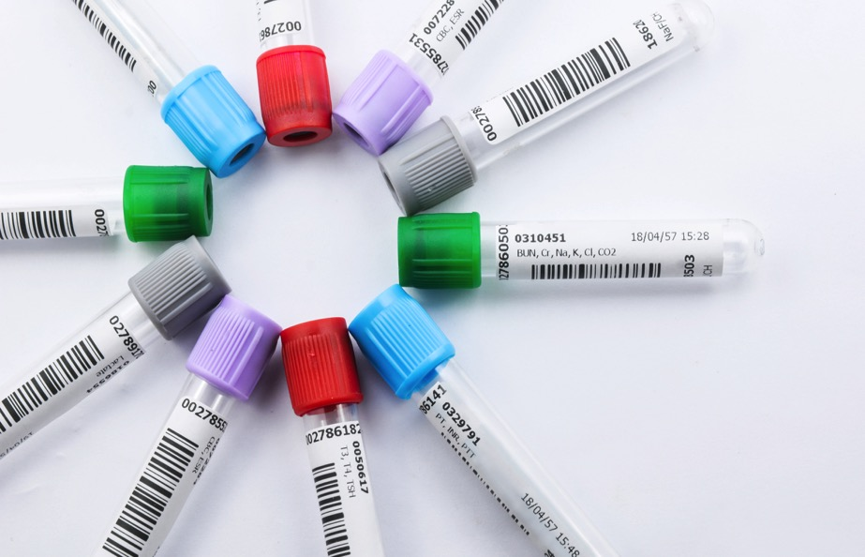
Keep Track of Tests and
Test Results
©The Care Partner Project 2023
Notes:
There are lots of different types of tests! Blood and urine, MRI, x-ray, CAT scans, just to name the most common.
In your notebook, keep track of …
Test name
Who ordered?
Why? To find out….?
How will results be used?
When to be administered?
When results will be ready?
When patient will hear results? By whom?

Slide 29
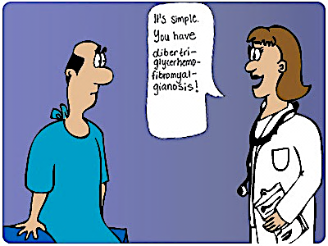
Huh?
Notes:
Huh? Very common! Often patients are embarrassed to admit they don’t understand what their doctors and nurses are saying. Medical jargon is NOT easy and there is NO WAY you should be expected to pick it up.
Expect your docs and nurses to speak to your loved one and you in simple, everyday terms. If they don’t just ask them to translate. Keep asking as necessary. They are a wealth of information and their care is too important to give in to the temptation to just nod along as they share important information in a completely foreign language.
Keep speaking up to ask for words in “plain terms” until you are satisfied you haven’t missed anything. And don’t forget to take good notes!

Slide 30

Trust …. but Verify
Notes:
READ HEADLINE, TRUST, BUT VERIFY. You are not second guessing your care providers, nor insulting them to research health care issues and questions or look for additional information about the topics they cover with you and your loved one. It’s prudent to learn as much as you can but be sure to use only qualified government and association sites.
PRESENTER: May want to share https://medlineplus.gov/healthywebsurfing.html -MedlinePlus Guide to Healthy Web Surfing is a good resource for this topic.

Slide 31

Get Friendly with the Hospitalist
Notes:
Hospitalist is a new term for many. It’s the person in charge of all care for patients in the hospital. He or she takes over for the patient’s main doctor, who may know the patient and medical history better. It’s important to speak up and make sure the hospitalist has clear, accurate records.
A typical hospitalist covers care for about 23 patients at a time, which is a heavy load. You’ll want to make sure the hospitalist knows your loved one well.

Slide 32

Wash Hands!
Make Sure Everyone Else Does, Too!
(Even nurses & docs!)
Learn more about how you can wipe out deadly infections at…
TheCarePartnerProject.org
Notes:
The #1 way to prevent infection is keeping hands clean. No one should touch a patient without washing their hands first. It’s easy to ask a 3 year old to wash their hands. Much harder to ask an adult – much less a doctor or nurse, but you must. A polite, but firm request is completely OK. However, if you get an argument, or push back, don’t hesitate to take it up with the medical director. If a nurse gives you a hard time, you can also ask that that nurse be assigned to a different patient. Again, uncomfortable, but also crucial to help make sure your loved one does not pick up deadly MRSA, C Diff or other infections. Google them! You’ll become a believer!
Surprisingly, doctors skip this step about half the time. It’s up to you to remind them… as hard as that may be.
Infections like MRSA, VRE and C diff kill about 100,000 patients a year and over 700,000 become infected.
Your Care Partner Project checklists offer more info and tips for preventing these deadly infections.

Slide 33
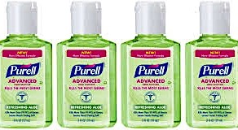
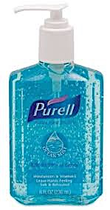
Stock up! Put in easy reach
Bedside table
Tray table
Bathroom sink
Notes:
In most patient rooms, the soap and foam dispensers are near the door. (Very weird!) Patients need to keep their own hands clean, too. They can’t be expected to get out of bed to do this! Please bring a supply of antimicrobial cleansers for your loved one’s tray and bedside tables. Does not have to be Purell, but DO make sure it is a good brand name. Sorry… Dollar Store, “off-brand” could be hazardous.
Put antimicrobial foam or gel in EASY reach – on the bed tray, or even on the bed – where it will be easy to use, and share with anyone who comes near who has not washed their hands.

Slide 34


Quick Tip: Tools to Share (with Checklists)
Notes:
You can help your loved one escape common hospital infections, like MRSA, C diff, VRE, CRKP, and more. Did you know that alcohol wipes out MRSA but only bleach kills C. diff. The surfaces in every hospital room are home to both without super vigilant cleaning after every time they’re touched! Use the The Care Partner Project checklist for more info about this topic and where germs most likely lurk.
These germs can attack anyone with deadly force – even in the very best hospitals. Superbugs are everywhere!
Ask for antibacterial surface wipes and hand cleansers for every room. Alcohol wipes kill staff bugs, and bleach wipes kill C. diff.
Wear disposable gloves and remember the “rule of ones”….
One wipe
One side
One surface
One direction.
Your Care Partner Project checklists have more good info, too.

Slide 35


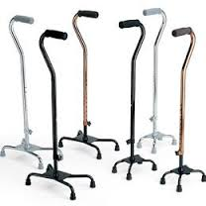
Pick up more tips for preventing falls at TheCarePartnerProject.org
Notes:
Every patient is at risk for a fall. Another practical solution with simple tools: ask for a 3-prong cane and non-skid socks. Make sure the call button works and is in easy reach. The Care Partner Project offers a great Fall Prevention checklist.
You’ll see more good tips for preventing falls on your Care Partner Project checklist.

Slide 36

Safeguard Sleep… but Speak Up for Alarms!
Bring
Bring ear plugs & eye mask for your loved one to use.
Manage
Manage visitors to permit rest, caution to be quiet (be considerate of other patients!)
Get Help
Get a nurse when an alarm goes off on monitors or pumps.
Learn more about “Alarm Fatigue”: TheCarePartnerProject.org/TIPS
Notes:
Alarm fatigue is a very real problem. It refers to times when we tune out noises in order to focus on a task at hand. On busy hospital units, nurses and docs do this, too.
Here’s a true story about Care Partner Project founder, Karen Curtiss, whose friend, TJ underwent minor outpatient hernia repair His wife, Marie, a nurse, was told it would be OK to leave and run a few errands while he gradually came out of the anesthesia. When she returned 2 hours later, he was brain dead. While still unconscious, he had vomited from the anesthesia -- a fairly common reaction -- and choked.
It takes 2 minutes for someone to die from choking – the alarms monitoring his oxygen and heart rates would have been ringing madly for 2 minutes, but no one responded.
As Karen tells it: ”Our wonderful, warm, funny friend had just turned 50 and he and Marie were so excited about celebrating their 25th wedding anniversary renewing their vows on the beach in Mexico. Instead, we gathered to bury him.”

Slide 37
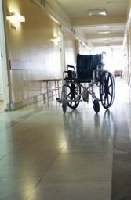
Prepare for
Watchful Weekends
Try to schedule non-emergency surgeries on Tuesday or Wednesday so likely to be discharged by Friday.
If a weekend stay is needed, consult with all docs about any potential problems to watch for.
Get all doctors’ contact info.
Arrange 24/7 Care Partner (family/friend) coverage at hospital.
Make sure everyone has Care Partner Project guides and will take notes.
Notes:
Staffing is not as full on weekends, and typically, senior staff get to take weekends off. It’s very quiet and so important that your loved one has 24/7 Care Partner support.

Slide 38
Loved one ”going downhill?”
Medical staff not responding – or, just not around?
Call the “HOSPITAL 911”
Dial ”0”/Operator on the hospital land line
Say: I am calling a Condition Help and need a Rapid Response Team
Give the room number and patient’s name.
Notes:
If you ever have a gut feeling that something just doesn’t feel right, esp. if you feel your loved one may be “going downhill” and your doctors and nurses aren’t paying attention to your concerns or your loved one’s worries, you can actually call the equivalent of 911 in the hospital: Here’s what you do GO TO NEXT SLIDE.

Slide 39

Ask for Tests! Get to the Root Cause! New/Sudden Onset of Mental Confusion
(Or, a dramatic increase in pre-existing confusion)
Could be…
Staph infection
Urinary tract infection
Medication side effect
Overdose of a narcotic drug
Drug interactions
Sometimes confusion results from too much time spent in the hospital room -- a sense of feeling “boxed in” causes hospital delirium.
Notes:
Too often confusion shown by patients in the hospital is chalked up to dementia – even when the patient is admitted with a mind that’s sharp as a tack. But only the family and close friends may know that. Confusion can signal a lot of other serious problems, namely hospital infections, medication side effects and more. Or maybe, the patient took a fall and got up on their own and the staff didn’t know. So… ask for blood and urine, question about falls, possibly ask for a neurology consultation.

Slide 40

Take the Time You Need at Discharge
Ask all the questions on your mind. Take Notes!
©The Care Partner Project 2023
Notes:
The discharge process can be hurried. Beforehand, make a list of all your loved one’s daily living and medical needs. This is not the time to go to the parking lot to get the car! Be part of the discharge conversation. Take notes. Ask questions. Find out who to call if you or your loved one have questions later. Ask for a list of things to watch for as early warning signs of potential problems. (GIVE SOME EXAMPLES. IE. SOMEONE SUFFERING FROM CONGESTIVE HEART FAILURE WILL NEED TO BE WEIGHED EVERY DAY. CAN THE PATIENT BALANCE ON A SCALE? DOES THE PATIENT HAVE A SCALE AT HOME. IF “NO” TO EITHER, NEED TO PLAN AHEAD.)
The discharge person can and should offer resources for post-discharge care, such as a referral to a wound care specialist, in-home nursing support. Don’t be afraid to speak up and ask.
This is a good time to ask others to pitch in. Organize others, to help!
Take good notes. Ask: what should we watch for? Call or see your loved one every day for at least 30 days. Call a doctor for any problems or concerns that crop up.
The discharge nurse may not have all test results on hand. Make a list of those that need to be tracked down post-discharge.
Patients can leave the hospital with an infection or blood clot brewing, but not have any symptoms. Ask for a list of symptoms to watch for – for these problems and any other potential complications.

Slide 41

Record Discharge Instructions
Ask First
Explain:
“Everything you’re saying is important.”
“I don’t want to miss any details.”
“I want to review later to make sure I get everything right.”
“I don’t want to have to bother you later if I forget anything.”
Notes:
Ask if you can record discharge instructions or any other conversations you’d like to remember (sometimes it’s hard to keep up with note-taking!) If you get push-back, explain that you can’t keep up with notes and give your full attention to the important instructions you and your loved one are hearing. You and your loved one will have peace of mind knowing you can go back and review and make sure you are both fully complying with the instructions. This will reassure them that you are not out to sue, just out to get the best results from the hospital stay and not end up making it a round trip!
Studies have shown that patients are less likely to end up back in the hospital when they have recordings of the discharge conversation they can listen to afterward.
Note that it is important to ask permission from the discharge nurse first, and helpful to explain why you want to record the conversation.
It’s great to have a record to go back to later.

Slide 42

Remember!
Check in with your loved one every day for at least a month after a hospital stay.
Watch and listen for…
Signs of setbacks in recovery
Help Get Medical Care
Notes:
Prevent a round trip! Get medical attention from your loved one’s doctors for any signs or symptoms of problems. No one wants to end up in an emergency room – or in the hospital, again!

Slide 43

It’s OK to Ask for Help!
www.LotsaHelpingHands.org
www.CaringBridge.org
Your friends and family
A professional advocate
Notes:
These sites offer free calendar planners you can create and share to organize family and friends to help support your loved one in the hospital, and for care at home afterward.
You can also post updates and others can send messages and photos to your loved one.
IF APPLICABLE: Professional advocate firms such as my own which can help patients and families with (INSERT SERVICES).

Slide 44

Support Your Nurses
They juggle a lot for several patients at once!
Ask: “What may I do to help?”
If able-bodied, help make the bed
“May I bring you a cup of coffee?”
Keep the room very tidy, uncluttered. Keep things off the floor to prevent trips!
Take your checklist guides from TheCarePartnerProject.org!
Many more great ideas and tips.
Notes:
25% of all times when a patient hits a call button to the nurses’ station, it’s for things like …”I can’t reach my glasses, can you get them for me?”, “May I have more ice?” “Would you raise the thermostat for me?” “I can’t get my favorite channel.”
This is where YOU can – and should -- happily pitch in to save the nurses’ time for real nursing care. If you are able-bodied, help make up the bed, get the ice and water, and extra blankets your loved one needs, keep the room neat, put clothes away.
Also, a tidy room helps prevent trips and falls!

Slide 45

Let’s Talk! Questions? Your Ideas?

Slide 46
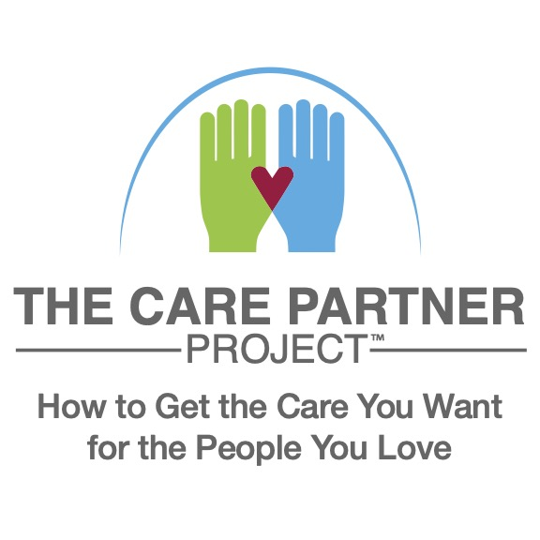
FREE guides with tips for getting good care
Join us on Facebook… more tips!
Sign up for our newsletter – even more tips!
www.TheCarePartnerProject.org

Slide 47

Thank you!
Presenter: Insert your headshot here.
Your Name Credentials
Company Name
Phone Number
Email
If this was helpful to you today, kindly spread the word about this presentation with your groups in our area.
I speak on other topics, as well – in person or on ZOOM. Just call or drop me a note!
Notes:
PRESENTER: INSERT YOUR HEADSHOT AND CONTACT INFO.

