Slide 1
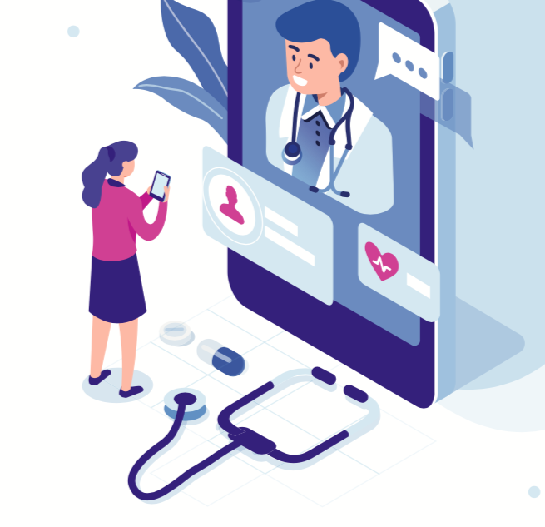
The Telehealth Trend
How to get great health care at your kitchen table!
The Care Partner Project ©2022

Slide 2
INSERT photo of presenter here
Welcome!
Thank you for
joining me today!
INSERT Presenter Name and credentials
INSERT Company Name
INSERT Email Address
INSERT Phone Number
Many thanks to our hosts!
INSERT: NAME HOSTS HERE
Notes:
PRESENTER: CUSTOMIZE THIS PAGE AS SHOWN

Slide 3
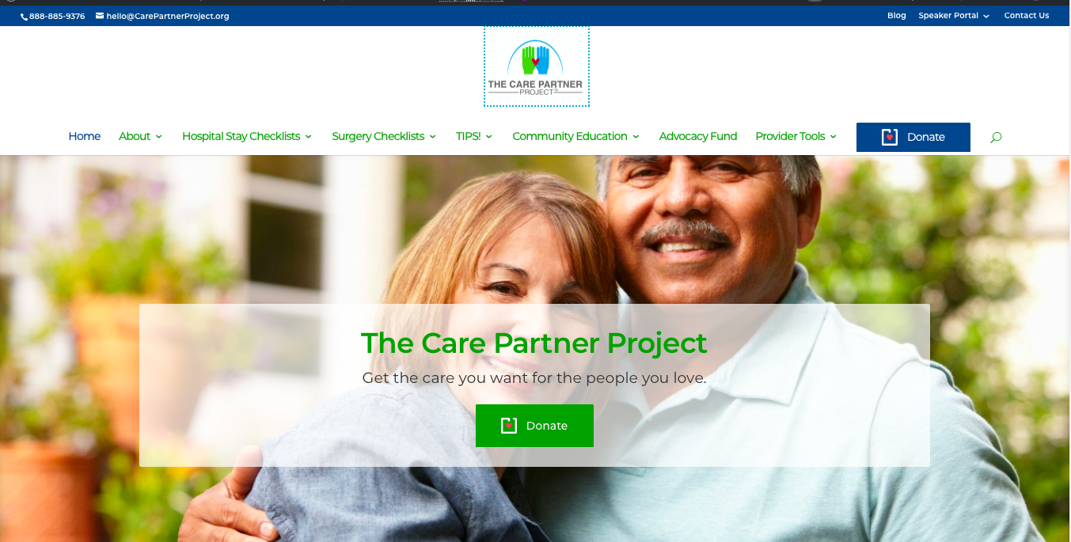
Brought to You by…
The Care Partner Project (TheCarePartnerProject.org)
Notes:
The Care Partner Project is dedicated to helping you feel informed and confident as Care Partners to your loved ones. Simple downloadable checklists and grass roots community education are all designed to help “everyday” people know what to watch for and what to do to pitch in for their loved ones’ care. The Care Partner Project also has a fund to help provide professional patient advocates for patients who have no one in their lives to help them through a medical crisis and no other resources, such as good insurance or an income. The Fund provides help for a lot of homeless people and those with developmental challenges. I’m very proud to be a Community Educator for the Care Partner Project in our area!

Slide 4

Today’s Plan: Next 30 Minutes Together
When you might want to have a telehealth meeting with your doctor and why
How to get the most out of every moment!
Then, we’ll talk! Your questions and ideas

Slide 5
NOT for everyone.
NOT for every purpose
X-rays, scans and blood work
Diagnoses that require a more hands-on approach.
If you have concerns about the security of personal health data
Insurance may not cover… check first!
Notes:
For example, your annual Medicare Wellness check could be done by telehealth because bloodwork isn’t part of the exam, but an annual physical probably requires an in-office meeting because blood tests are included.
On the 2nd point, your doctor will make this determination when you call to set up a meeting. It helps to be able to explain the reason for your need to meet with the doctor.

Slide 6

When you may want to meet your doctor from home!
You can get an appointment sooner via telehealth (common!)
You want to avoid contagious illnesses in a waiting room.
You want to avoid exposing others to germs you’re carrying!
You want to save time.
You want to see a doctor who’s out of your area…
  Possibly a specialist?
  2nd opinion?
Notes:
There are companies cropping up that offer virtual meetings with doctors for 2nd opinions. May want to keep that in mind if you ever have the need.

Slide 7
When you may want to meet your doctor from home!
May get an appointment sooner via telehealth (common!)
You want to avoid contagious illnesses in a waiting room.
You want to avoid exposing others to germs you’re carrying!
You want to save time.
You want to see a doctor who’s out of your area…
  Possibly a specialist?
  2nd opinion?
Notes:
There are companies cropping up that offer virtual meetings with doctors for 2nd opinions. May want to keep that in mind if you ever have the need.

Slide 8

Complete your HIPAA form
Allows doctor to talk with you when you have someone at your side
Health
Insurance
Portability and
Accountability
Act
Notes:
Forms are free to download at reputable sites. Be sure to send to your doctor’s office in advance.

Slide 9

Arrange for your Care Partner to join in
Side-by-side, or from a distance, 2 heads are better than1!
If your Care Partner can’t be at your side, ask the Dr.’s office if they can provide them with their own login.
Some Dr.’s offices don’t have the technology for multiple users, but…
There’s a SOLUTION!
Use Face Time or a speaker phone!

Slide 10
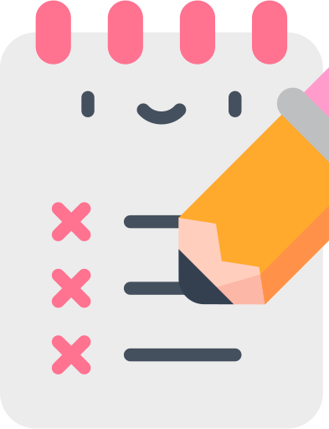
Prepare your agenda – in advance
Average length of time with doc = 15 minutes (Goes by fast!)
Make every minute count!
When you make the appointment, ask how long the doctor has allotted for your time together.
(if you need more time, it’s OK to ask.)
Write down your…
Goals for seeing the doctor
Questions
Concerns
Changes in your health
Share with your doctor and Care Partner
before your meeting.
Email to your Dr. or upload to your portal
Call the Dr. office to let them know you sent notes
Ask that your notes are delivered to your Dr. before you meet

Slide 11



Create a quiet “conference room”
Not a time to multi-task or let the dog out!
Have your supplies on hand
Your notebook, pen/pencil, especially if you are alone
Your medications, supplements, vitamins, herbs, any non-prescription drugs you take
Medical supplies you use:
Blood pressure cuff
Pulse oximeter
Thermometer
Notes:
Believe it or not, some patients have been known to participate while grocery shopping!

Slide 12
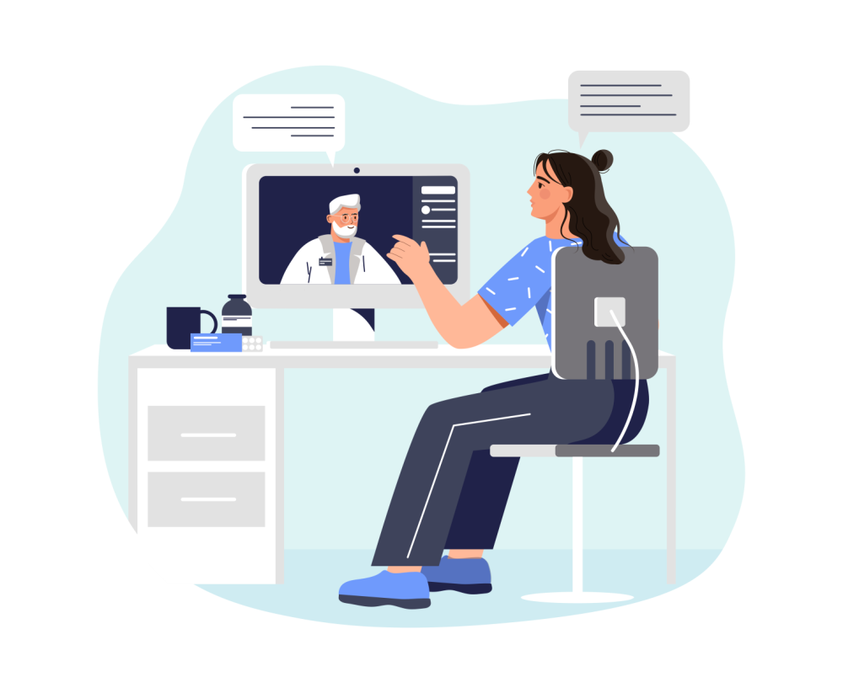
Test your computer, camera and sound
Figure on Murphy’s Law. Don’t wait until the last minute!
Test your camera and sound on your computer well before meeting your doctor.
Ask your doctor’s office for a link to their telehealth system to test it.
They will appreciate that you want to make sure you have a good connection.

Slide 13

Test your technology!
Just because it worked yesterday… (remember, Murphy!)
Be sure of your
internet connection!

Slide 14

Good lighting is key!
Show your natural self. It’s medical, not vanity!
Help your Doctor gauge your wellness
Try to sit in a spot with a window in front of you or at your side.
If a window isn't available, a lamp or overhead lights can also be used to give you better light.
Shades or drapes in the room? Try adjusting them with the lighting before meeting the doctor.
Goal: not too much light, not too little. Show yourself in the most natural way.
Notes:
.

Slide 15

Doctor running late?
DON’T log off! Continue waiting. Your turn will come!
When you schedule, allow for the possibility that your doctor may run late, so allow extra time.
Your doctor’s office will likely send messages online or by text to keep you posted on the doctor’s timing.
Try to be patient and understanding. It’s possible a patient before you had a complication and needed more time. That could be you someday!

Slide 16
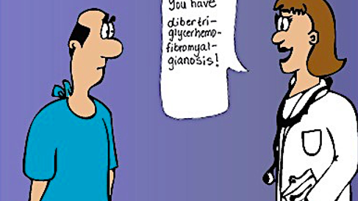
Speak Up for Plain Speak
You didn’t go to medical school! It’s OK to ask for “translation” for anything you don’t understand.
Notes:
People just tend to nod their heads and listen -- but leave feeling confused and no better informed about their own health and care! What would you say if your doctor seems to be “speaking Greek” to you? (AUDIENCE SUGGESTIONS.)

Slide 17
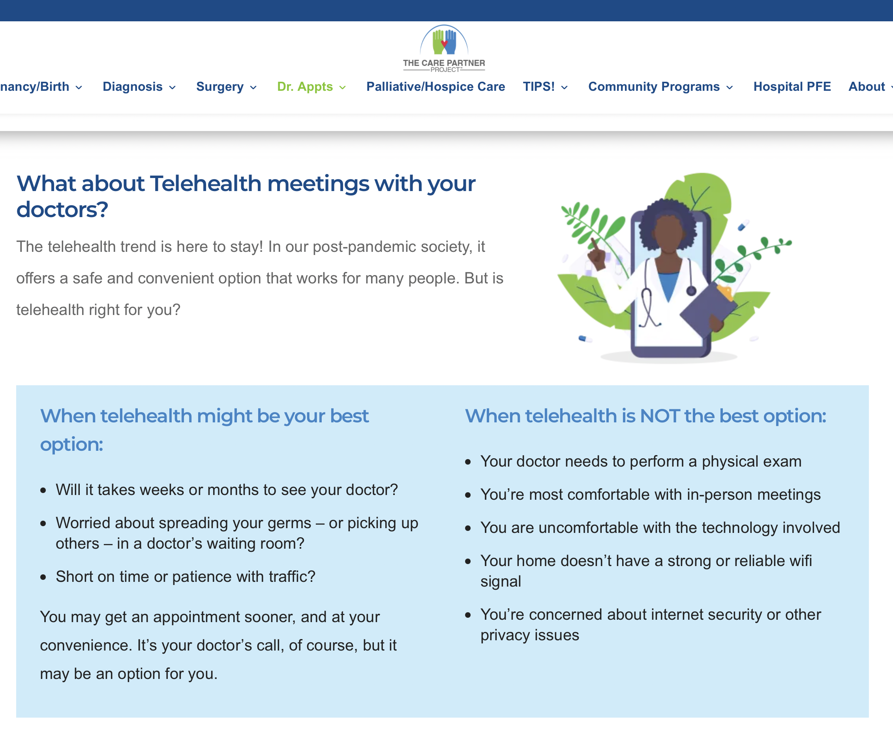
Notes:
You can find more information on managing your telehealth and in-office meetings with your doctors at TheCarePartnerProject.org. Look in the menu or search bar.

Slide 18

Let’s Talk! Questions? Your Ideas?

Slide 19

Thank you!
Presenter: Insert your headshot here.
If this presentation was helpful to you, kindly spread the word about today’s presentation with your groups in our area.
I speak on other topics, as well. (In person or on ZOOM!) Just call or drop me a note!
Your Name Credentials
Company Name
Phone Number
Email
Notes:
PRESENTER: INSERT YOUR HEADSHOT AND CONTACT INFO.

