Slide 1

Your Super Power Over Super Bugs!
(and when to get help)

Slide 2

Today:
Your Super Power over
Super Bugs
How infections are picked up in hospitals and your community (besides Covid)
Key facts that that aren’t well known – but are actually critical to know!
What to to do to prevent infections in hospital care and everyday life
How to spot an infection setting in
When to sound alarms!
Q & A!
Notes:
We are covering a lot today so, if you add your email address to the sign in sheet, I will email this presentation to you. I hope it will give you peace of mind to have these facts on hand.

Slide 3

We are talking about very bad bugs!
MRSA AKA staph or “staff” infection: a common SUPERBUG
VRE, Vancomycin Resistant Enterococcus, another SUPERBUG
C diff, Clostridium Difficile, caused when fecal bacteria (“Poop”) enter body by mouth
UTI, Urinary Tract Infection caused when bacteria enter the urinary tract system
VAP, Ventilator Associated Pneumonia caused when germs enter ventilator tubes
Notes:
PRESENTER: SUMMARIZE ONE KEY POINT ABOUT EACH. THESE ARE COVERED IN MORE DEPTH LATER IN THE PRESENTATION

Slide 4
What do they have in common?
All potentially deadly
Labor intensive to prevent – small details need attention
In health care settings, staff is stretched for time
But…PREVENTION is not rocket science!

Slide 5
Your Super Power over Superbugs!
You can save a life without 8 years of medical school.
Let’s get started!

Slide 6

Your Super Solutions Here!
www.TheCarePartnerProject.org
Notes:
I will email this presentation to you so you won’t need to take notes today. You can also get even more information here at The Care Partner Project, where you will see quick checklists of all the “”To-Do’s” to prevent infections – and much more – which you can download any time. Especially helpful for hospital stays where every patient is at risk for infection! These infections can be deadly and almost always result in extra days in the hospital.

Slide 7
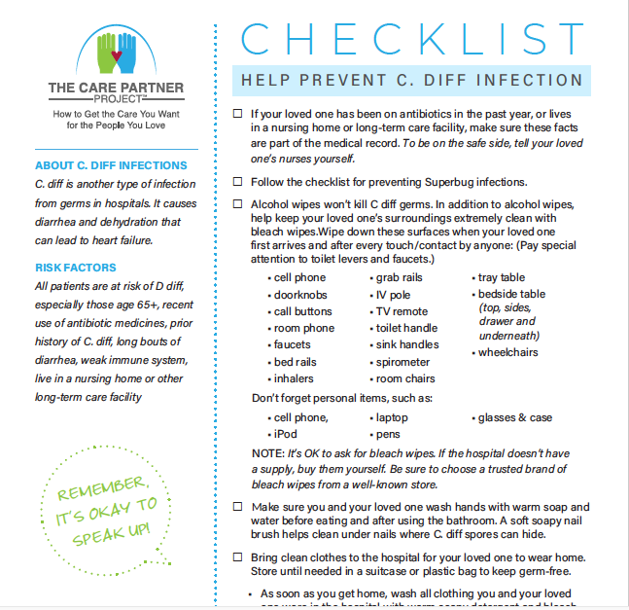
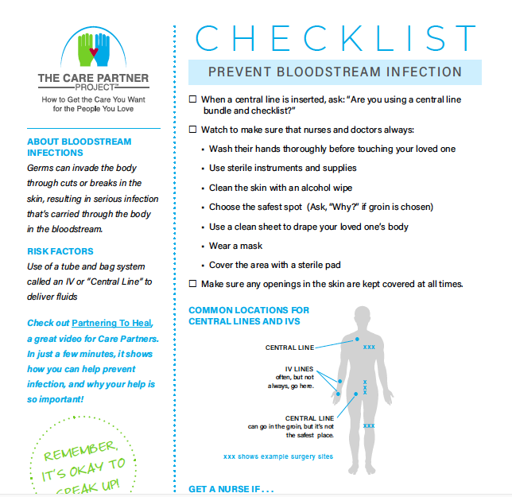
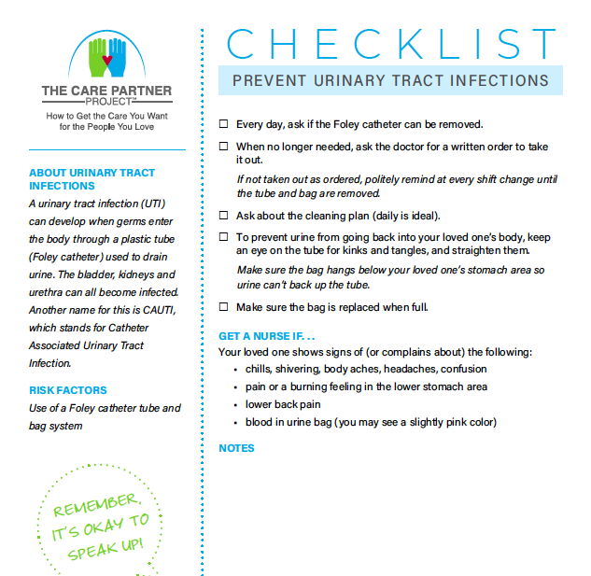
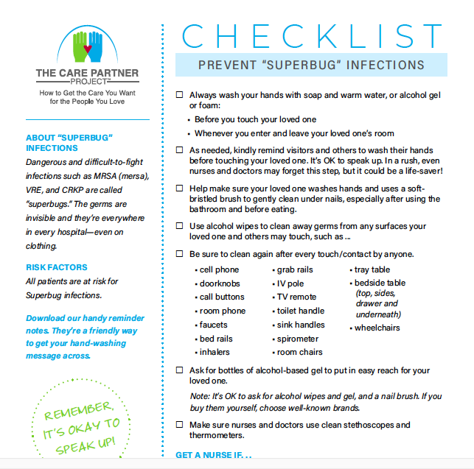
Free to download at www.TheCarePartnerProject.org
Notes:
These are some examples of the checklists you will see and can download at The Care Partner Project.

Slide 8
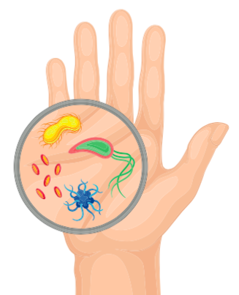
MRSA/VRE (Everywhere)
Notes:
One of the infections that took Bill’s life is the MRSA bug. It’s known as a Super Bug because it is resistant to many antibiotics, so hard to treat. VRE is a different bug, but also one of the ”Supers” because it does not respond even to Vancomycin, one of the very strongest antibiotics.

Slide 9
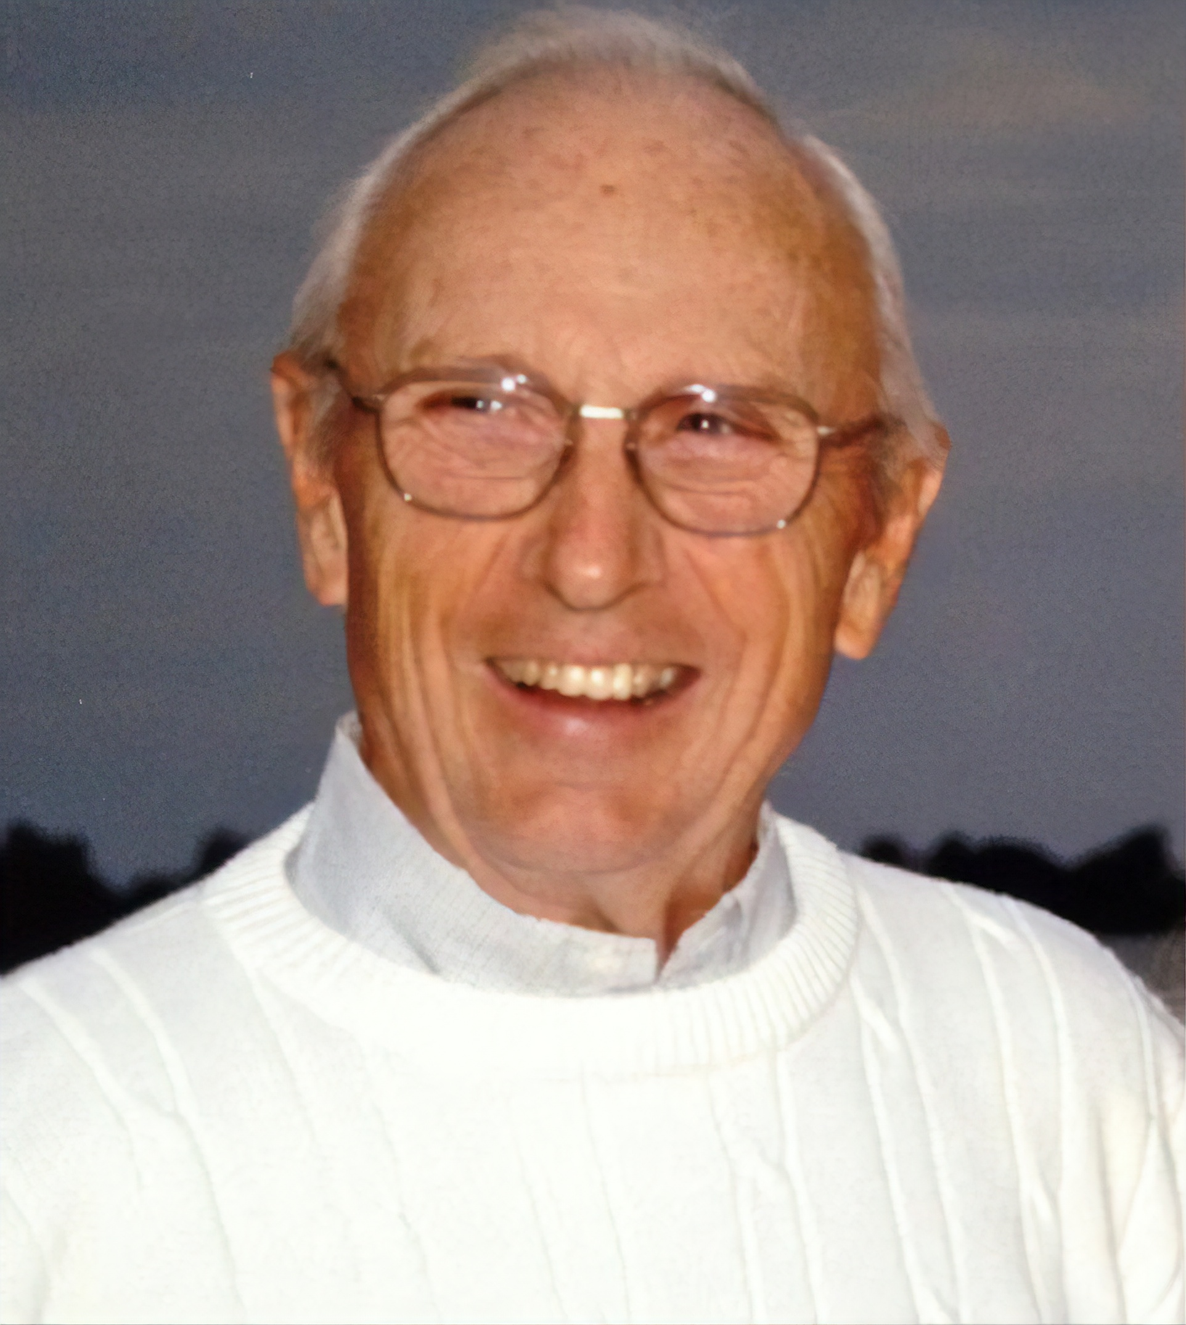
Bill Aydt
Successful lung transplant to cure pulmonary fibrosis
Fall
VAP
MRSA
C diff
DVT, PE to new lung
Stage 4 bed sore
MRSA – again
C diff – again
7 months post transplant, died from infections
Never left the hospital
Notes:
In Bill’s case, the stars lined up for him to receive a life saving lung transplant to cure Pulmonary Fibrosis, a rare terminal disease that doesn’t have any treatments or any other cure. Less than 1% of those with PF ever get the chance for a life-saving transplant, so it was especially tragic that he died from common and preventable hospital infections.
Bill is actually the reason why the Care Partner Project was started. Our founder was determined that no other patient would suffer a similar fate, and the best way to do that would be to help all the families who sit bedside in hospitals know what to do and say while they are there to help prevent common complications in hospital care that threaten patients’ lives.
As everyone knows, hospital staff is stretched and strained. When patients have Care Partners who know how to pitch in, patients’ care can be safer and better.

Slide 10
Key Facts for Preventing MRSA/VRE
Surface cleaning is just as important as hand-washing: alcohol-based cleansers work best
Hand cleansers: use 80%+ alcohol content to be effective. Soap & water are great.
MRSA bugs thrive on clothing & fabrics (hospital drapes!) Wash your own clothes after hospital visit
Gloving protects the health care worker, not the patient
70% of hospital MRSA infections show up after discharge
Surfaces must be cleaned after every touch.
Watch like a hawk & speak up for hand-washing! Train hospital visitors to do same.
Sound the Alarm
Report docs and nurses who don’t wash hands or argue with you about it to QI, CNO, CMO, CEO.
Notes:
PRESENTER: GO OVER THESE KEY FACTS, SUMMARIZE IN YOUR OWN WORDS.

Slide 11

Try the “The Twizzler Trade”
Getting eye rolls and arguments to your polite hand-washing requests?
Trade a Twizzler for a scrub-up!
Notes:
It’s easy to ask 3-year olds to wash their hands, but asking another adult, much less a nurse or doctor, can be daunting. But speak up you must because those germs are everywhere, even on clothing. Humor helps in lots of difficult situations, doesn’t it?
Bring Twizzlers as a little “bribe” or ”reward” – however you want to think of it, with your handwashing requests.
Who doesn’t love Twizzlers/!

Slide 12
Try the
“Soap Stopper” strategy
Line up bottles of antimicrobial hand gels/foams on the tray table and bedside table. Be quick to pass to clinicians before they touch your loved one, the patient. Clean cap and bottle with alcohol wipe after every use.
Wash your own hands before and after every touch, too.
Notes:
Bring a handful of antimicrobial hand cleansers to line up on your loved one’s bedside tray table. Think of them as little soldiers in the fight against superbugs. If you see anyone come near your loved one with out washing their hands first, simply hand them a cleanser!
Often you will see a nurse or doctor come into the room, put on fresh gloves and then touch some surface like a monitor or bed rail or even their stethoscope, and then try to touch the patient. Those gloves are infected! Gloves protect the wearer. Putting them on and then touching anything does nothing to protect the patient. It’s funny how training for hospital staff does not seem to plant this key concept very well in their staff.

Slide 13
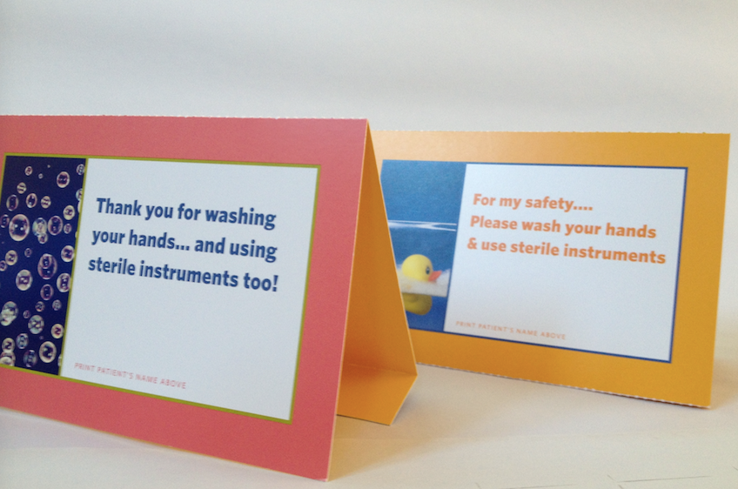
The “Paper Plea”
When you can’t be there, leave a sign to speak up for the patient.
Place on the tray table and hang over the bed.
Notes:
Another humorous strategy to promote hand hygiene is to my little signs and post them on the bed rail, trail table, over the head of your loved one’s bed. Paper, tape, markers are all the tools you need! (use painters tape or masking tape if you attach to walls). Let’s brainstorm a few little funny ways to ask!
PRESENTER: THIS IS A GOOD WAY TO GENERATE AUDIENCE INTERACTION AND CONVERSATION. YOU MAY WANT TO OFFER THE FIRST SUGGESTION: ”INFECTION IS NOT ON MY BUCKET LIST! PLEASE WASH UP!”

Slide 14

Be Aware of Community Spreaders
In your grocery store
Your favorite lunch place
Anywhere in public!
Sound the Alarm:
Report to their school: Dean level
Report to hospital: Infection preventionist, quality, CNO/CMO
Notes:
Every time you see a student or medical staff out and about in the community, you can gently remind them they are spreading hospital Superbugs around town, or you can leave it up to their supervisors or trainers. Please DO call, and follow up in writing, too. Then, just don’t sit at the table they just left at Panera! Get it wiped off too!

Slide 15

C Diff: Deadly gut punch
Notes:
C. diff is not your everyday case of diarrhea. It is unrelenting and vicious causing dehydration, which really puts all organs at risk but especially, the heart. What’s more, it is VERY hard to treat. One C. diff infection usually leads to another… and another. Some can only conquer it with a fecal transplant. The important thing to remember is that it CAN be prevented with attention and paying attention to small details. Another key point, treatments for MERSA and VRE infections with heavy duty antibiotics can actually cause C. diff because all the good and bad bacteria are knocked out of the gastrointestinal tract, which is where the immune system is supported. So, another good motivation for taking proactive steps to prevent ANY infection!

Slide 16

Karla Wilson
During her 4-day stay, Karla ate food in the hospital that she says, “didn’t agree with me.”
She experienced almost Immediate diarrhea that has lasted for 2 years and has lost over 200 pounds as a result.
Nothing has worked to stop diarrhea and now Karla is hoping for a fecal transplant.
Notes:
PRESENTER: READ RORY’S STORY. PLEASE GO TO ENDSEPSIS.ORG TO READ MORE ABOUT WHY A SEPSIS DIAGNOSIS WAS MISSED.

Slide 17
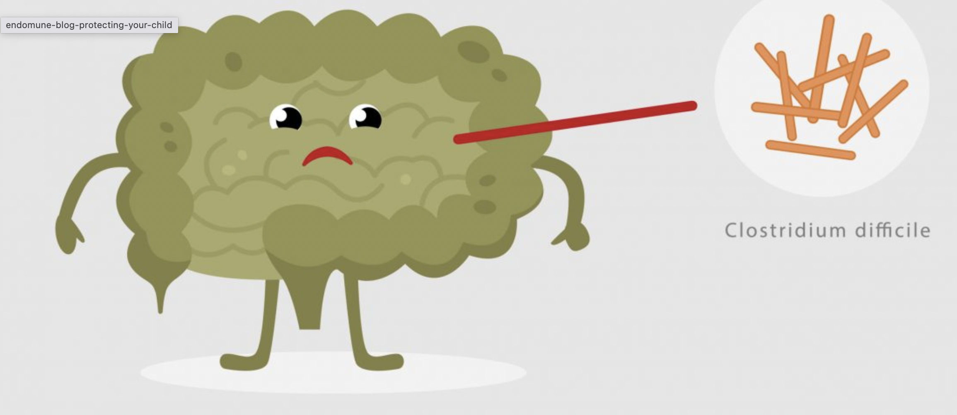
Key Facts for Preventing C diff
Surface cleaning, esp. in bathroom, is just as important as hand-washing.
Patient’s hands must be kept clean. Soapy washcloth works best.
Clean under the nails with a nail brush
Clean hands after every trip to the bathroom
C diff can't be killed by alcohol – Bring your bleach wipes!
Clean hands before every meal
Ask yourself: where can poop be picked up?
Not just human!
Sound the Alarm:
Any diarrhea.
Notes:
PRESENTER: GO OVER THESE KEY FACTS, SUMMARIZE IN YOUR OWN WORDS

Slide 18
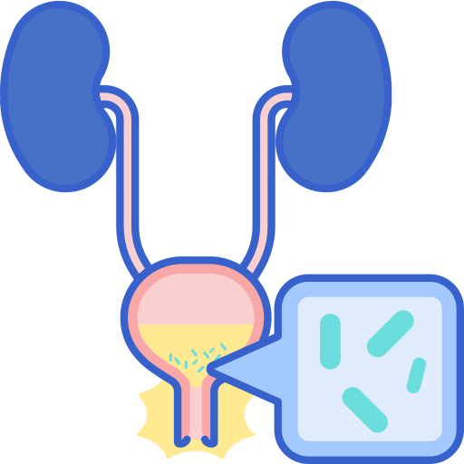
Urinary Tract Infection: Gender blind
Notes:
Urinary tract infections, or UTI’s as they are commonly known, and usually thought to be ”a women’s issue”, but as we age the bugs cross gender lines and men are susceptible as well.

Slide 19
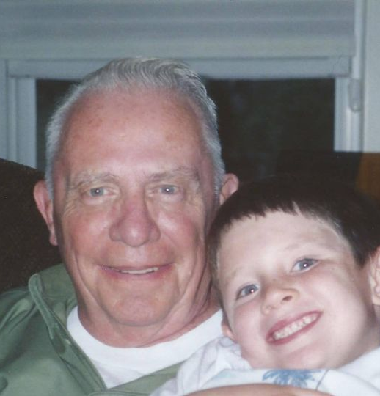
Frank O’Connor
Suffered Lewy-Body disease with early-stage memory decline
Lived in Independent Living community in New York
Daughter in Oregon received phone calls from Frank, increasingly confused and disoriented
From confusion, fell in bathroom, hit the sink, got up but did not how to call for help: died from head trauma with underlying condition – untreated urinary tract infection.
Notes:
PRESENTER: READ FRANK’S STORY.

Slide 20
Key Facts for Preventing UTI/CAUTI*
(In hospital) daily cleaning of catheter is necessary
When catheter no longer needed, make sure doc writes order. Stay on top of it!
Keep an eye on tubing to prevent kinks or tangles
Make sure bag is replaced when full
Stay hydrated with 8 glasses of water and/or cranberry juice daily
Avoid caffeine and empty bladder as soon as full
Check adult diapers every 2 hours
Keep area clean, wipe front to back
Ask: Is a Foley/catheter really necessary?
Ask daily: Is the catheter still necessary?
Sound the Alarm
Onset or increase in mental confusion
Chills, shivering, body aches,
Lower back pain, blood in urine bag
UTI = Urinary Tract Infection
CAUTI = Catheter Associated Urinary Tract Infection (when urine is drained using a tub and bag system)
Notes:
PRESENTER: GO OVER THESE KEY FACTS, SUMMARIZE IN YOUR OWN WORDS.

Slide 21
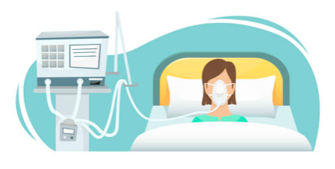
VAP/Ventilator Associated Pneumonia: Not just Covid crisis
Notes:
Covid taught all of us about ventilators, but we didn’t learn too much about why they are risky. The tubes provide a direct pathway to the lungs! These can be germ highways and cause pneumonia, a dangerous infection for anyone, but especially so for someone who is medically fragile, depending on a ventilator to help them breathe.

Slide 22
Key Facts for Preventing VAP (Ventilator Associated Pneumonia)
Oral care is super important to remove bacteria: teeth, gums & tongue
Ask about stomach lying vs. bed angle (new learning from Covid)
Ask about medication to prevent stomach ulcers (from vent)
Some patients are put in hand restraints to keep from pulling vent tubing out – very scary
Ask about the bed angle (30 degrees)
Ask daily: Is ventilator still needed? Ask for a daily test of ability to breathe independently.
Sound the Alarm:
Cough with green or yellow phlegm
Chills, shivering, body aches, confusion
Increased need to suction to remove fluids
Panic attack (if restrained)
Notes:
PRESENTER: GO OVER THESE KEY FACTS, SUMMARIZE IN YOUR OWN WORDS.

Slide 23

“I feel like I’m dying.”
Notes:
Sepsis is truly an emergency when every second counts and it can creep into the body in teeny, tiny breaks in the skin.

Slide 24
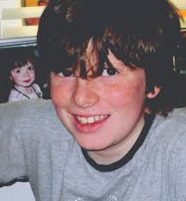
Rory Staunton
On Wednesday March 28, 2012, Rory dived for a ball during gym class at the Garden School in Jackson Heights, NY, and cut his arm. The gym teacher did not send him to the nurse who was on duty in her office, but instead, applied two band aids. He did not clean Rory’s wound.
Sepsis took Rory’s life 3 days later.
Read: https://www.endsepsis.org/about-rory-staunton/
Notes:
PRESENTER: READ RORY’S STORY. PLEASE GO TO ENDSEPSIS.ORG TO READ MORE ABOUT WHY A SEPSIS DIAGNOSIS WAS MISSED.

Slide 25
Key Facts for Preventing Sepsis
Common skin scrapes!
Scratching bug bites
Places where IV’s lines enter the body
Sepsis can result in organ failure, death – shockingly fast
Infection can come from bacteria entering the body through any cuts, openings in the skin
Sepsis results from immune system’s extreme reaction fighting a bad infection (or several), eg., urinary tract, bronchitis, strep, pneumonia
Hospitals are getting better at spotting sepsis, but can be slow to react
Press for tests.
Press for results.
Press for treatment.
Act fast! Trust your gut! Persist as necessary. Press for testing. Ask about rapid test.
Sound the alarm for…
Lethargy, confusion, disorientation, inability to stay awake, fever, pain that doesn’t respond to common pain relievers.
Your loved one/the patient Patient says:
“I feel like I’m dying.”/similar plea, fear.
:
“I
Notes:
PRESENTER: GO OVER THESE KEY FACTS, SUMMARIZE IN YOUR OWN WORDS.

Slide 26
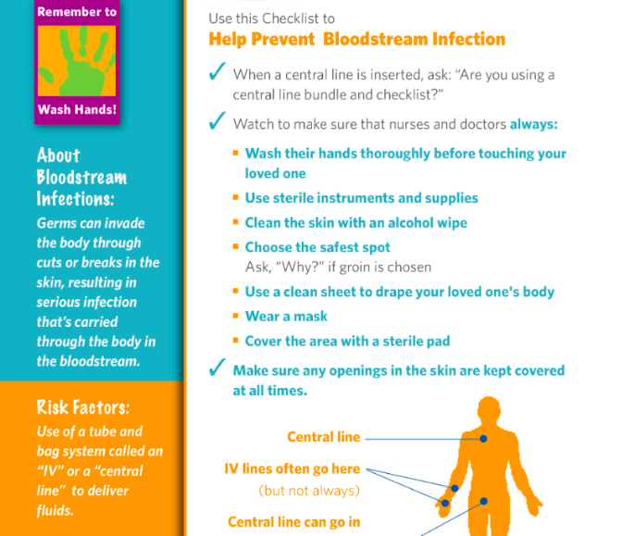
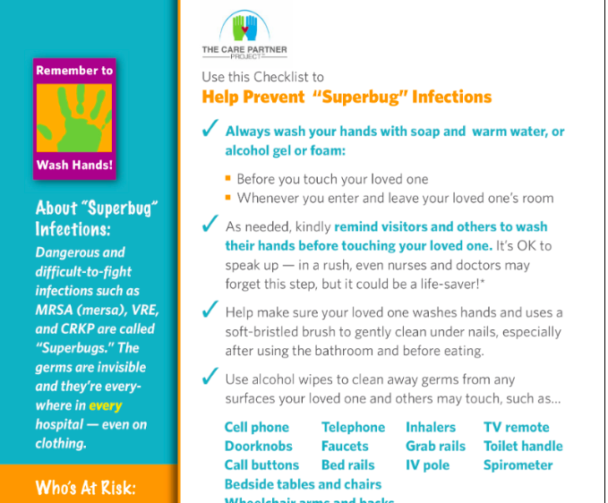
Sound the Alarm for…
These symptoms are common across Infections.
See TheCare PartnerProject.org for specifics.
Shortness of breath, shallow breath, rapid breathing
New onset of mental confusion/disorientation/inability to focus
Lethargy, inability to stay awake or alert
Fever (note: some people don’t run fevers with infection)
Shivering
“Off color” in skin, person “just doesn’t look right”
Pain not controlled by OTC relievers, e.g., Tylenol, Motrin
Patient says:
“Something is really wrong with me.”
“I don’t feel like myself.”
Notes:
PRESENTER: GO OVER THESE KEY FACTS, SUMMARIZE IN YOUR OWN WORDS.

Slide 27

Download your free checklists at www.TheCarePartnerProject.org
Notes:
These are some examples of the checklists you will see and can download at The Care Partner Project.

Slide 28

Questions? Ideas? Let’s talk!
Notes:
PRESENTER: OPEN UP Q & A. SEE THE NEXT SLIDE FOR AN IDEA YOU MAY WANT TO USE TO START THE CONVERSATION.

Slide 29
Thank you!
If this information was helpful to you today, kindly spread the word with your groups in our area.
I speak on other topics, as well.
In person or on ZOOM
Just call or drop me a note!
YOUR NAME
COMPANY
web URL
Email address
Phone number
INSERT YOUR HEADSHOT HERE.
Notes:
PRESENTER: INSERT YOUR HEADSHOT AND CONTACT INFO.

